Slide 1
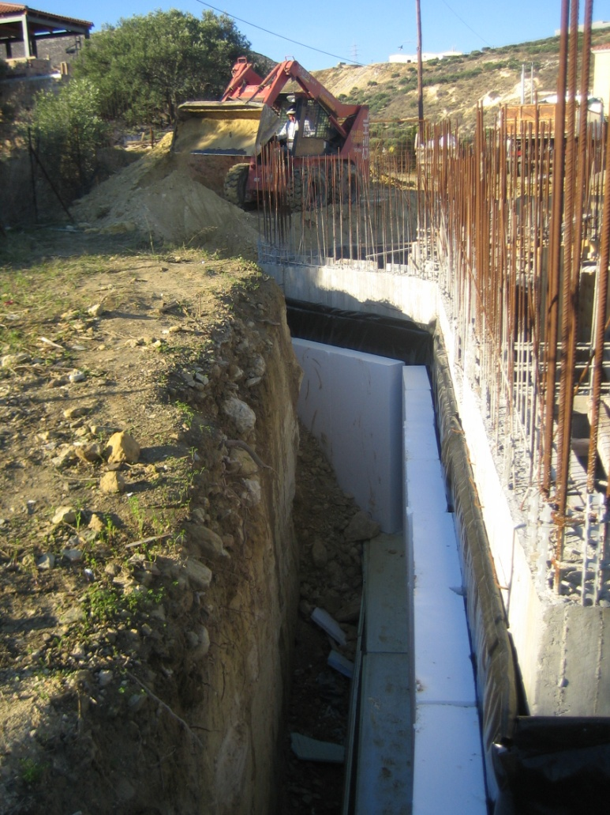
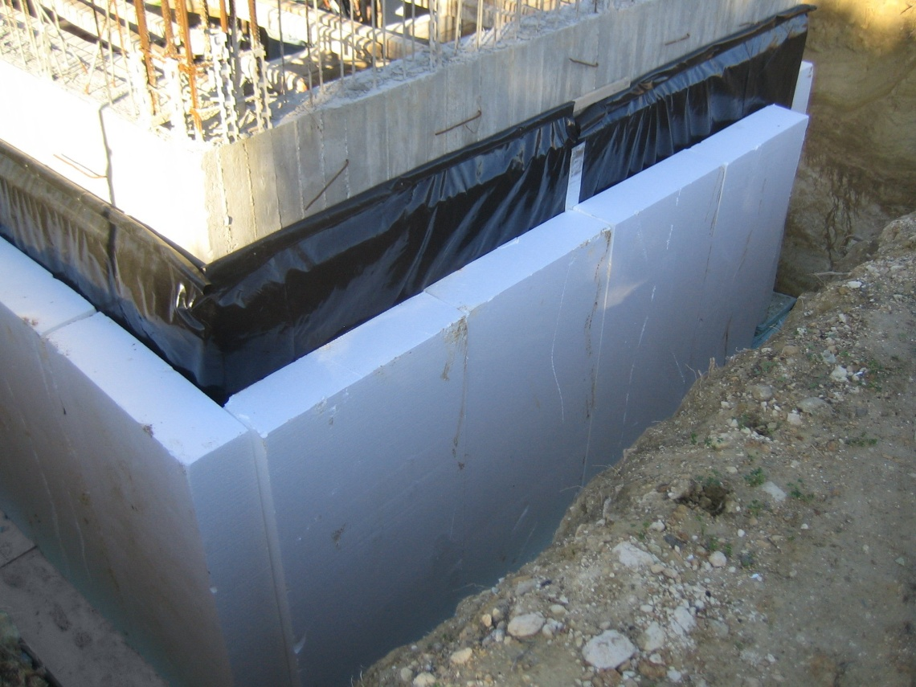
Geofoam EPS
As seismic and static earth insulation

Slide 2
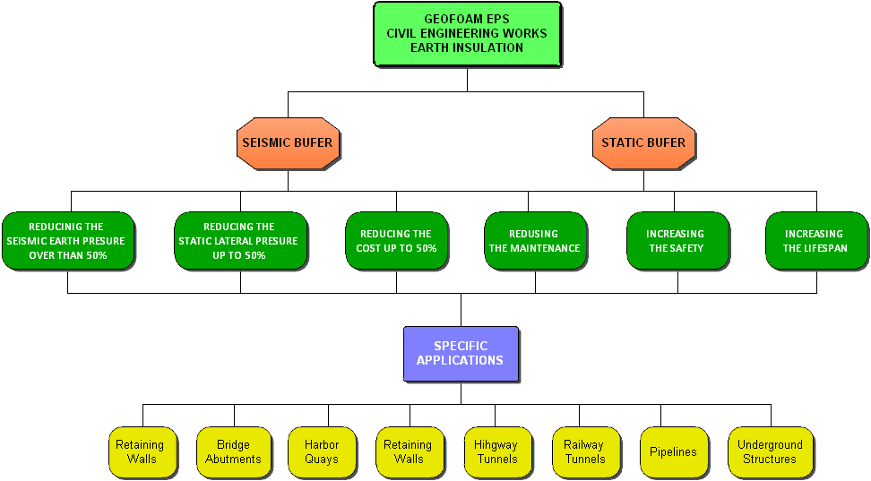

Slide 3

Earthquake shielding of constructions
Percent thickness inclusion of EPS 100, t_{r} (%),
for seismic insulation A_{r}=50%
Wall height h (m) | Seismic Zones (Greece)
 | Ι | ΙΙ | ΙΙΙ
2 | 3 | 3 | 4
4 | 5 | 6 | 8
6 | 5.5 | 7 | 10
8 | 6.5 | 9.5 | 13

Slide 4
Earthquake shielding of constructions
Application for retaining concrete wall height 4.0m
results to the following cost reduction
(instead of the usual method without EPS inclusion)
for the three seismic zones of Greece
Seismic Zone | Percent thickness inclusion , t_{r}, % | Percent cost reducing, %
Ι | 5 | 11
ΙΙ | 6 | 30
ΙΙΙ | 8 | 40

