Slide 1


State-of-interest survey for Corresponding Members
YMPG Report
21 September 2017

Slide 2
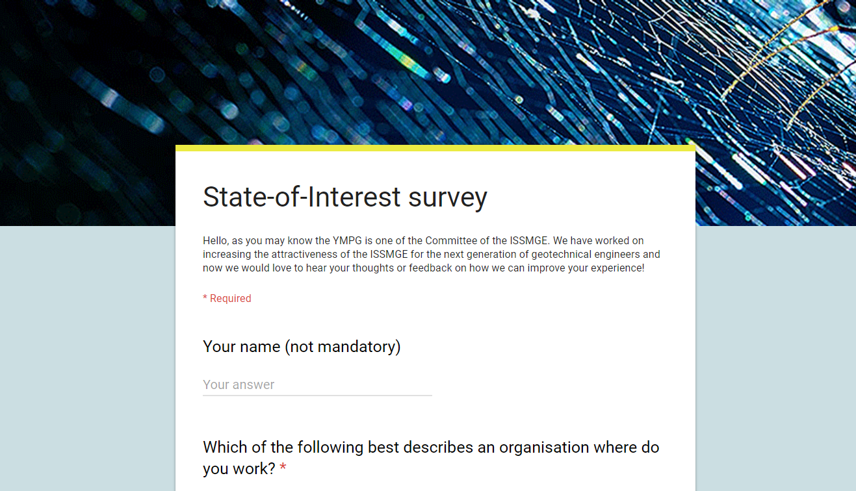
1 month
18 questions
57 participants

Slide 3
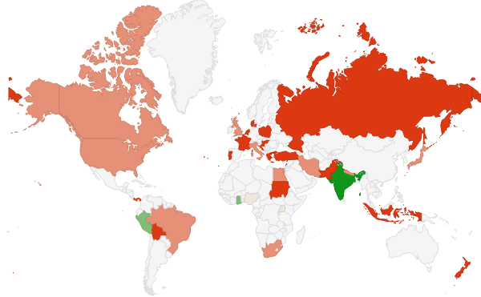
Glob coverage
57 attendees
33 countries

Slide 4
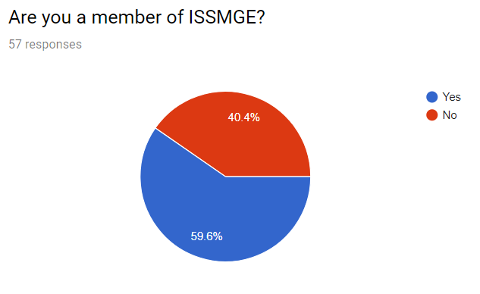
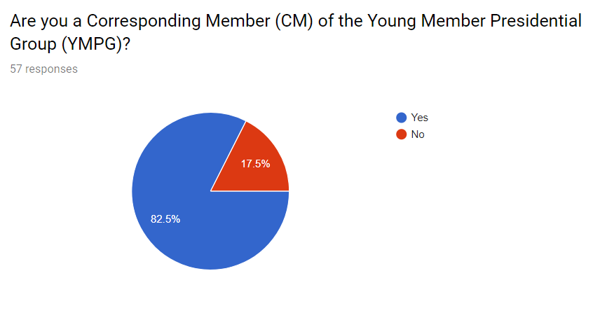

Slide 5
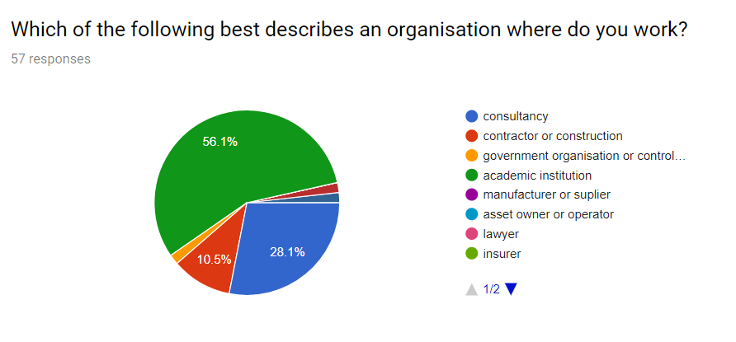
Academic institution – 56%
Consultancy – 28%
Contractor or constructor – 10%
Government organization/student – 2%

Slide 9
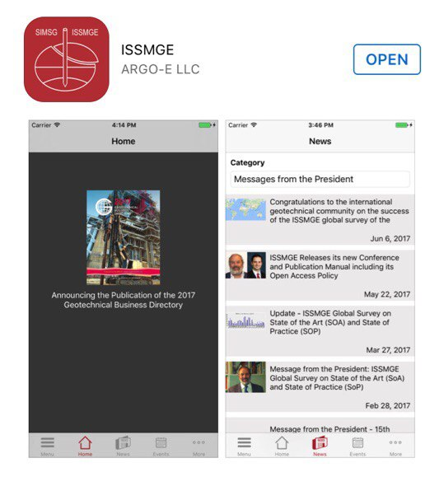
Summary and future proposals
YMPG is a bridge between YMs and senior less younger engineers
Activities of the YMPG are in demand. Keep going on!
Development of new ways of communication, information is the main request.
YMPG could be much more recognized, but this depends strongly on the respective geotechnical society.
Scientific support (i.e. mentoring, online classes) ?

