Slide 1


Collaboration in Geotechnical Engineering
Impact on Research and Project Delivery

Slide 2
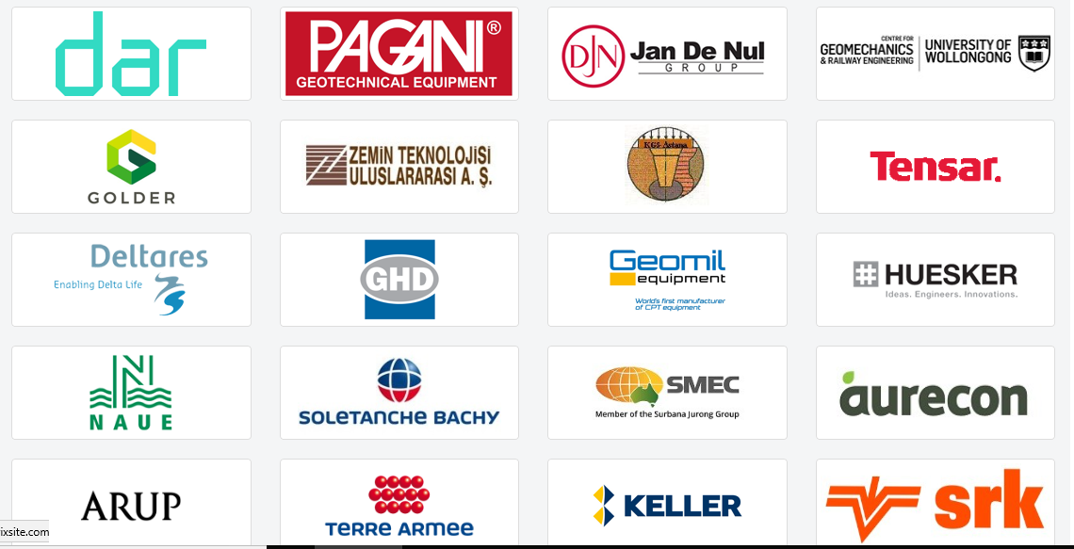
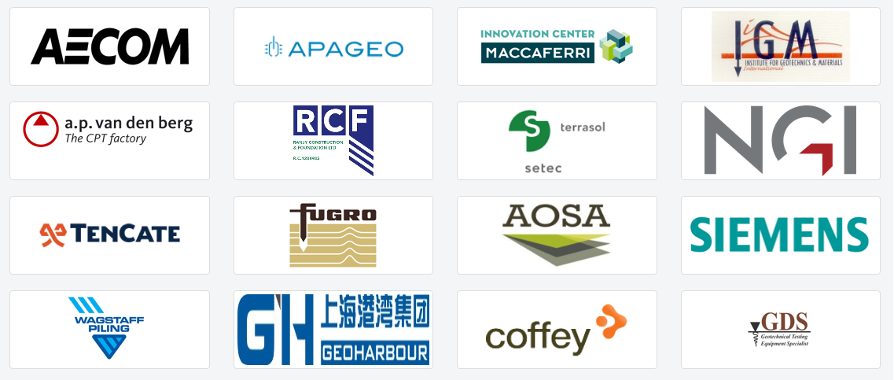
Corporate Associates Presidential Group (CAPG)
36 Corporate Associates
Aim to grow to 50+
https://www.issmge.org/corporate-associates/corporate-associates-presidential-group

Slide 3
Panellists
Ross Roberts – Auckland Council
Susan Tilsley – Beca Geotechnical
Liam Wotherspoon – The University of Auckland
Nick Wharmby – March Construction
https://www.polleverywhere.com/discourses/jv1z5aw3scMDj0YVTPykC

