Slide 1
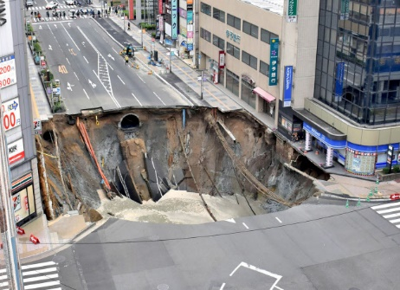
https://www.nikkei.com/content/pic/20161115/96958A9E93819891E3E79AE2868DE3E7E3E3E0E2E3E4E2E2E2E2E2E2-DSXMZO0954116015112016MM0001-PB1-9.jpg

Slide 2
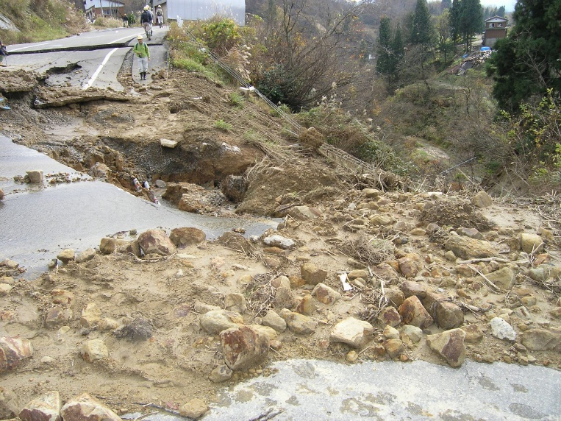
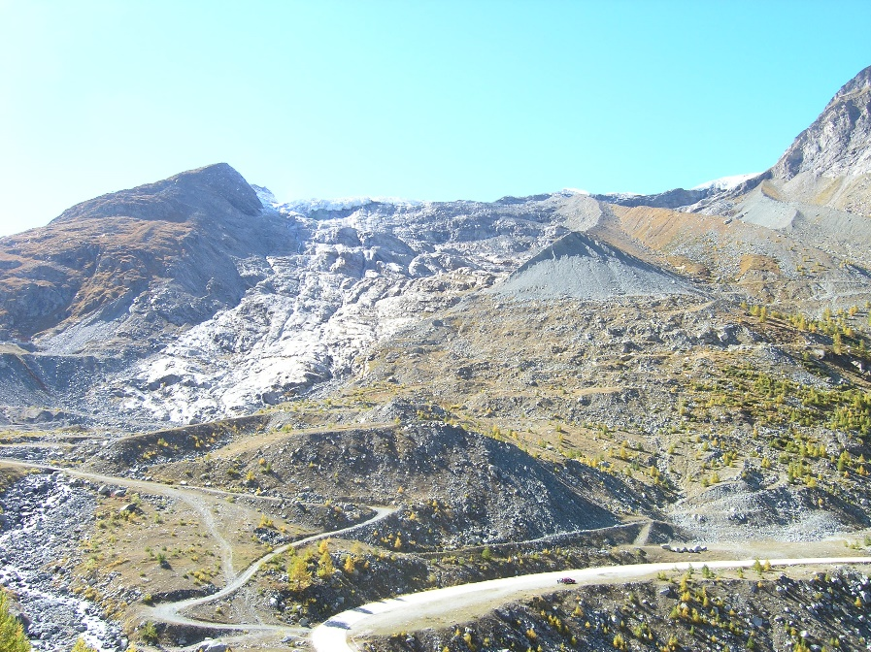
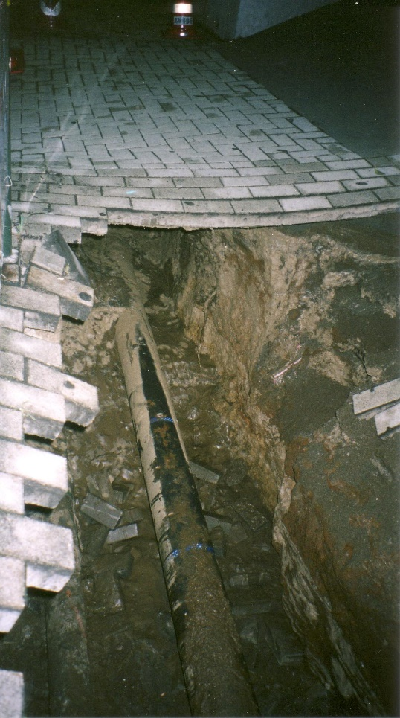
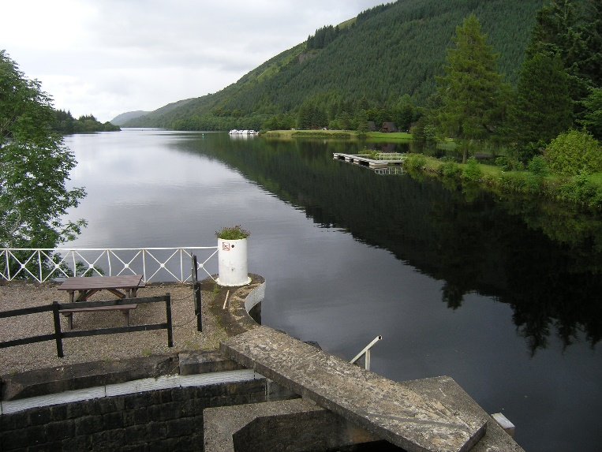
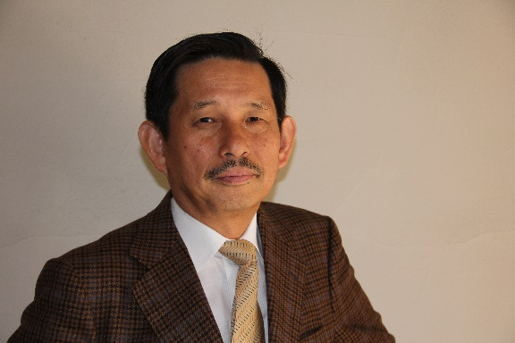
Discussion on activity of
Professional Image Committee of ISSMGE
Ikuo Towhata
Chair of PIC

Slide 3
Two important themes of PIC
(1) How to improve poor recognition of the value of geotechnical engineering (GE) among people
Joke calls it “DIRTY ENGINEERING.”
People are not interested in underground invisible world.
Income is low (not high); working under clients, architects, structural consultants and contractors.
In the past, GE was happy only with satisfaction of customers and did not propose better future of human community. So, people do not care GE.
For our next generation, this situation should be changed.
(2) Better georisk management is an opportunity to demonstrate the professional value of geotechnical engineers
Projects are reluctant to allocate good budget to underground works.
Less geotechnical trouble improves GE’s appearance.
Better income of geotechnical engineers improves their image.
Hitech GE is attractive to the next generation.

Slide 4
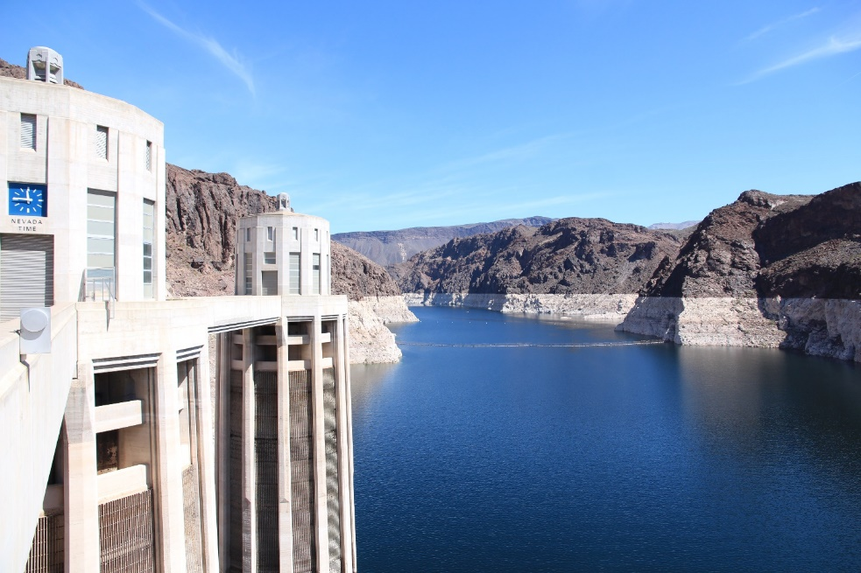
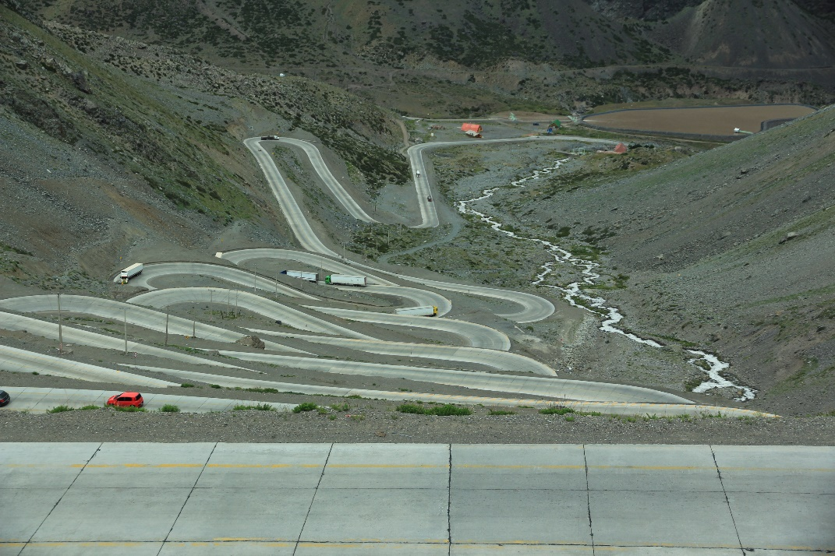
Important contribution of GE to human welfare
There is no question about past good achievements of GE:
GE have tried to appeal them to people. So far, not very successful.
Other disciplines did the same appeal more successfully; see automobile, computer, bio and many other industries.
GE did not talk about future lifestyle of human.

Slide 5
Georisk management
Georisk is a trouble during construction that is caused by unforeseen subsurface conditions.
Examples: poor soil, embedded obstacle, cavern, high-pressure ground water, contamination, etc.
Consequence: increased construction budget and/or delayed completion of project.
Good risk management detects risk in very early stage of projects. More subsoil investigation is carried out to precisely capture the risk. Modified design and construction help avoid troubles and save expenditures (collaboration study with Georisk Society).

Slide 6
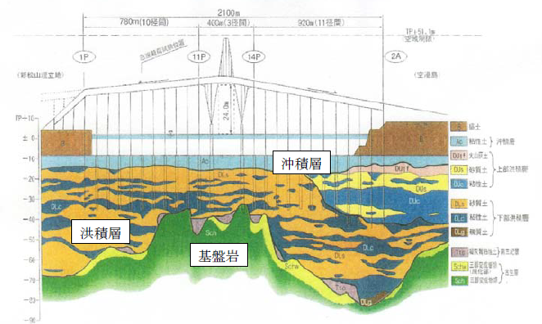
Detailed soil investigation drastically reduced the total construction cost (after Georisk Society)
Three options for pile foundation
1. Supported by bedrock (end bearing)
2. Friction pile designed by SPT-N (conventional)
3. Shorter friction pile designed by additional field investigation, soil sampling and lab tests
10m
1
2
3
Holocene soft soil
Pleistocene
50m
Baserock
Soil investigation budget increased from US 1 to 3 million $ and 100 million $ saving in construction. DO THIS MORE.
After Georisk Society, Tokyo
http://www.georisk.jp/pdf/risk02.pdf

Slide 7
Unfortunate example of georisk
Metro tunnel under construction collapsed.
Local ground condition was heterogeneous.
Weak portion was not taken into consideration.
Lesson: more efforts needed for subsurface investigation.
Furthermore, decades ago, one of the previous projects at this site encountered the heterogeneity problem. Unfortunately, this important knowledge was lost.
Knowledge transfer is an important georisk management.
Reference shown in the first slide

Slide 8
How much subsurface investigation should we do?
On average, 0.5% of the construction budget is allocated to subsurface investigation.
Cases of successful georisk management recommend 3% additional budget to be allocated to detailed investigation.
3% for sizeable projects
To receive more fund, the quality of investigation has to be high.
After investigation, better construction scheme should be proposed: direct communication with clients is essential.
Further, need for open-access borehole database and other relevant knowledge from past experiences.

Slide 9
Contribution of GE to good future of human: this has to be visible to people
Addition to past efforts
Human civilization is going to suffer from
Stronger natural disasters; heavy rain, flood, drought, famine, etc.
More water resource to promote food production and safer life
Remediation of environment that was contaminated in 20th century
Limited energy and other natural resources
Tell me your proposal.

Slide 10
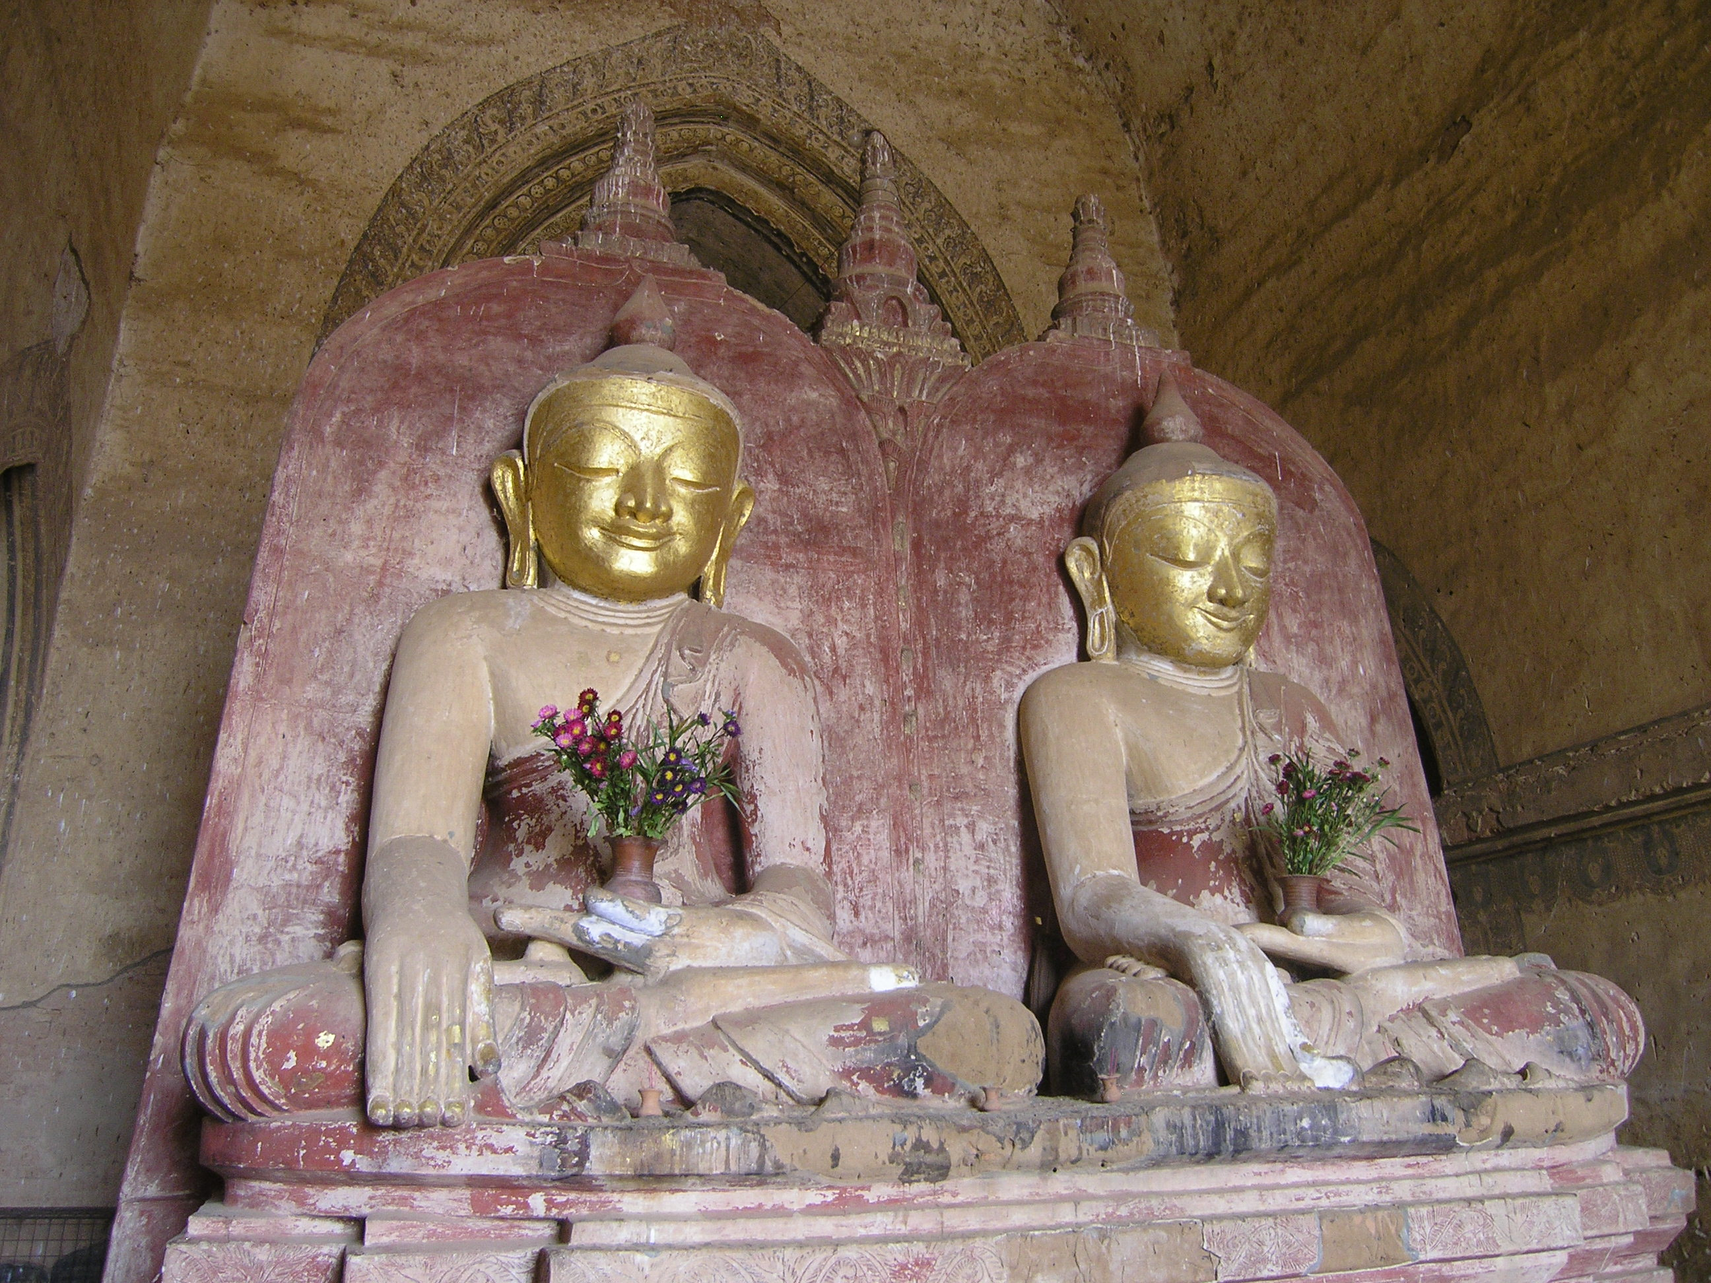
Your free discussion and active input are deeply appreciated.
This PPT is just a draft.

Slide 11
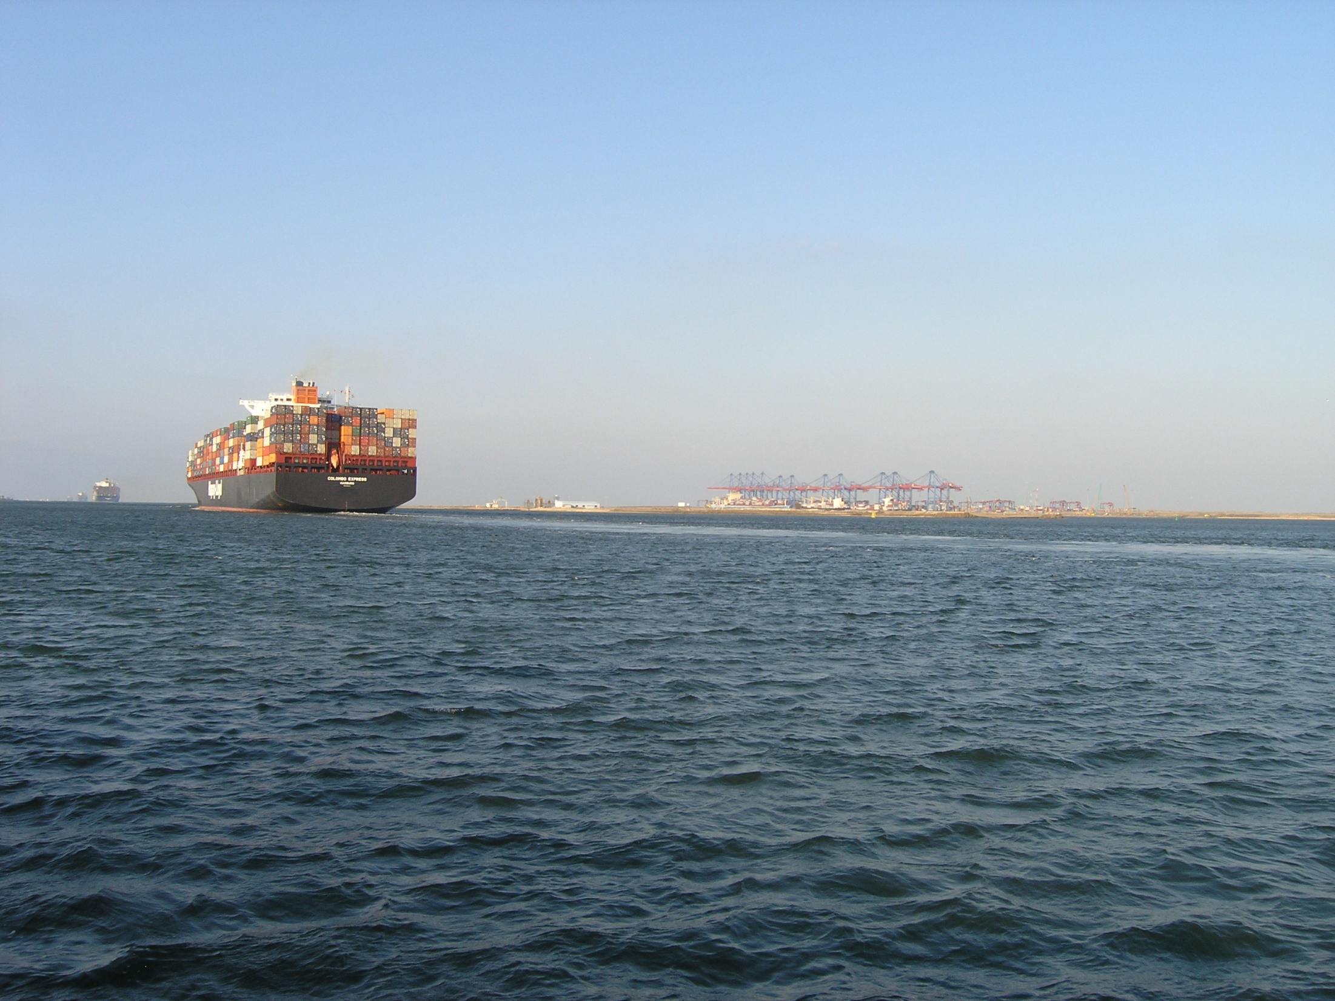
For our better future
Suez Canal
connecting two seas

