Slide 1
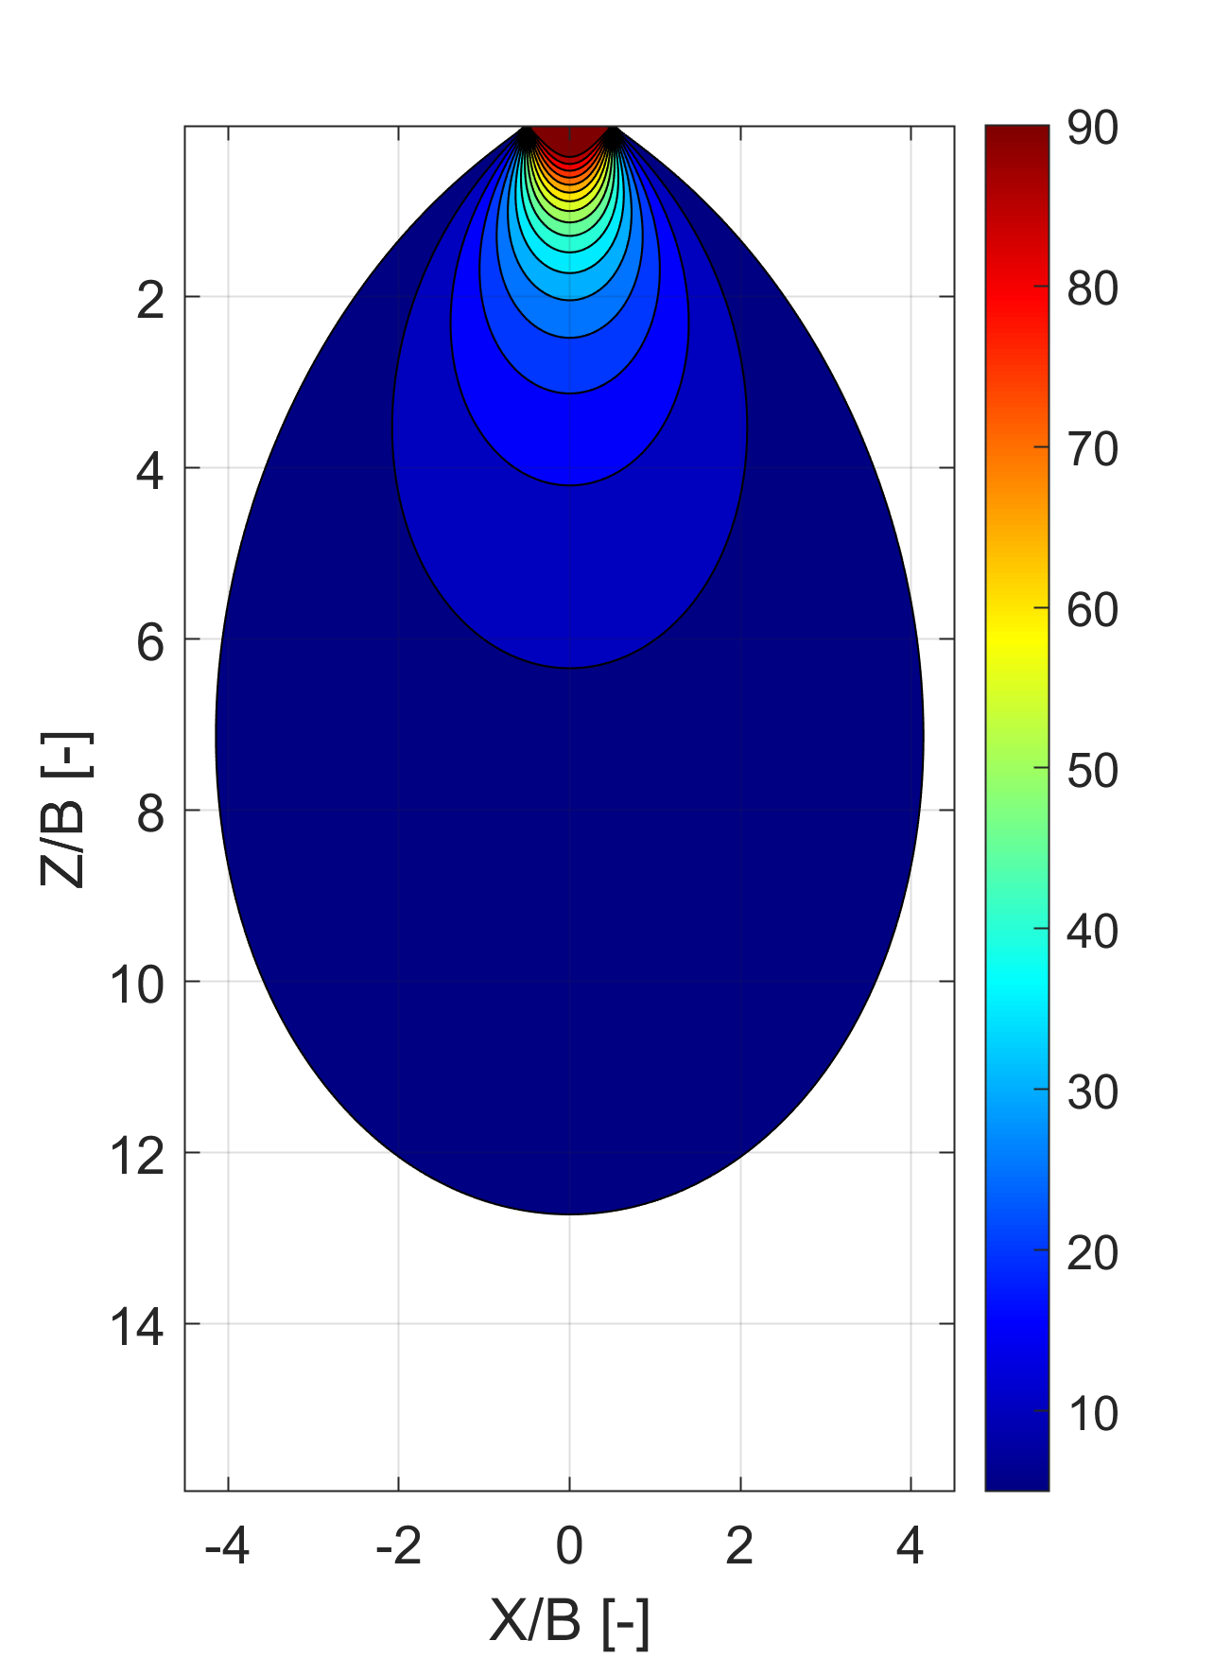
Increment of vertical stress due to a uniform, flexible strip load
Finite Element method
Analytical method
(+)
σ_{z}
Δσ_{z}/q [%]
Δσ_{z}/q [%]

Slide 2
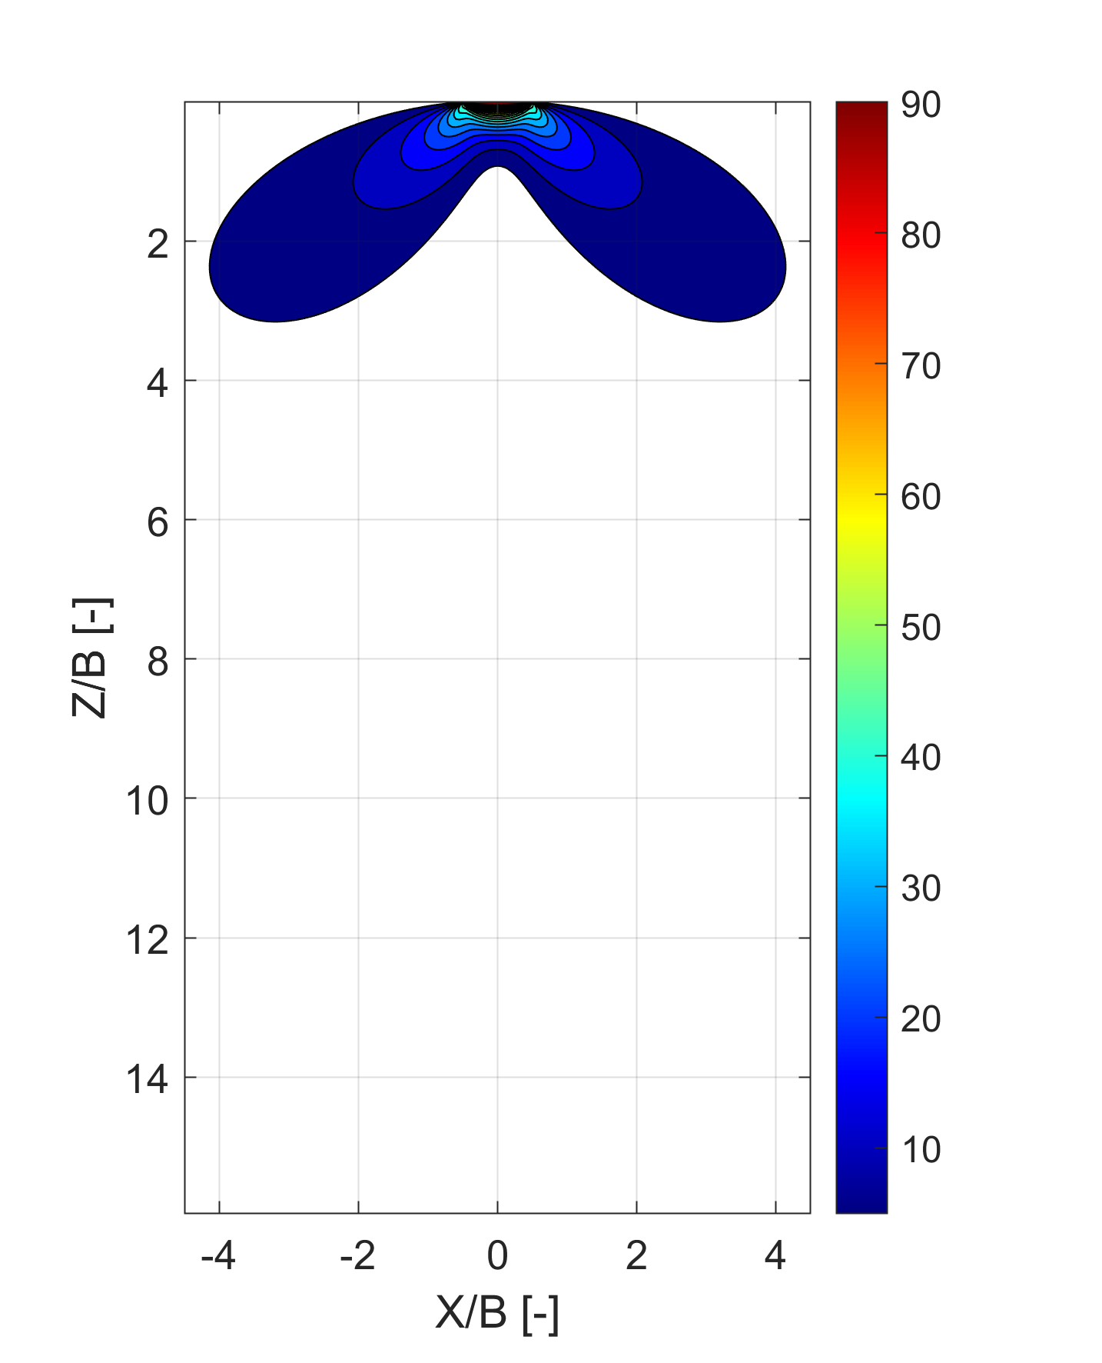
Increment of horizontal stress due to a uniform strip load
Finite Element method
Analytical method
σ_{x}
Δσ_{x}/q [%]
(+)
Δσ_{x}/q [%]

Slide 3
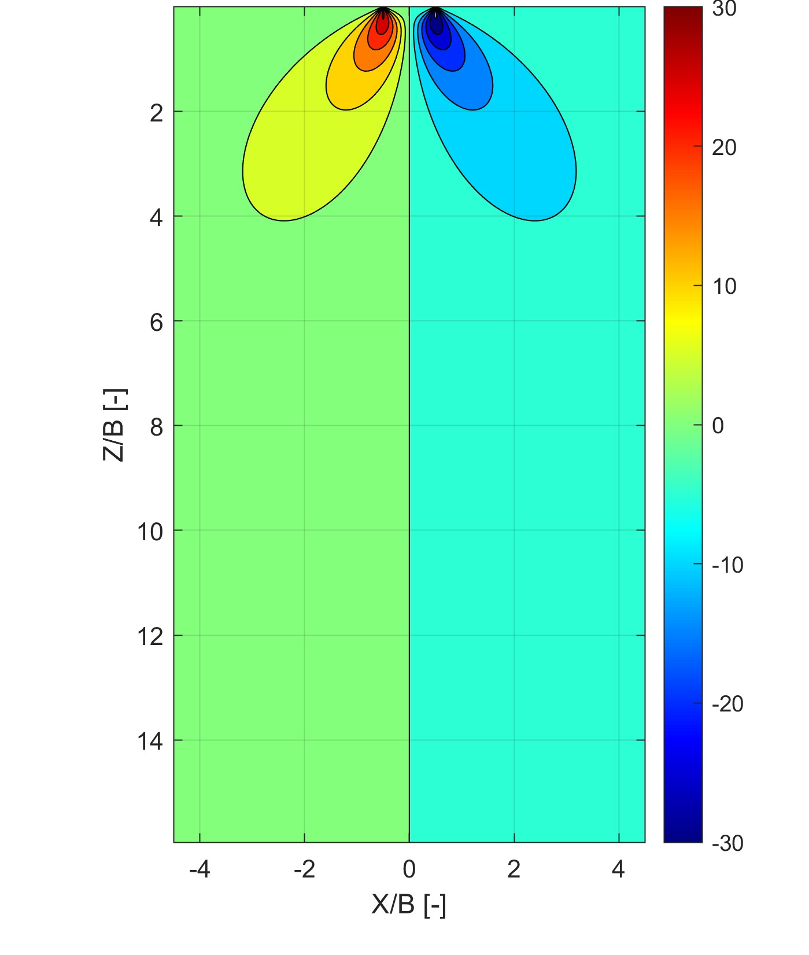
Increment of shear stress due to a uniform strip load
Finite Element method
Analytical method
τ_{xz}
Δτ_{xz}/q [%]
(+)
Δτ_{xz}/q [%]

Slide 4
Mean stress and deviatoric stress increment due to a uniform strip load

Slide 5
Increment of vertical stress due to a uniform strip load: effect of model size in FEM
Large FEM model (far boundaries)
Good agreement with analytical solution
Δσ_{z}/q [%]
Results of FEM
Results analytical solution
Small FEM model (close boundaries)
Bad agreement with analytical solution
Δσ_{z}/q [-]
Results of FEM

Slide 6
Vertical displacment due to a uniform strip load: effect of Young modulus
Material |  | Medium dense sand | Soft clay
Young Modulus [kPa] | E | 30 000 | 1000
Poisson’s ratio [-] | ν | 0.3
Foundation width [m] | B | 2
Load [kPa] | q | 100
Vertical stress increment at centerline
Vertical displacement at centerline
Vertical displacement at surface
Vertical stress increment is identical!

Slide 7

Vertical displacment due to a uniform strip load: Linear elastic (LE) vs elastic-perfectly plastic soil (EP) with Mohr-Coulomb failure criterion
Medium dense sand
Young Modulus [kPa] | E | 30 000
Poisson’s ratio [-] | ν | 0.3
Friction angle [°] | ϕ | 35
Foundation width [m] | B | 2
Load [kPa] | q | 100
Vertical displacement at surface
Surprised?
Contour of vertical displacement in FEM analysis.
LE and EP are identical!

Slide 8
Vertical displacement due to a uniform strip load on clay: application of Modified Cam Clay Model (MCC) – load on the surface
Load q=100kPa applied on the surface.
The simulation does not converge!
Material parameters
Initial void ratio [-] | e₀ | 1
Overconsolidatio Ratio [-] | OCR | 2
Poisson ratio [-] | ν | 0.3
Slope of critical state line [-] | λ | 0.32
Slope of loading reloading line [-] | κ | 0.07
Unit weigth [kN/m³] | γ | 20
Friction angle [°] | ϕ | 28

Slide 9
Vertical displacement due to a uniform strip load on clay: application of Modified Cam Clay Model (MCC) – load on a small excavation
Calculation steps:
Generation of in-situ stresses
2. Small excavation (0.5m)
3. Load application

Slide 10
Vertical displacement due to a uniform strip load on clay: Modified Cam Clay Model (MCC) vs Linear Elstic model (LE)– load on a small excavation
Modified Cam Clay Model
Linear Elastic model (E=1000kPa, ν=0.3)

Slide 11
Vertical displacement due to a uniform strip load on clay: Modified Cam Clay Model (MCC) vs Linear Elstic model (LE)– load on a small excavation
Vertical stress increment at centerline
Vertical displacement at centerline
Vertical displacement at depth of foundation plane
Vertical displacements are totally different!
Vertical stress increments are very similar!
Vertical displacement at Z=-2m
Vertical displacement at Z=-6m

