Slide 1
Design and build
– Retaining Wall Competition

Slide 2
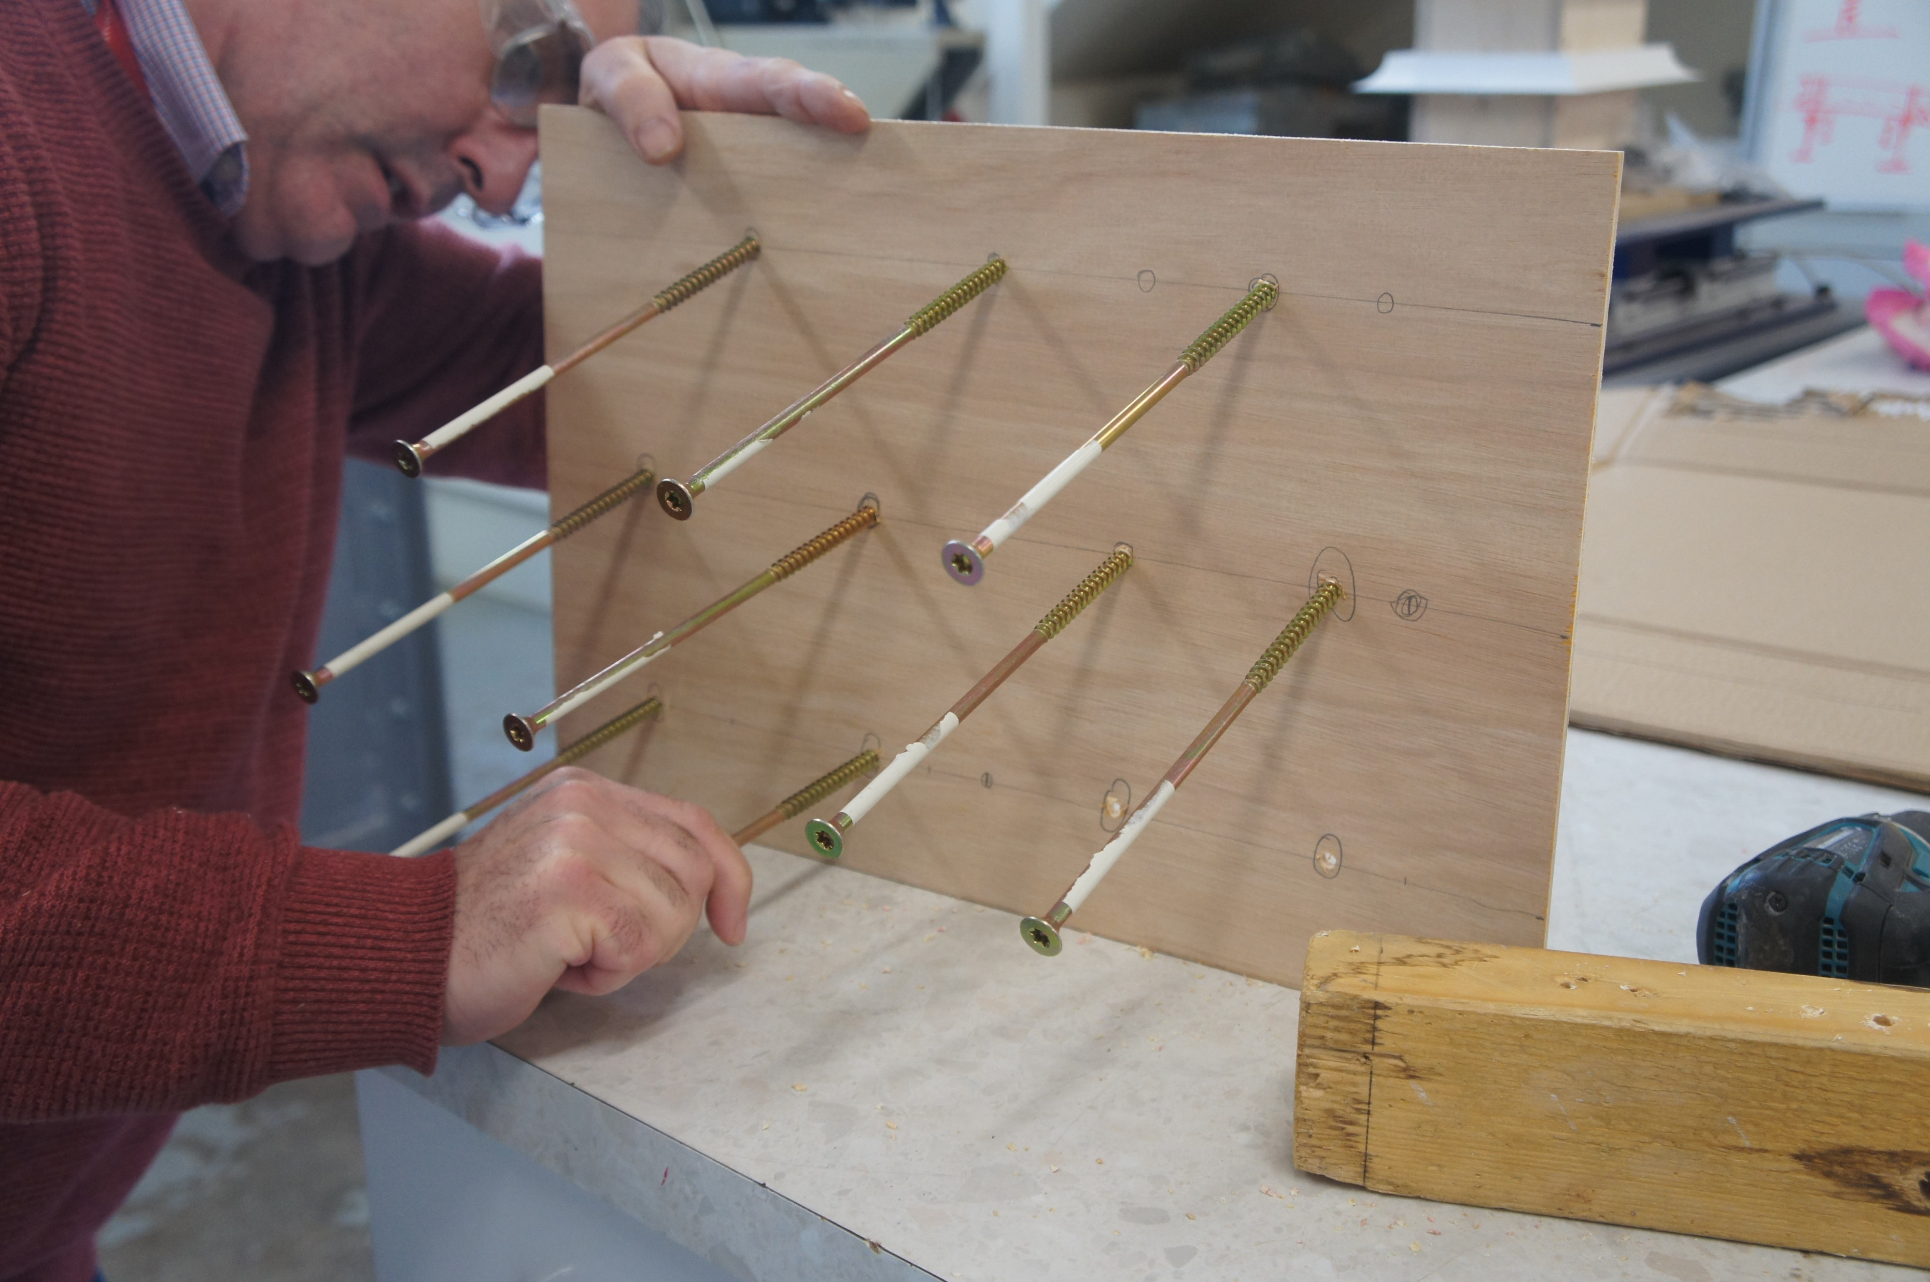
Wall No. 1
Facing panel:
Plywood, 5 mm thickness
Nails/reinforcements:
8 mm diameter, 20 cm length timber screws
(11 across three levels, less than specified because no more of these were available)
Construction stage

Slide 3
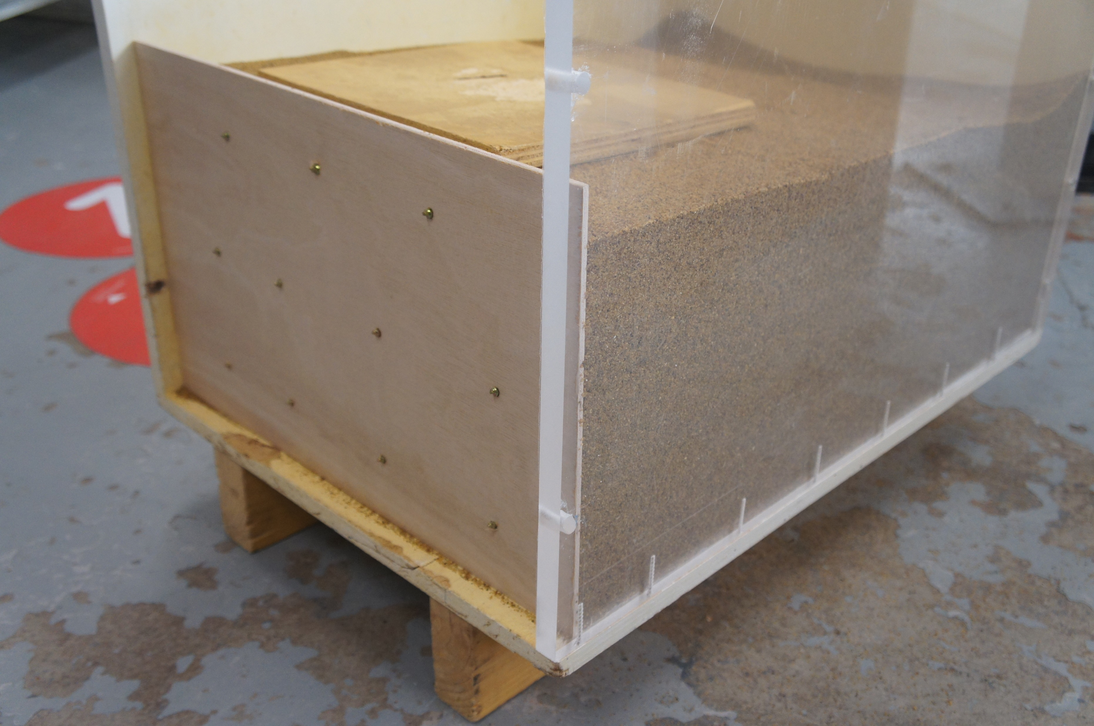
Wall No. 1
Ready for testing!

Slide 4
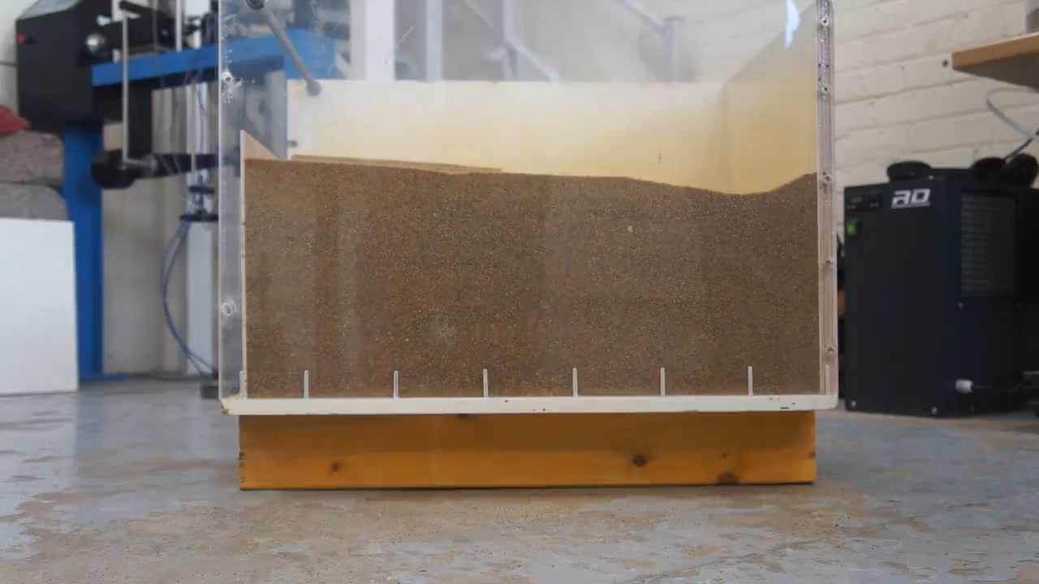
Wall No. 1 - Testing
130 kg with no
failure!
… and we tried hard (see next slide)

Slide 5
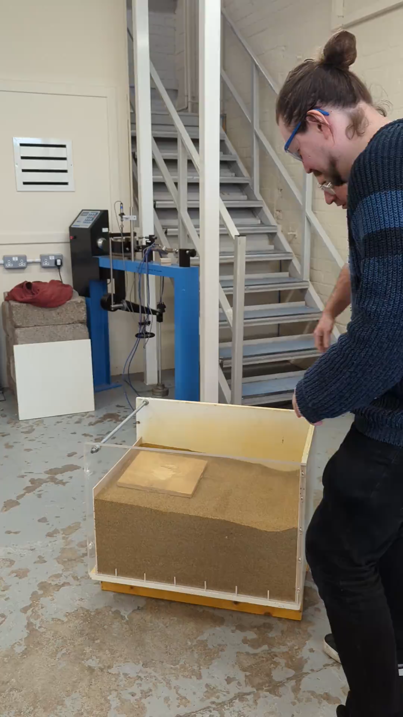
Wall No. 1
Key thoughts:
A very rigid wall (the only one that did no fail)
Strength also influenced by increased contact area of screws and screwhead.

Slide 6
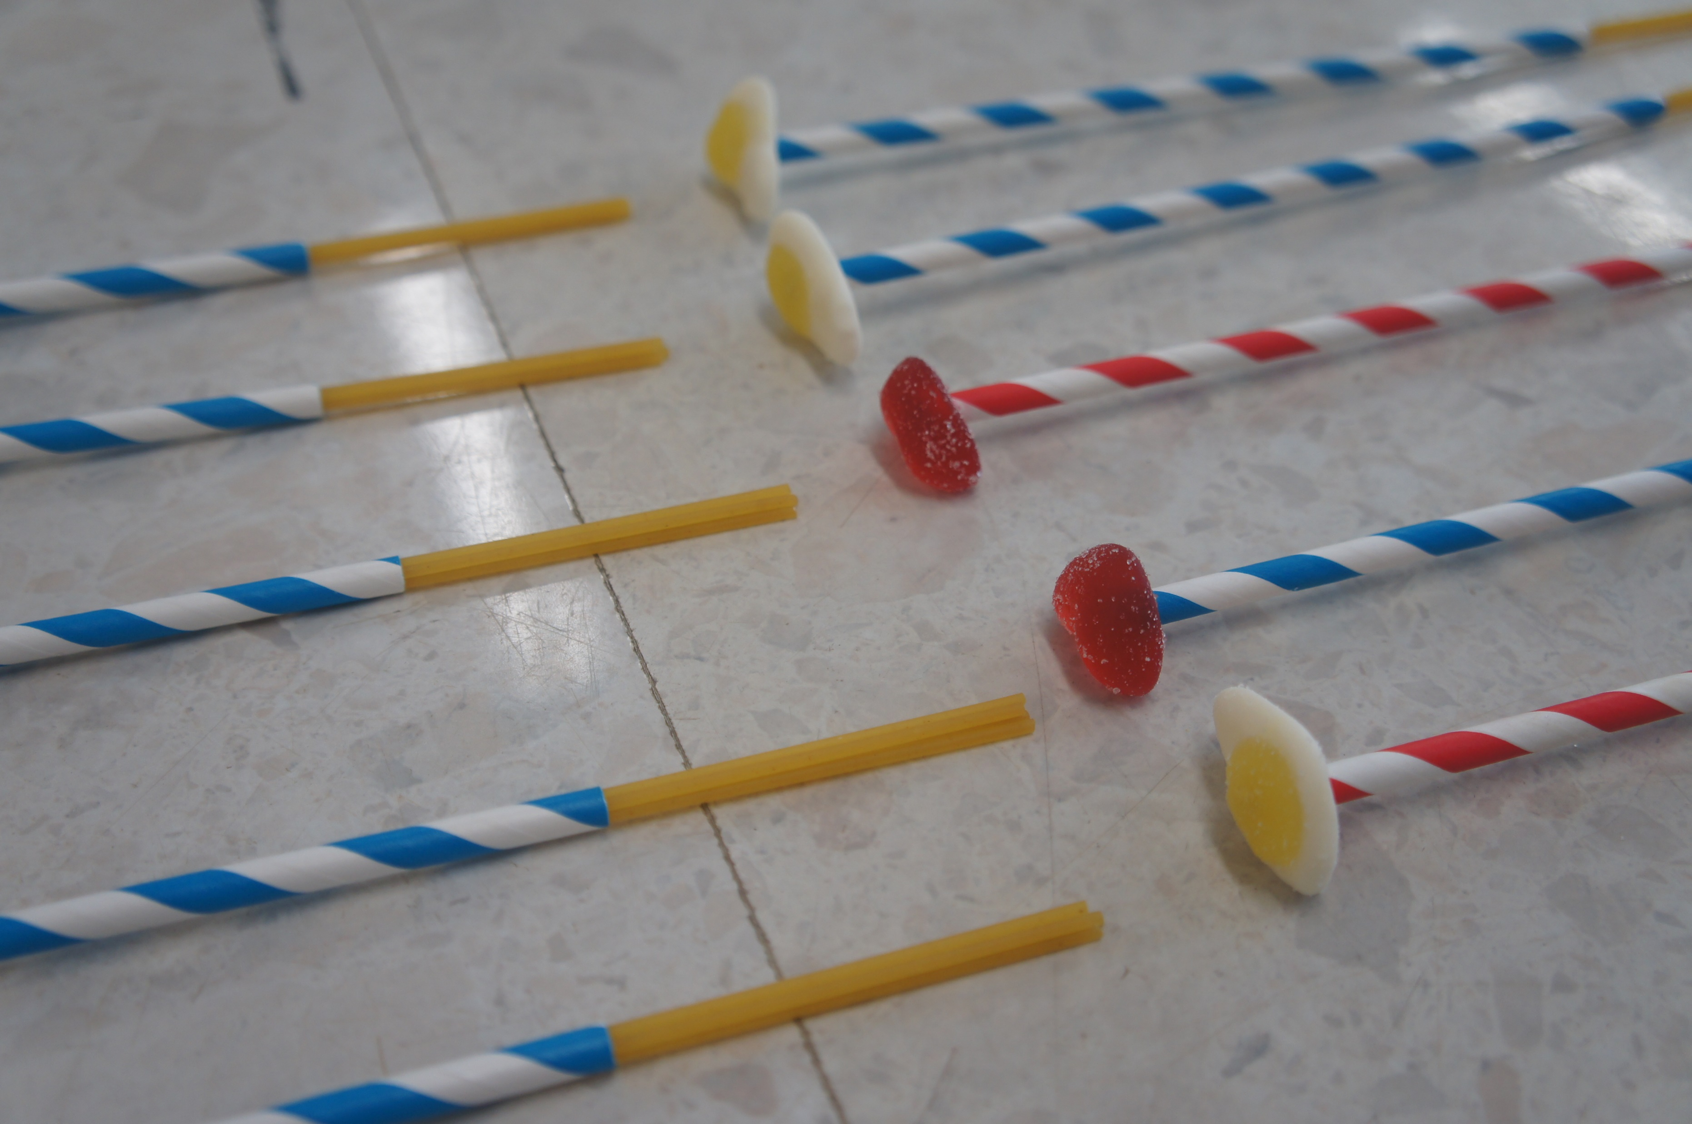
Wall No. 2
Facing panel:
Standard (box) cardboard
Nails/reinforcements:
15 paper straws filled with 4 spaghetti strands each. Attached to facing panel using Haribos. We also attached an extra Haribo at the end for extra strength (as an anchor)
Construction stage

Slide 7
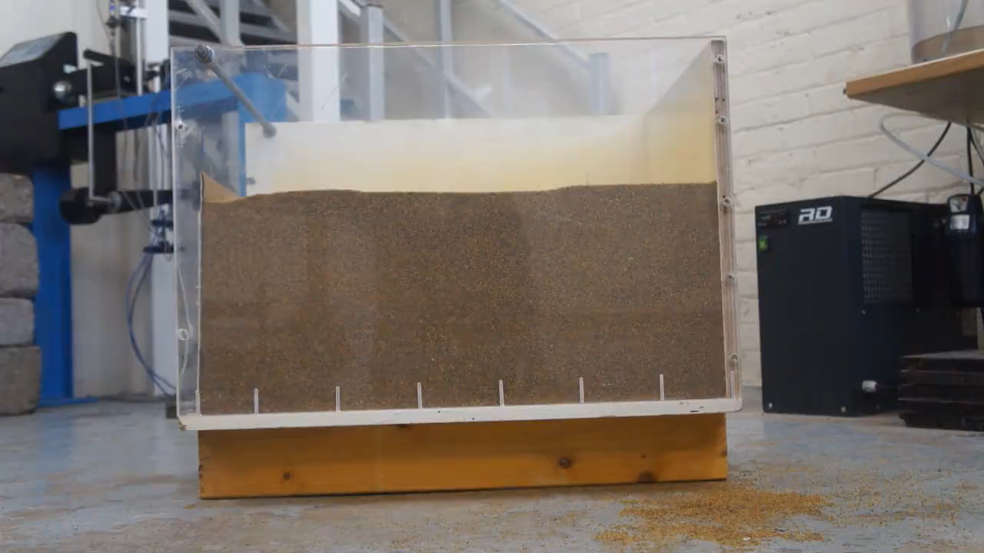
Wall No. 2 - Testing

Slide 8
Wall No. 2 – Key Observations
Failure at 120 kg
Failure was due to pull-out of reinforcement elements at points of attachment to the facing panel. Reinforcement itself did not fail. In other words a structural, rather than geotechnical failure.
Very little deformation of facing panel (even at high loads), despite its apparent flexibility.

Slide 9
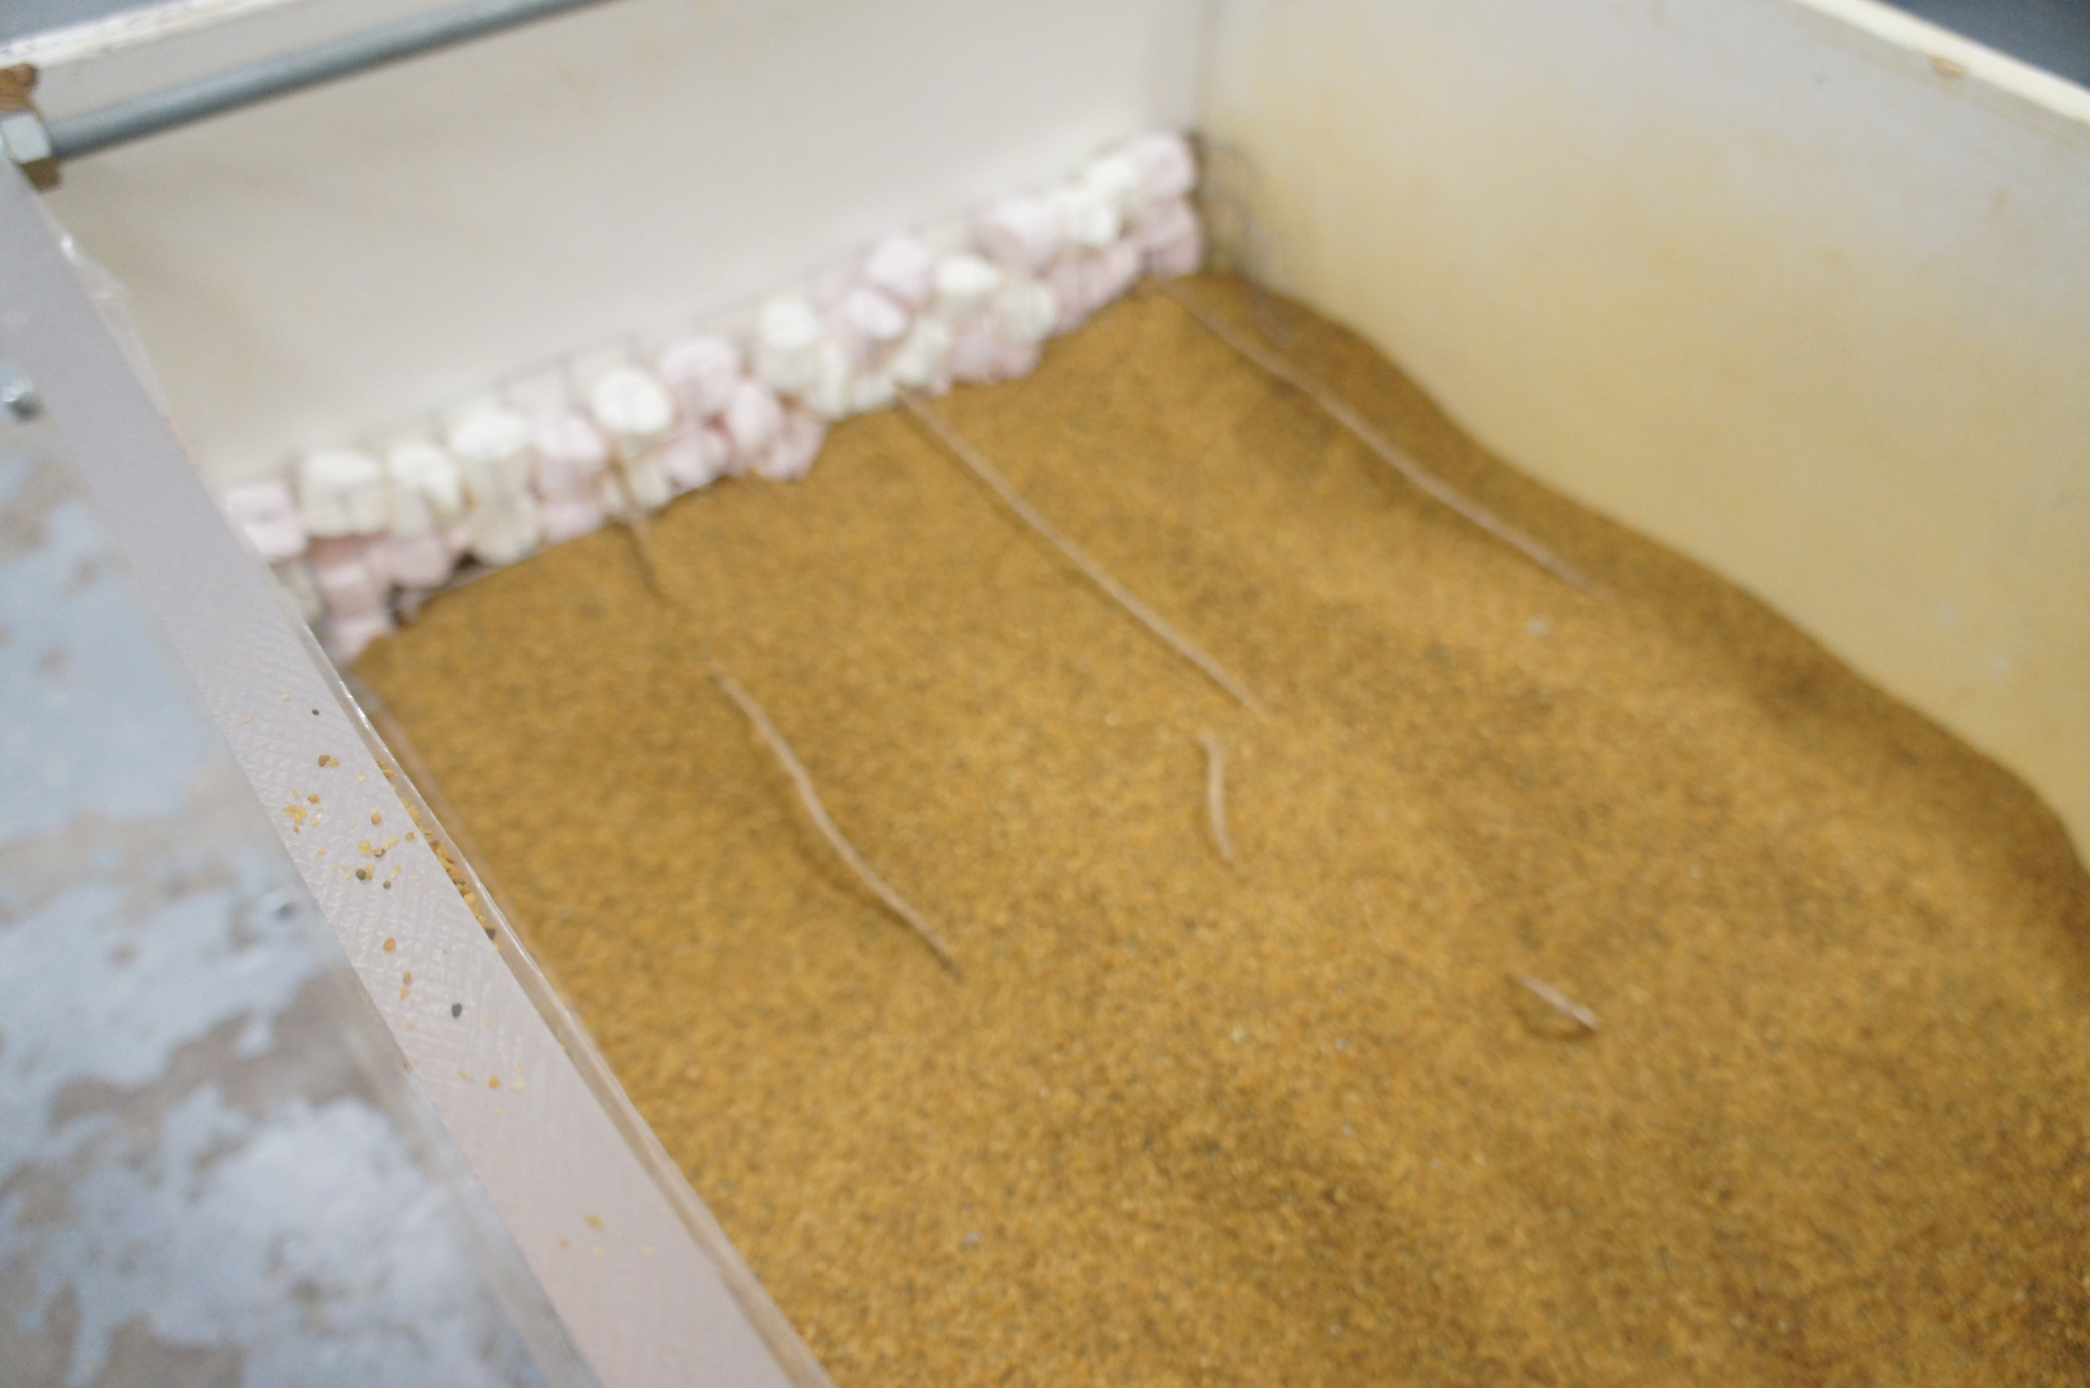
Wall No. 3
Facing panel:
Gabion wall made of square chicken wire filled with marshmallows
Nails/reinforcements:
Standard yute rope
(6mm diameter)
Construction stage

Slide 10
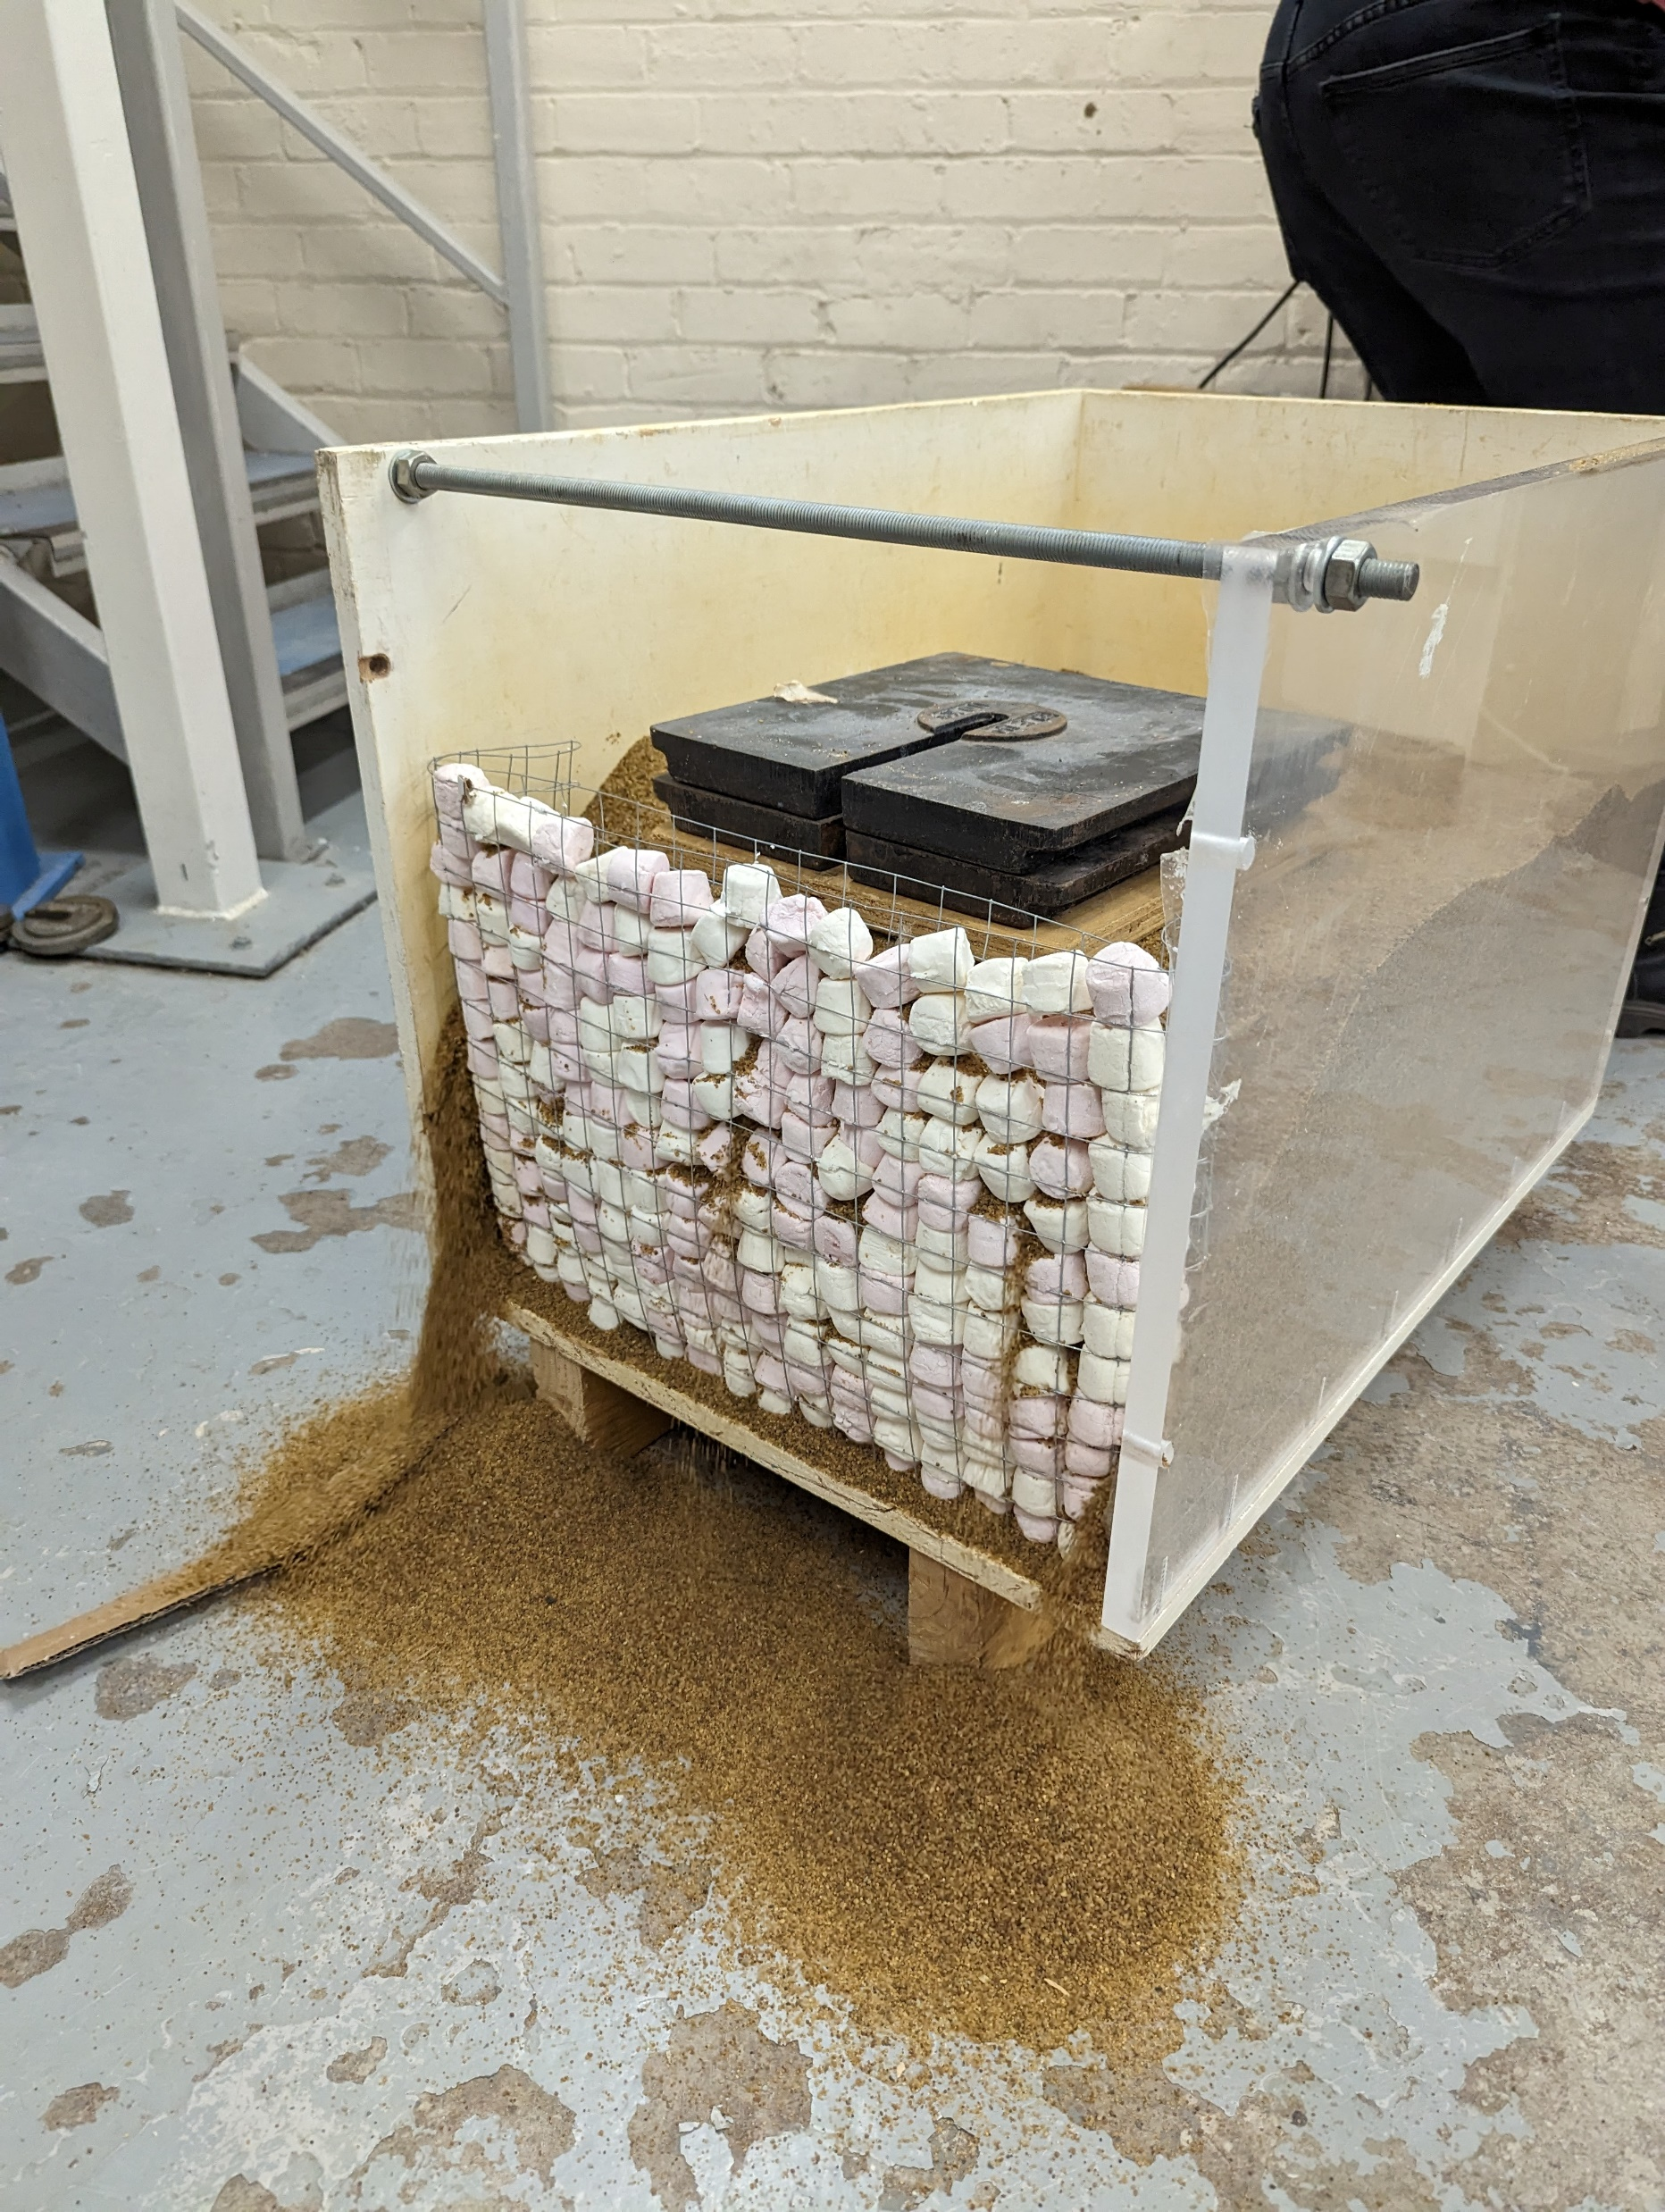
Wall No. 3 – During testing
Plenty of soil spillage at the front as a result of poor workmanship (by lecturer and technician)
Clearly a very flexible wall, but still maintained 40 kg (see next slide for test)

Slide 11
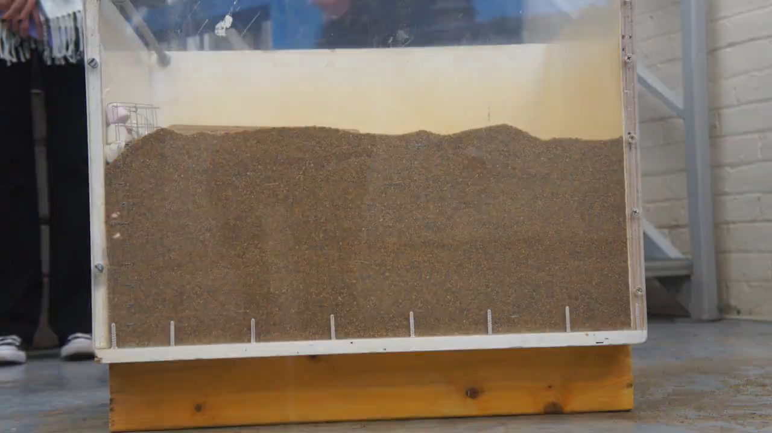
Wall No. 3 - Testing

Slide 12
Wall No. 4
Facing panel:
Gabion wall made of square chicken wire filled with marshmallows
Nails/reinforcements:
1 mm diameter wire
Note: Very similar to Wall No. 3. We used the same marshmallows and wireframe. This affected the testing. Wall failed before loading (see video)

Slide 13
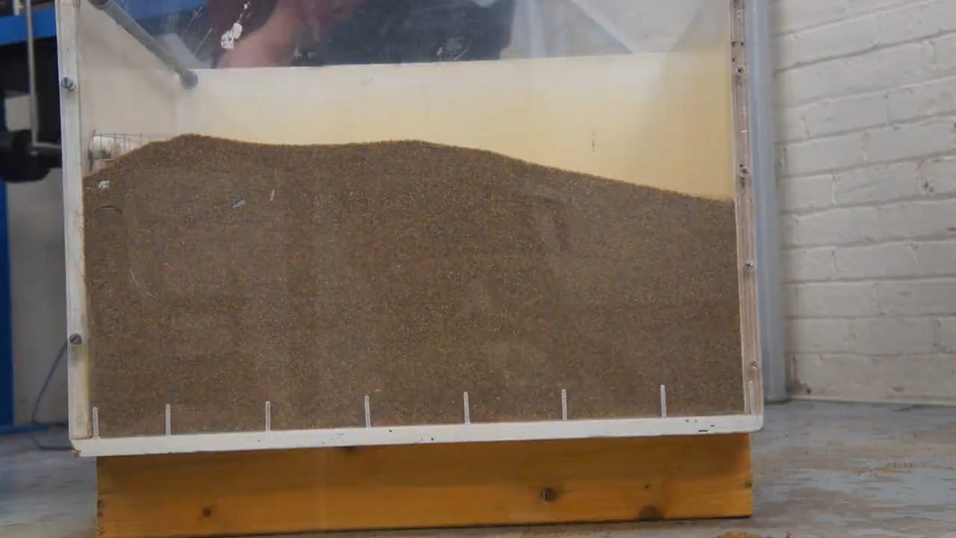
Wall No. 4 - Testing

Slide 14
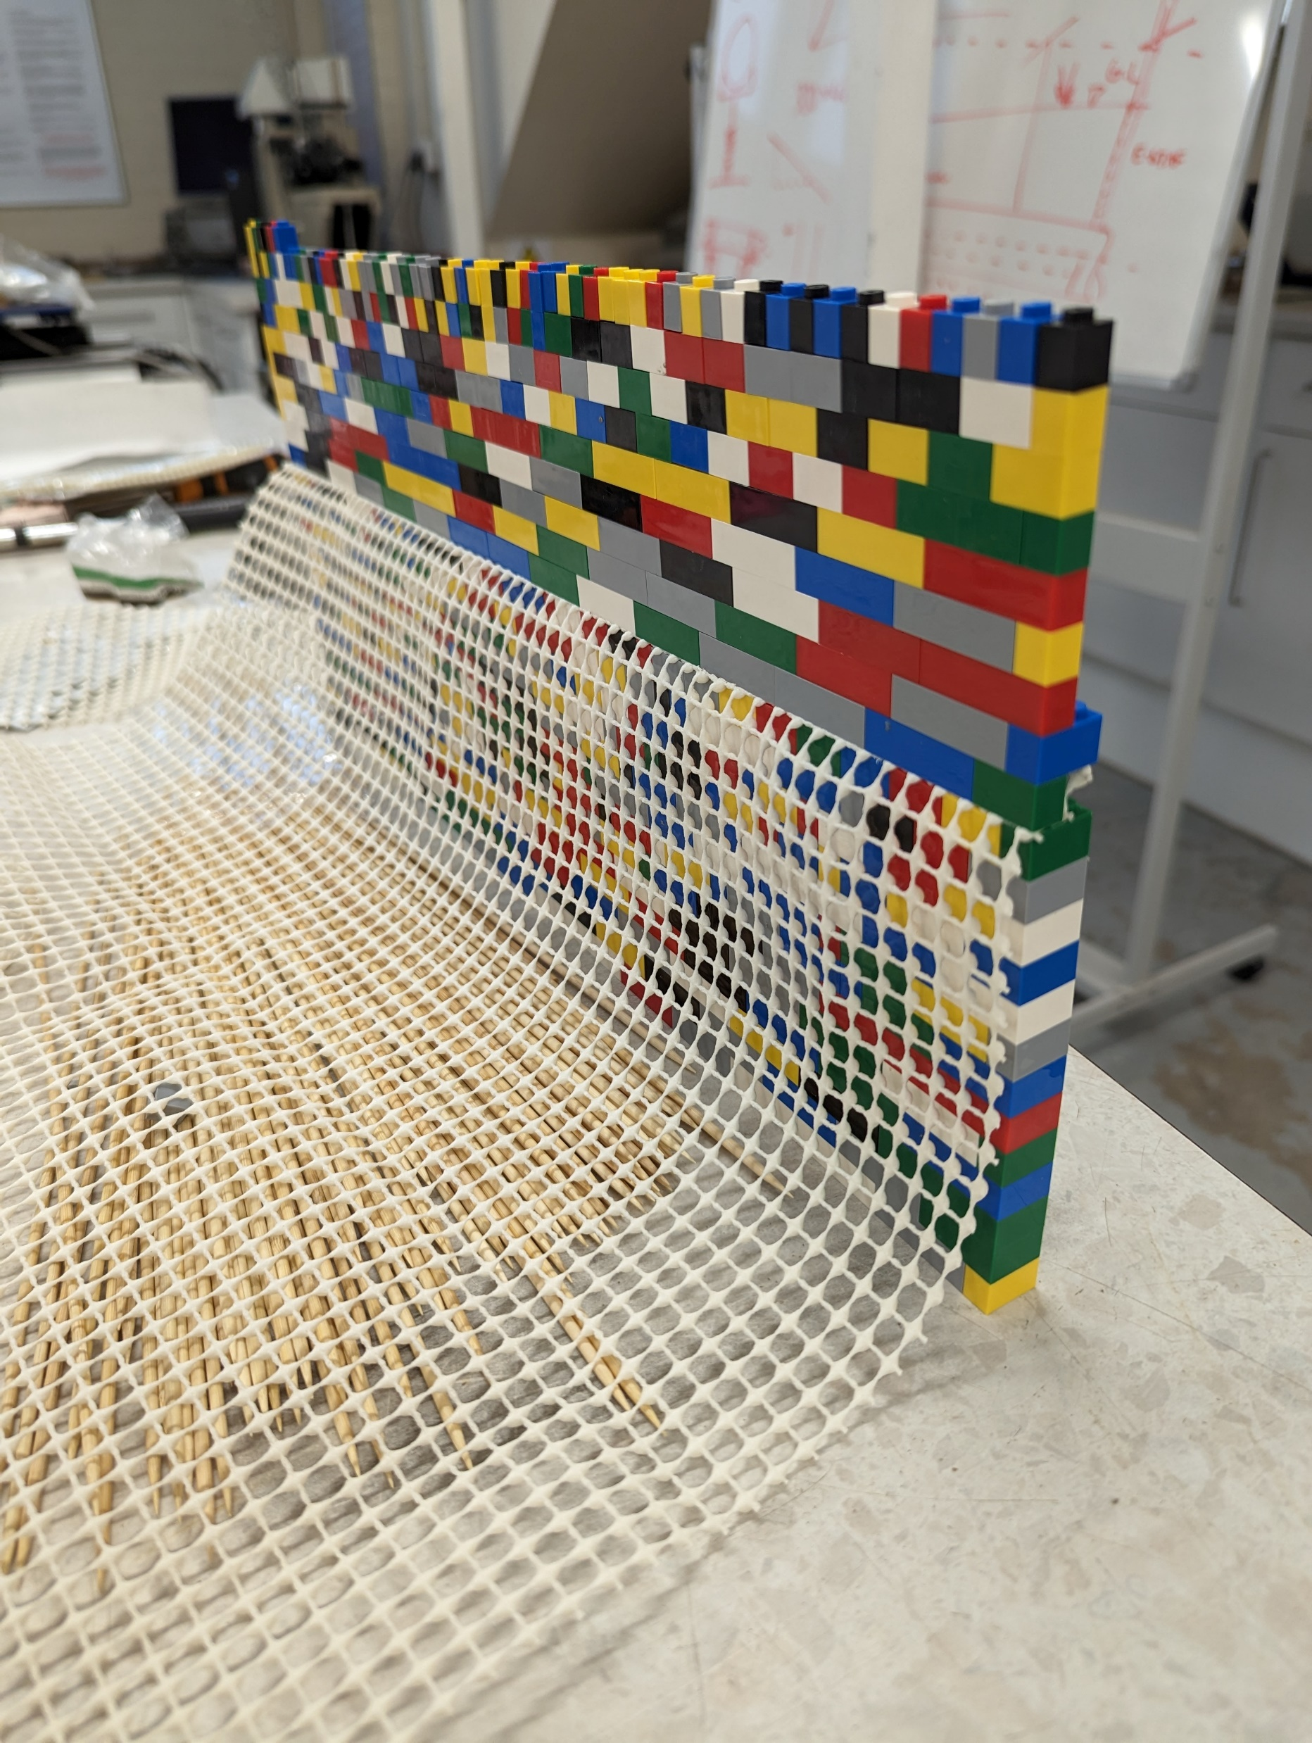
Wall No. 5
Facing panel:
Lego pieces
Nails/reinforcements:
Anti-slip rug underlay
Testing of this wall was not possible. Number of Lego pieces specified by students was much less than actually required!
Construction stage

