Slide 1
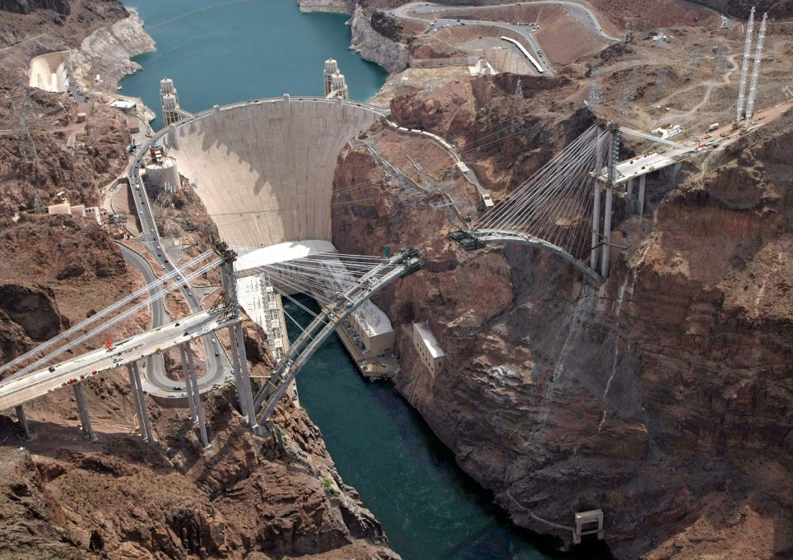

Soil Liquefaction Analysis Software
NovoLiq
www.Novotechsoftware.com

Slide 2
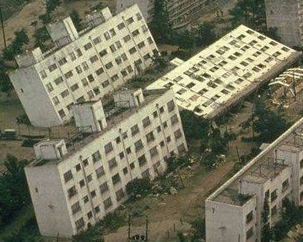
Soil liquefaction is a phenomenon in which the strength and stiffness of soil is reduced during earthquake shaking. The main reason for loss of shear strength of soil is pore pressure build up.
Susceptibility of a site to liquefaction depends on a series of parameters including but not limited to:
Soil void ratio
Soil density
Nature of the earthquake shaking
Geological history of site
Ground water level
Soil permeability
www.NovotechSoftware.com

Slide 3
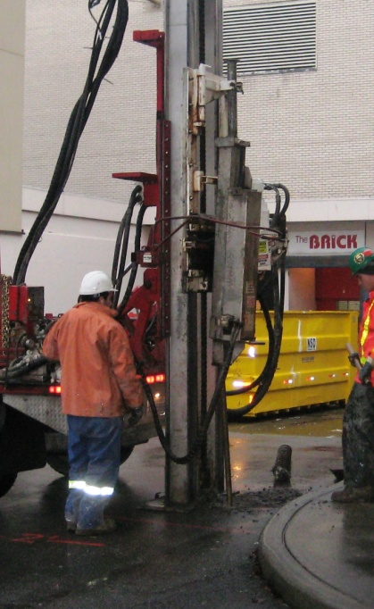
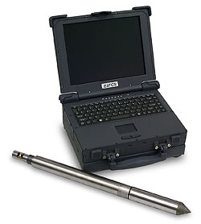
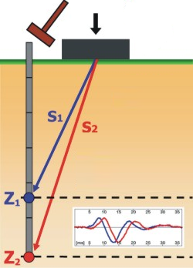
Many different methodologies have been developed during last few decades for soil liquefaction assessment. Most of them use in-situ test results in conjunction with site stratigraphy to estimate the potential of soil layers to liquefaction.
Following is the list of the most common tests:
SPT
CPT
Shear Wave Velocity
www.NovotechSoftware.com

Slide 4
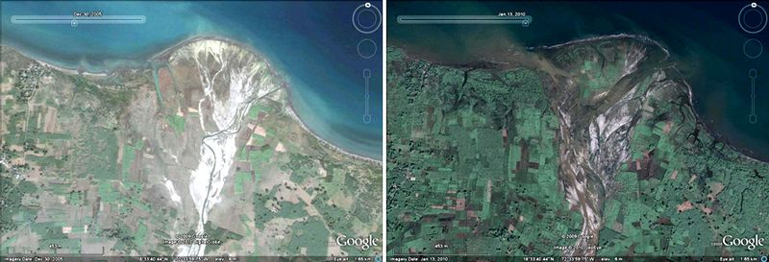
Liquefaction-induced movements and residual shear strength of the soil are very critical in liquefaction analysis. Following pictures show the disastrous lateral spreading during earthquake:
Before After
www.NovotechSoftware.com

Slide 5
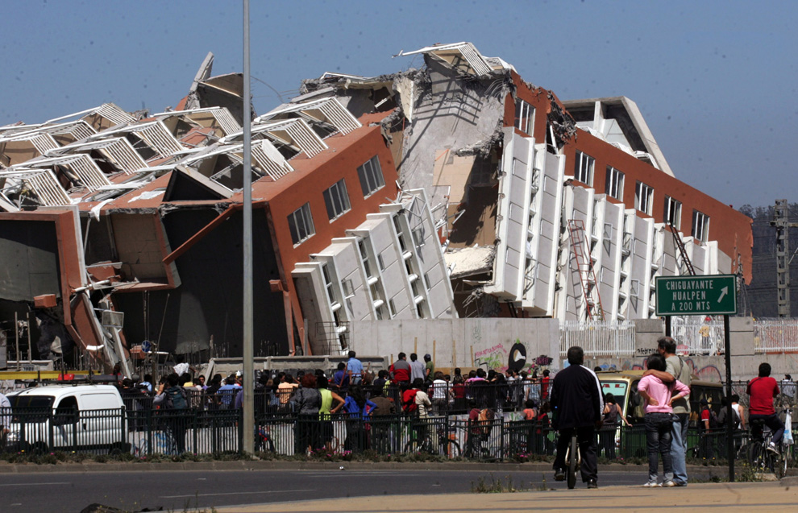
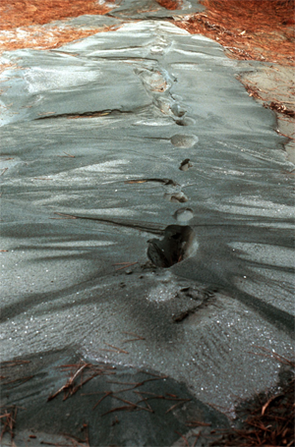
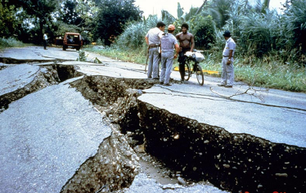
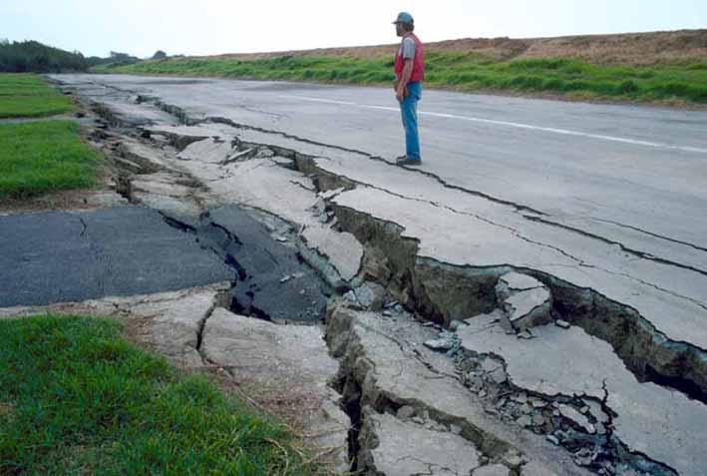
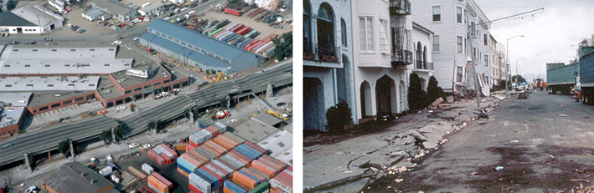

www.NovotechSoftware.com

Slide 6

What is your tools for liquefaction analysis?
Excel spreadsheets?
Design charts?
Flac?
…
How much does it cost for you?
Are the results reliable?
How long does it take?
How many methods are incorporated into your analysis?
www.NovotechSoftware.com

Slide 7

Introducing:
Liquefaction Analysis Software
NovoLiq
Developed by:
Novo Tech Software Ltd.
Vancouver, Canada
Copyright 2009-2010
www.NovotechSoftware.com

Slide 8
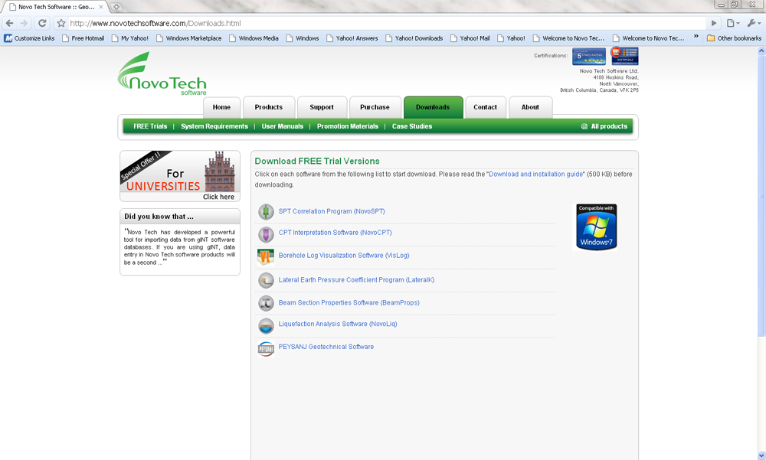
Easily download the software from our website
NovoLiq Software
www.NovotechSoftware.com

Slide 9
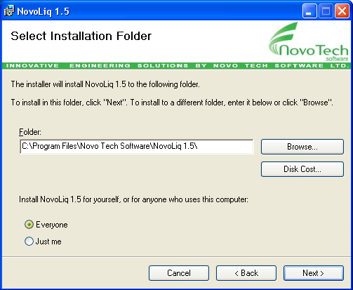
Quick and easy installation
www.NovotechSoftware.com
NovoLiq Software
www.NovotechSoftware.com

Slide 10
Features
NovoLiq Software
Excel
LogPlot
Access
Winlog
Liquefaction Assessment
Post-Liquefaction Analysis
Calculation Details & Reports
Data
communication
gINT
10 methods
SPT, Vs, BDT
Export results to Excel
Save graphs as image
Standard printable report
Lateral displacement
Settlement
www.NovotechSoftware.com

Slide 11
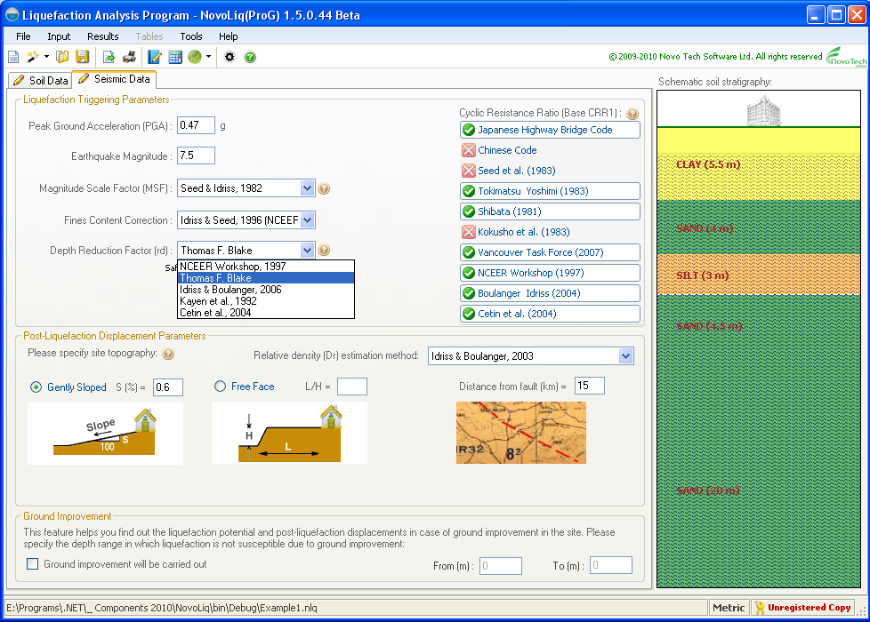
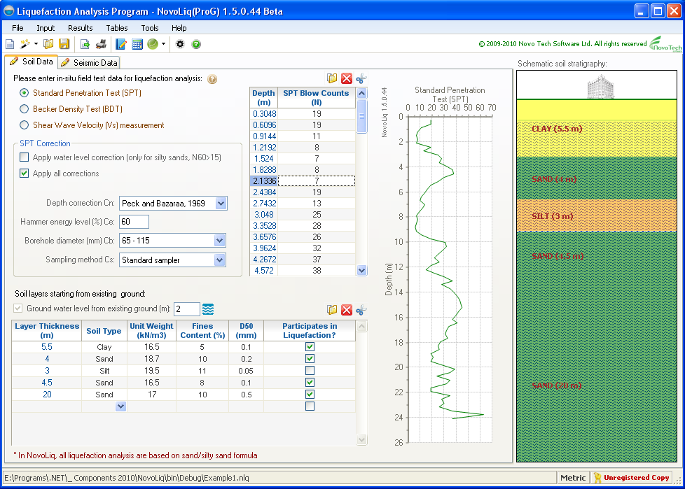
Input data for soil liquefaction analysis
www.NovotechSoftware.com
NovoLiq Software
Field test data (SPT, BDT, Vs)
Correction & normalizations
Soil stratigraphy
Seismic parameters of the site
Ground improvement data
Selection of methodologies
www.NovotechSoftware.com

Slide 12
NovoLiq, provides you with several options:
www.NovotechSoftware.com
NovoLiq Software
Field Tests
Standard Penetration Test (SPT)
Becker Penetration Test (BPT)
Shear Wave Velocity (Vs)
SPT Corrections
Depth (Overburden) Corrections
Hammer Energy Correction
Borehole Diameter Correction
Rod Length Correction
Sampling Method Correction
Water Level Correction
Overburden Correction Methods
Gibbs and Holtz, 1957
Peck and Bazaraa, 1969
Peck, Hanson and Thornburn, 1974
Seed, 1976
Tokimatsu and Yoshimi, 1983
Liao and Whitman, 1986
Skempton, 1986
Samson, 1986
Canadian Foundation Engineering Manual, 2006
Becker Conversion
Harder & Seed
Alex Sy & Campanella
www.NovotechSoftware.com

Slide 13
NovoLiq, provides you with several options:
www.NovotechSoftware.com
NovoLiq Software
Depth Reduction Factor (rd)
NCEER Workshop, 1997 recommended
Thomas F. Blake
Idriss & Boulanger, 2006
Kayen et al., 1992
Cetin et al., 2004
Liquefaction Analysis Methods (CRR)
NCEER Workshop (1997)
Vancouver Task Force (2007)
Boulanger and Idriss (2004)
Cetin et al. (2004)
Japanese Bridge Code
Chinese Code
Seed et al. (1983)
Tokimatsu-Yoshimi (1983)
Shibata (1981)
Kokusho et al. (1983)
Magnitude Scaling Factor
Seed & Idriss, 1982
Idriss
Ambraseys, 1988
Andrus & Stokoe
Arango, 1996
Youd & Noble, 1996Ohba and Toriumi, 1970
Tokimatsu and Seed, 1987
Silt Content Correction
Idriss & Seed, 1997 (NCEER Workshop)
Robertson & Wride, 1997 (NCEER Workshop)
Idriss & Boulanger, 2004
Cetin et al., 2004
www.NovotechSoftware.com

Slide 14
NovoLiq, provides you with several options:
www.NovotechSoftware.com
NovoLiq Software
Liq. Lateral Displacement
Zhang, Robertson & Brachman, 2004
Youd et. al., 2002
Barlett and Youd, 1992
Hamada et. al., 1986
Youd and Perkins, 1987
Probability of Liquefaction
Youd and Noble, 2001
Cetin et al., 2004
Liq. Settlement
Ishihara & Yoshimi, 1992
Residual Strength
Idriss & Boulanger, 2009
Please see more options in our website …
www.NovotechSoftware.com

Slide 15
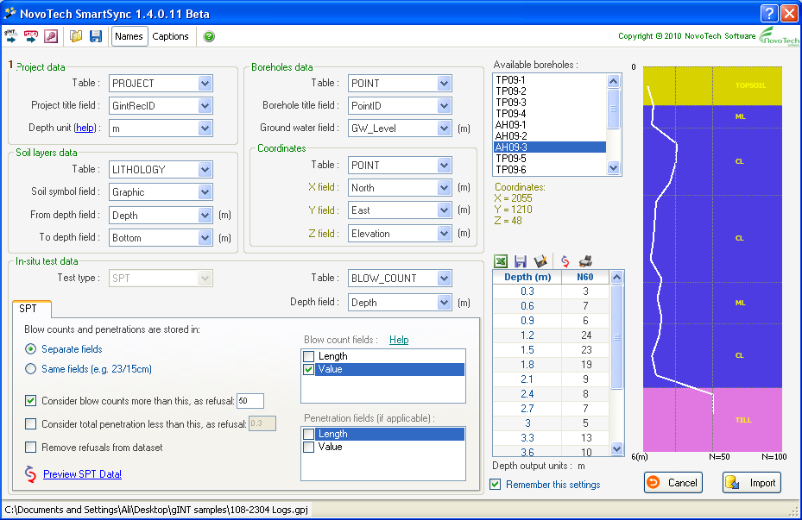
www.NovotechSoftware.com
NovoLiq Software
Import your borehole log/ SPT data from gINT files
Database structure
Schematic soil layers and SPT plot
All type of SPT data storage are supported
SPT blow counts for selected borehole
www.NovotechSoftware.com

Slide 16
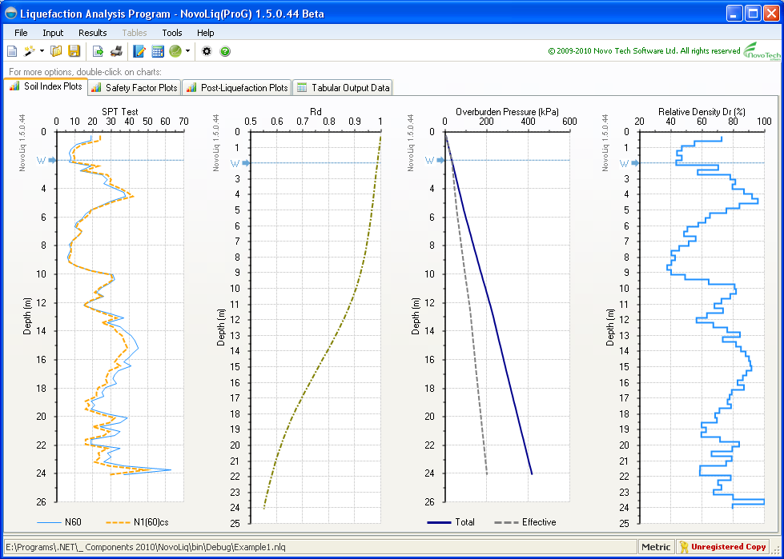
Analysis results include:
www.NovotechSoftware.com
NovoLiq Software
Soil Index Properties
SPT/Vs raw and corrected data
Rd
Overburden pressure (total/ effective)
Relative density (Dr)
www.NovotechSoftware.com

Slide 17
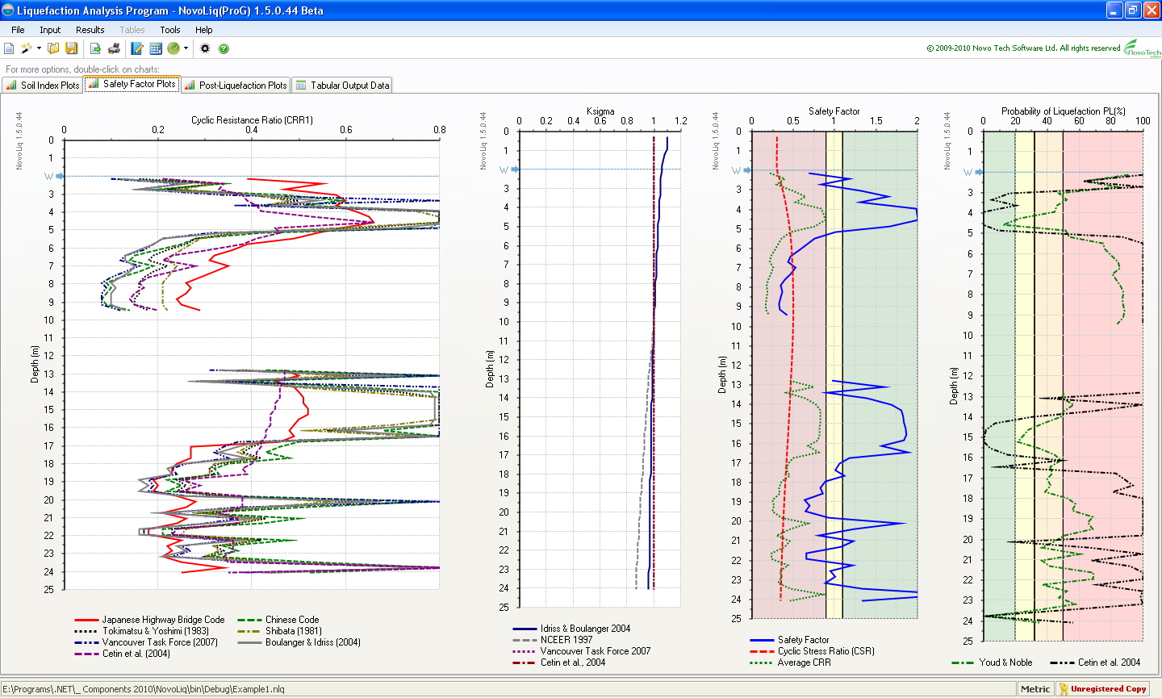
Analysis results include:
www.NovotechSoftware.com
NovoLiq Software
Safety Factor Plots
CRR curves
Kσ
Safety Factor
Probability of Liquefaction
www.NovotechSoftware.com

Slide 18
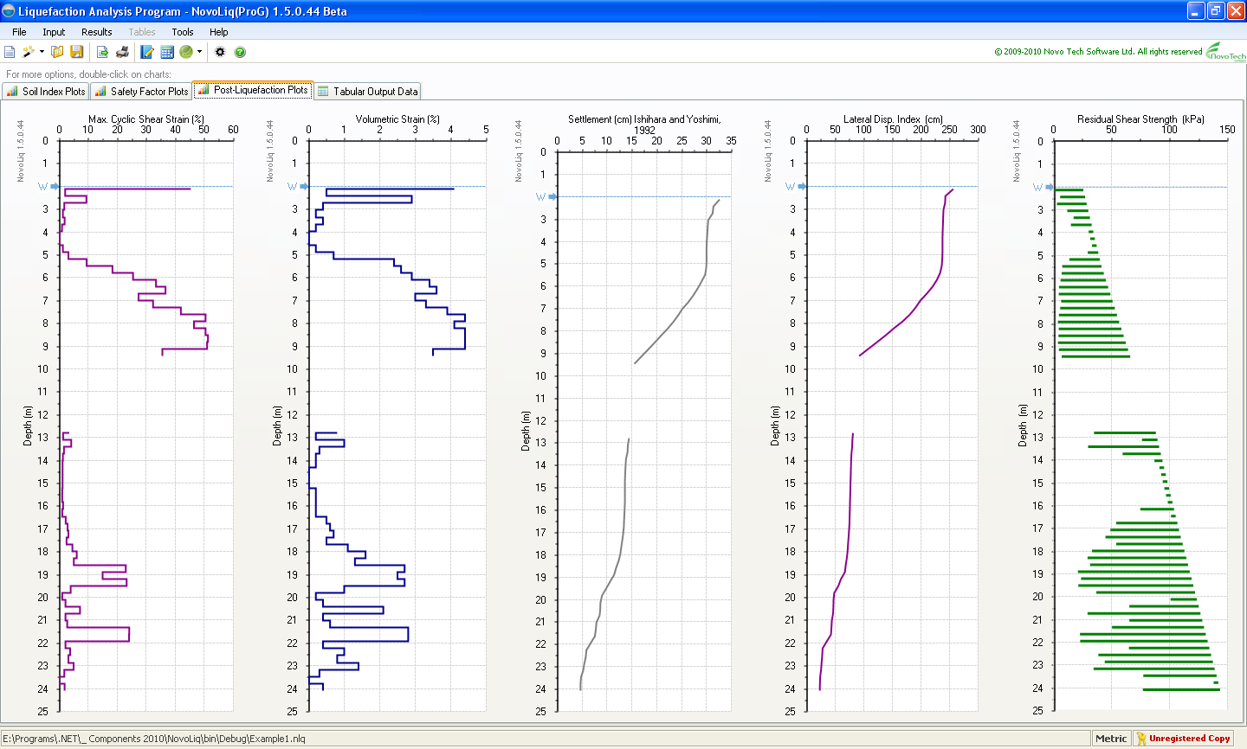
Analysis results include:
www.NovotechSoftware.com
NovoLiq Software
Post-liquefaction Plots
Cyclic Shear Strain
Volumetric Strain
Residual Strength
Settlement
Lateral Displacement
www.NovotechSoftware.com

Slide 19
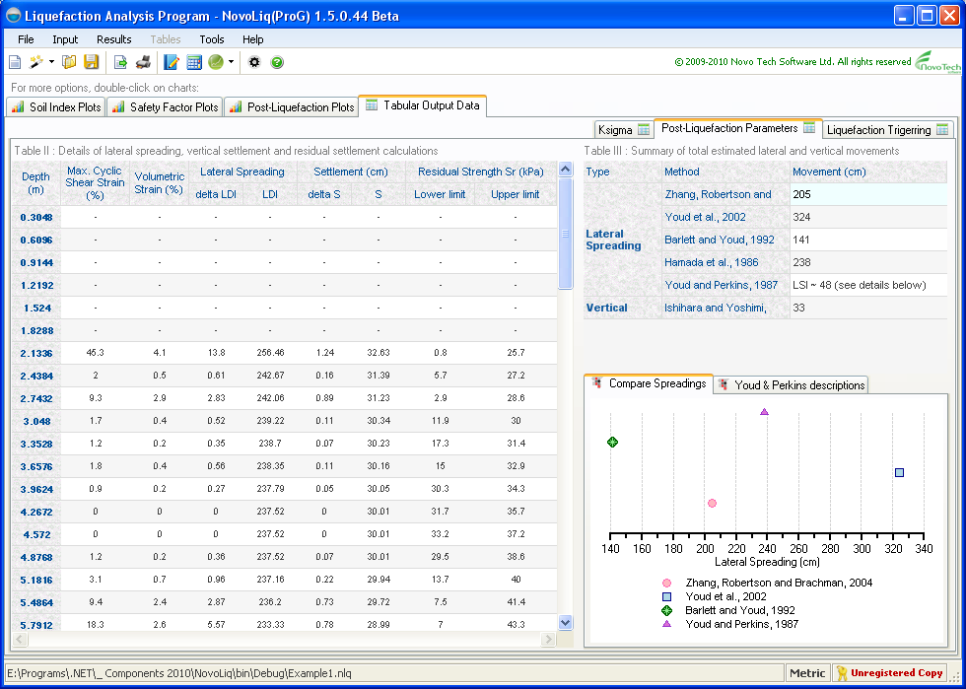
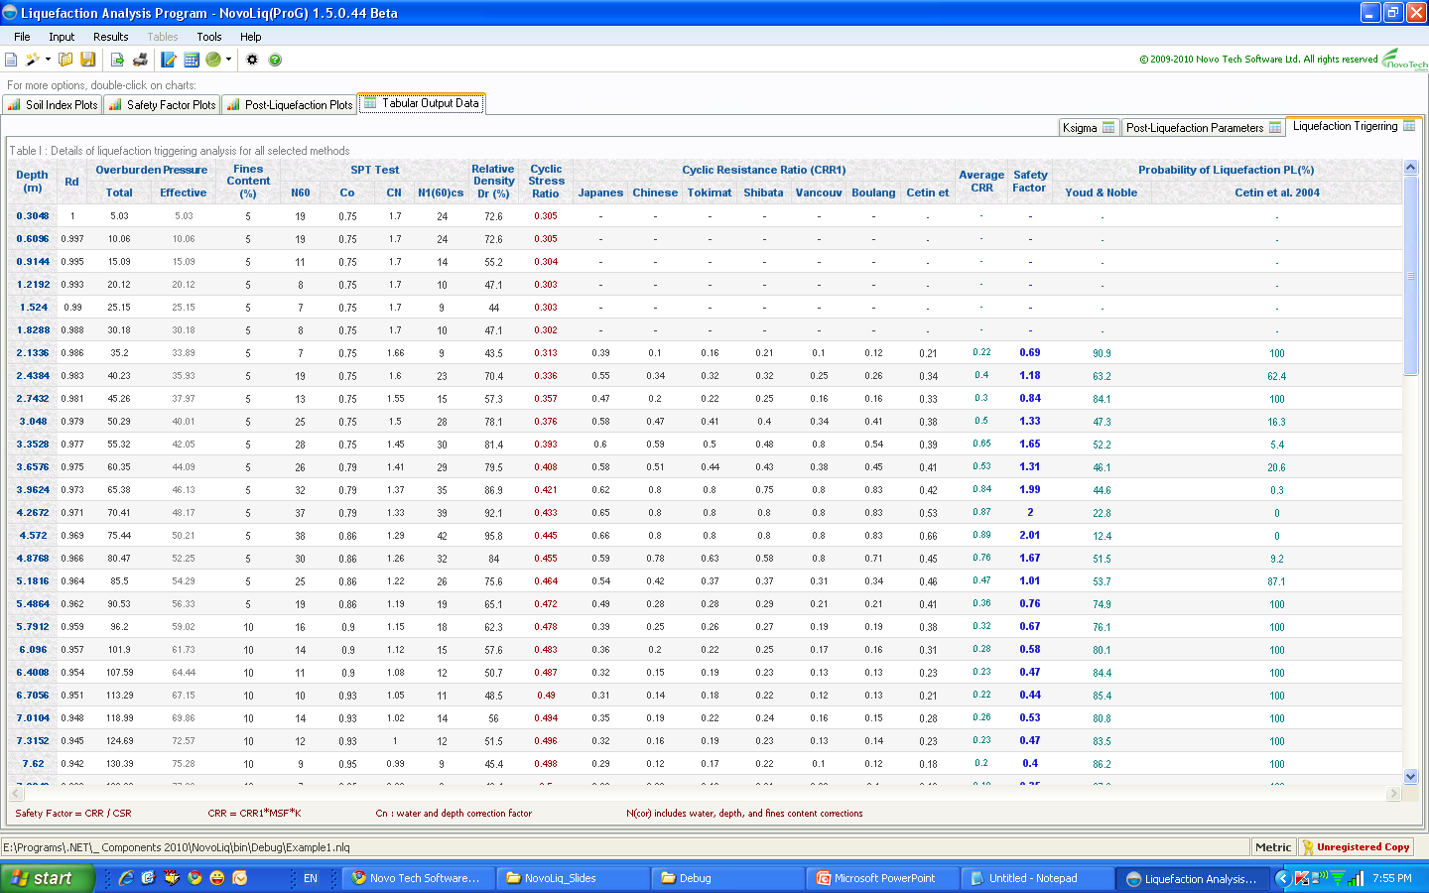
All calculation details are presented as tabular data:
www.NovotechSoftware.com
NovoLiq Software
www.NovotechSoftware.com

Slide 20
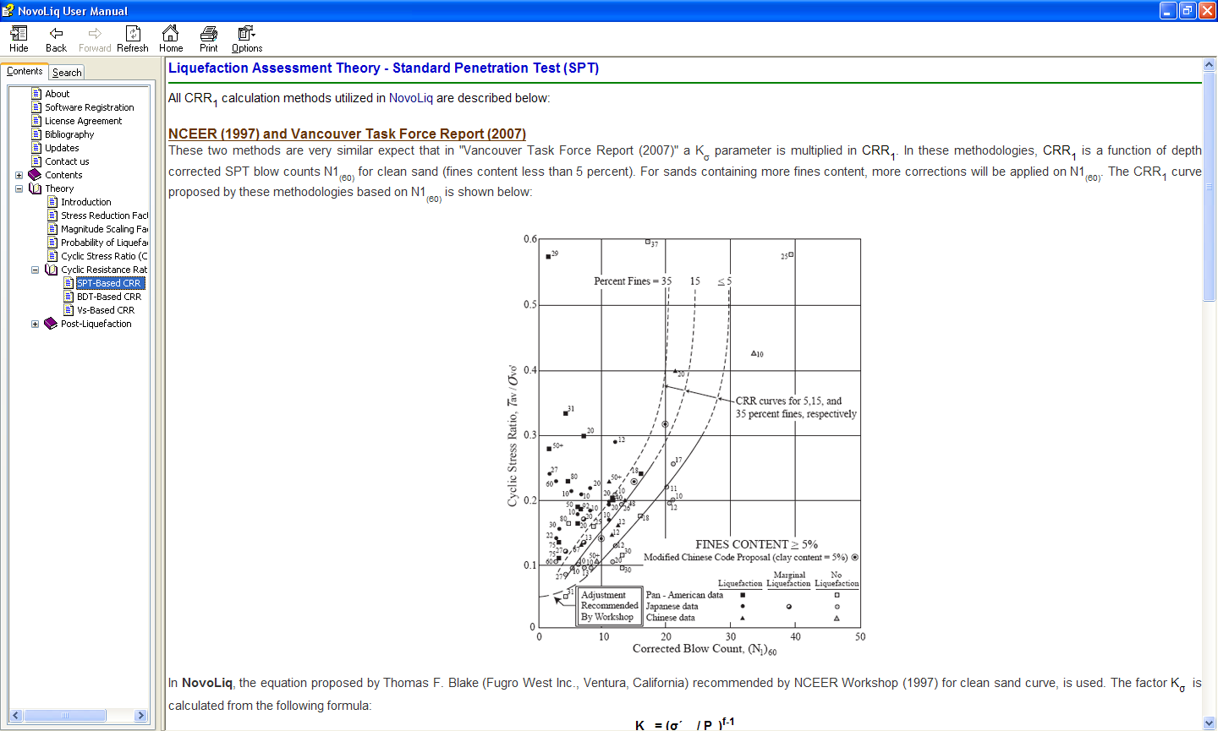
Help file for using program features as well as theory manual:
www.NovotechSoftware.com
NovoLiq Software
www.NovotechSoftware.com

Slide 21
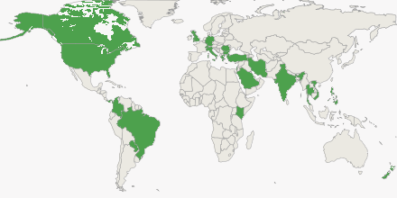
NovoLiq customers in more than 25 countries around the world
www.NovotechSoftware.com

Slide 22
Save your time by using Novo Tech geotechnical software tools
www.NovotechSoftware.com
NovoLiq Software
www.NovotechSoftware.com

Slide 23

Visit us today and try NovoLiq software
www.NovoTechSoftware.com
Become our reseller …. Contact us today

