Slide 1



SPT Correlations Software
(NovoSPT)
www.Novotechsoftware.com

Slide 2
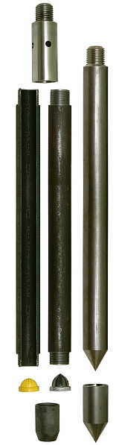
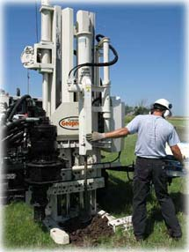
The standard penetration test (SPT) is an in-situ dynamic penetration test designed to provide information on the geotechnical engineering properties of soil.
www.NovotechSoftware.com
The test procedure is described in the British Standard BS EN ISO 22476-3 and ASTM D1586
… and still SPT is the most popular geotechnical field investigation test

Slide 3
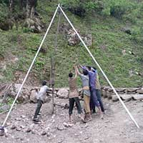
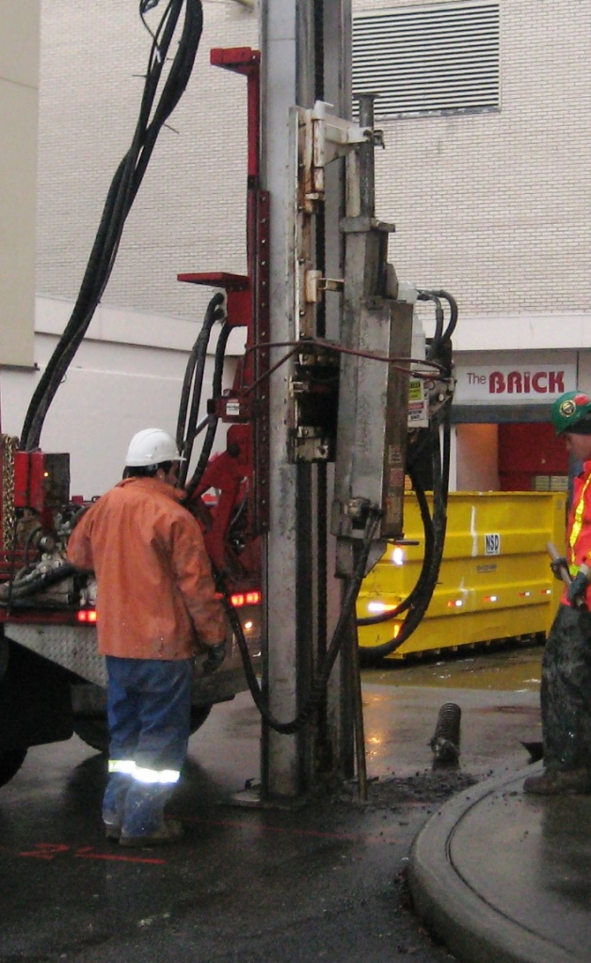
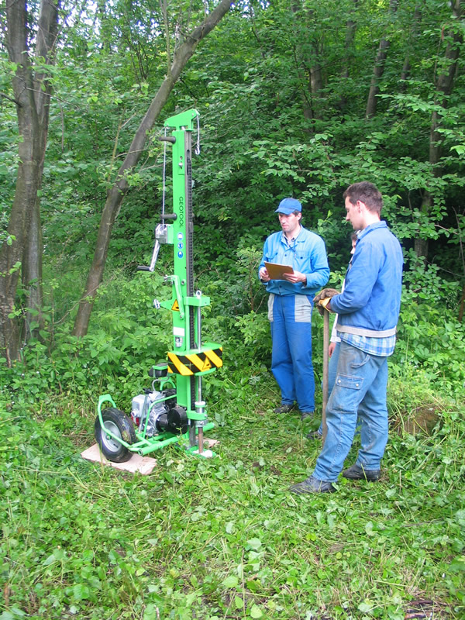
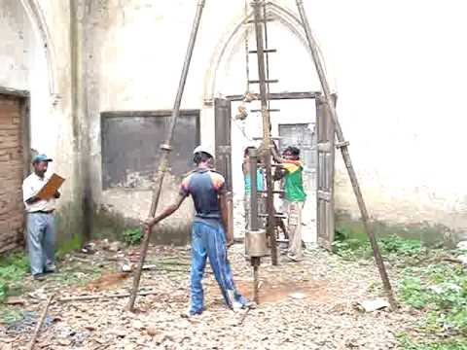
Various SPT equipments have been developed for different type of drill rigs and applications in different situations
www.NovotechSoftware.com

Slide 4
SPT blow counts obtained from the field tests, must be corrected / normalized for:
www.NovotechSoftware.com
Energy level correction
Borehole diameter correction
Sampler type correction
Rod length correction
Water level correction
Overburden (depth) correction
N₆₀
N1₆₀
N

Slide 5
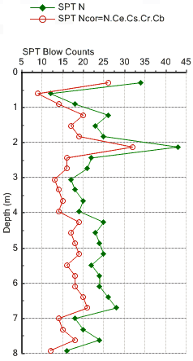
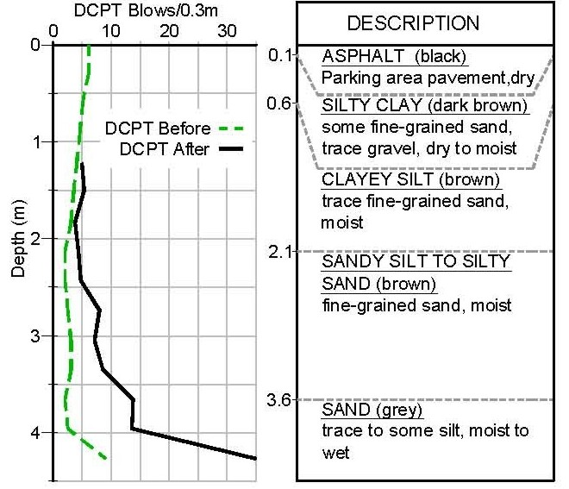
How N₆₀ and N1₆₀ are used in geotechnical engineering interpretations?
www.NovotechSoftware.com

Slide 6


N₆₀ and N1₆₀ , magic numbers!
www.NovotechSoftware.com

Slide 7
Geoscientists and researchers have carried out numerous efforts to correlate SPT blow counts to geotechnical soil properties:
www.NovotechSoftware.com
Physical properties
Mechanical properties
Bearing capacity
Settlement analysis
Liquefaction analysis
Correlation to other penetrometers

Slide 8

Introduction to encyclopedia of SPT correlations
NovoSPT
(SPT Correlations Software)
Designed & developed by:
Novo Tech Software Ltd.
Vancouver, Canada
All rights reserved
www.NovotechSoftware.com

Slide 9
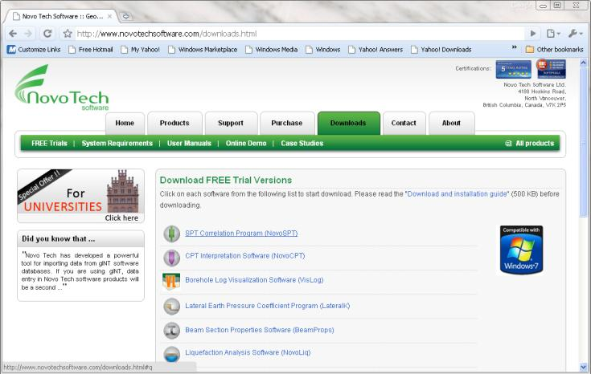
1- Easily download the software from our website
www.NovotechSoftware.com
NovoSPT Software

Slide 10
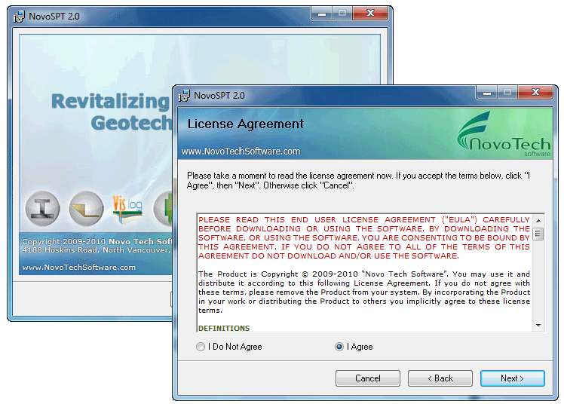
2- Quick installation
www.NovotechSoftware.com
NovoSPT Software

Slide 11
NovoSPT
More than 260 correlations are in palm of your hand

Slide 12
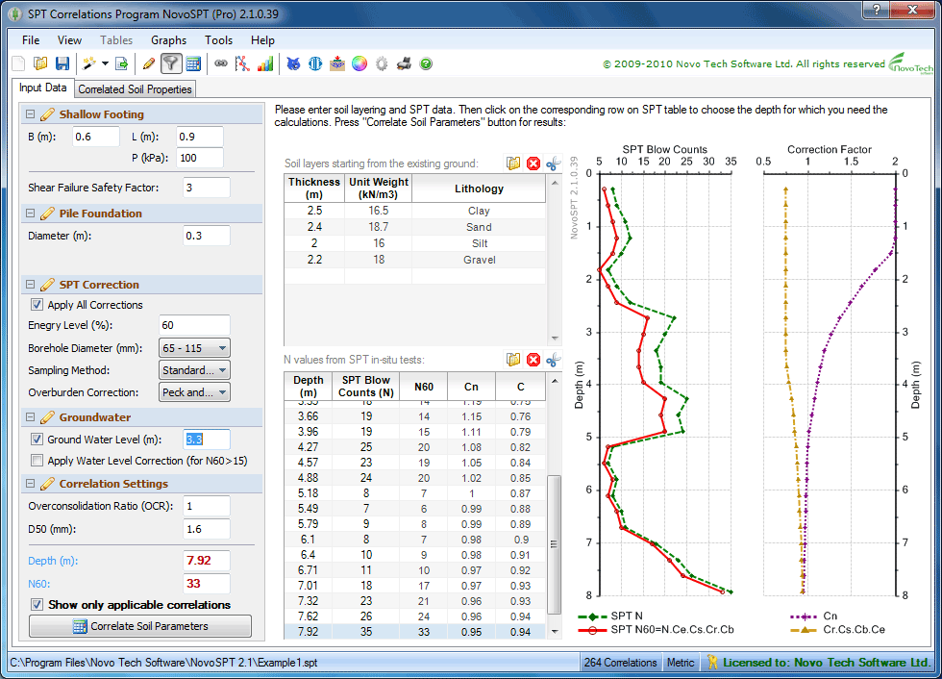
Input Data
www.NovotechSoftware.com
NovoSPT Software

Slide 13
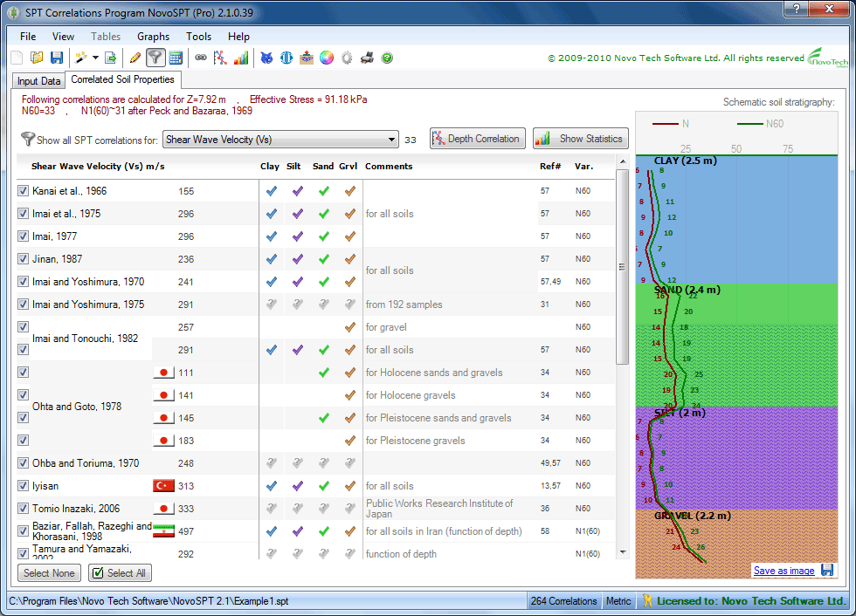
Correlated Parameters
www.NovotechSoftware.com
NovoSPT Software
Soil compactness
Modulus of elasticity (Es)
Undrained shear strength (Su)
Internal angle of friction (Φ)
Relative density (Dr)
Shear modulus (Gmax)
Shear wave velocity (Vs)
Equivalent Becker density
All SPT correction factors
Equivalent Wildcat penetrometer blows
Equivalent CPT tip resistance (qc)
Liquefaction CRR
Pressuremeter deformation modulus
Deformation modulus (mv)
Inferred unit weight (γ)
OCR for clays
D10 for granular soils
Initial stiff modulus (Go)
Bearing capacity of shallow and deep footing
Foundation settlement
Modulus of subgrade reaction (Ks)
Choose parameter
Turn off/on correlations which are not applicable to your soil type or region
Schematic soil profile
List of all correlations for a soil parameter, plus the country where field data was collected

Slide 14
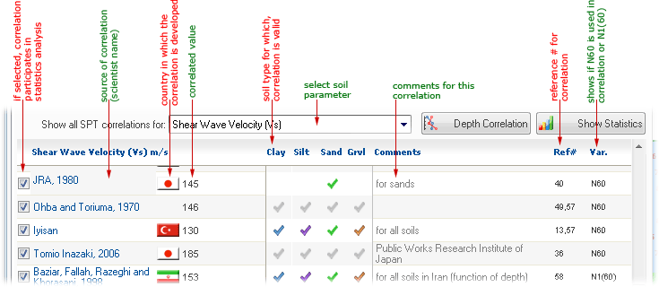
Soil Type Filter (new in version 2.1)
www.NovotechSoftware.com
NovoSPT Software
- This new feature shows each correlation is applicable to what soil type
- User can filter and show only the correlations applicable to that soil type, at each depth

Slide 15
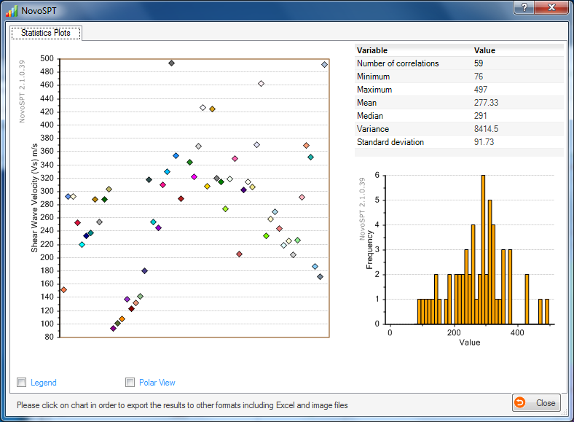
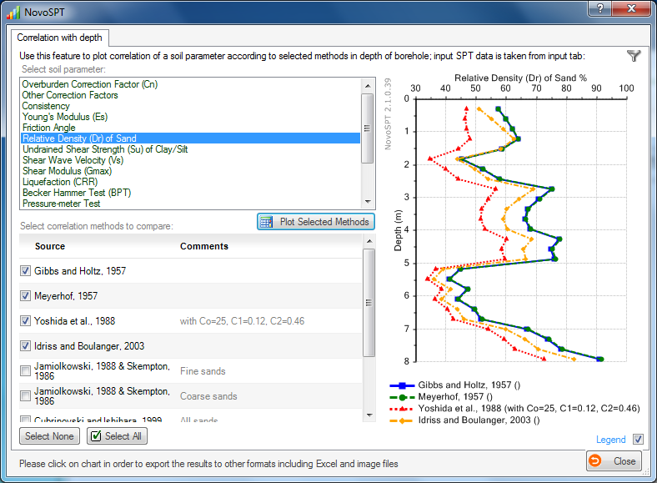
Correlated Parameters
www.NovotechSoftware.com
NovoSPT Software
Zoom
Print
Save as Excel file
Save as image file

Slide 16
Correlation Along Borehole Depth
www.NovotechSoftware.com
NovoSPT Software
Choose parameter
Comparison of correlated parameter along depth of borehole
Turn off/on correlations which are not applicable to your soil type or region
List of all correlation methods

Slide 17
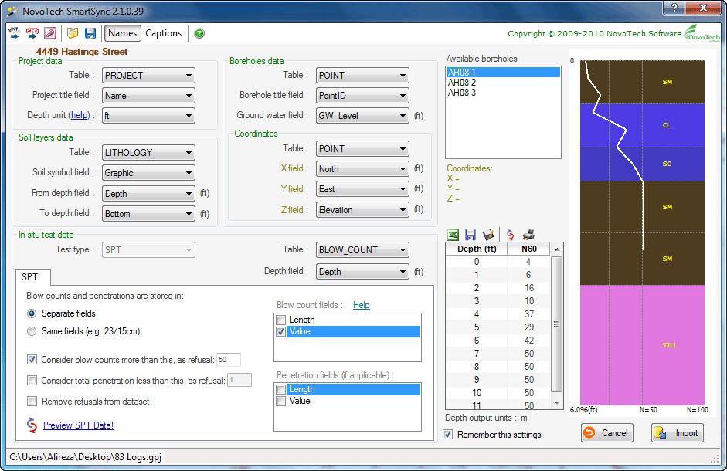
Import SPT data from gINT files
www.NovotechSoftware.com
NovoSPT Software
Database structure
Schematic soil layers and SPT plot
All type of SPT data storage are supported
SPT blow counts for selected borehole

Slide 18
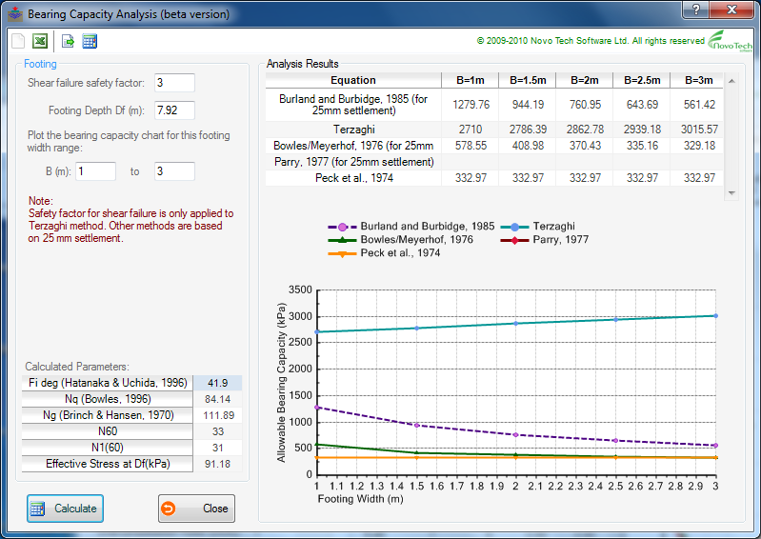
Bearing Capacity / Settlement Analysis
www.NovotechSoftware.com
NovoSPT Software
Burland & Burbidge, 1985
Terzaghi
Meyerhof, 1976
Parry, 1977
Peck et al., 1974

Slide 19
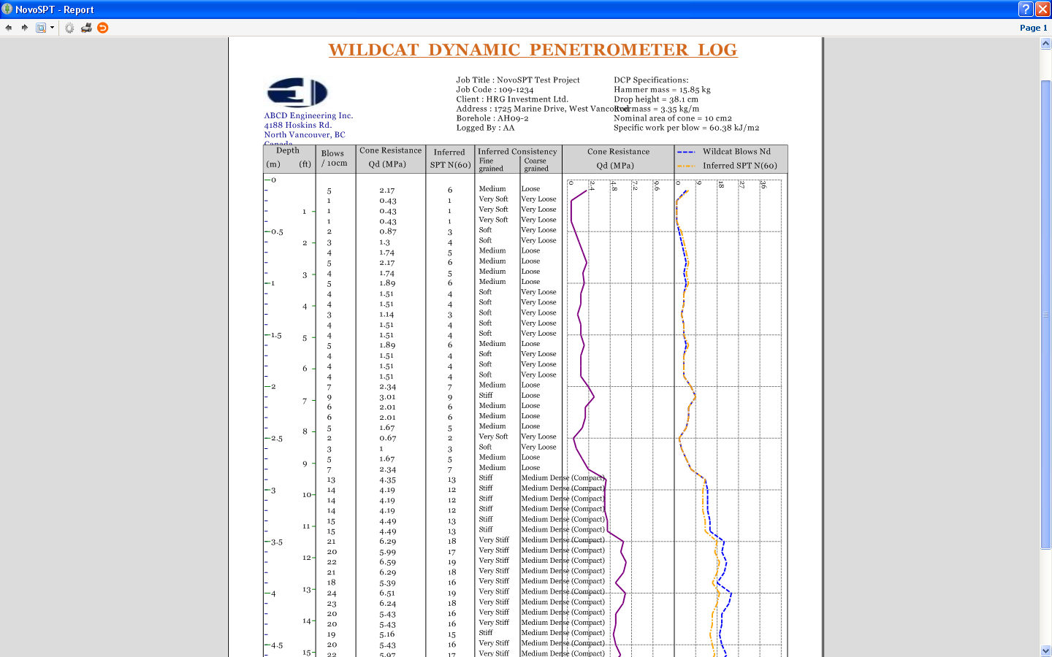
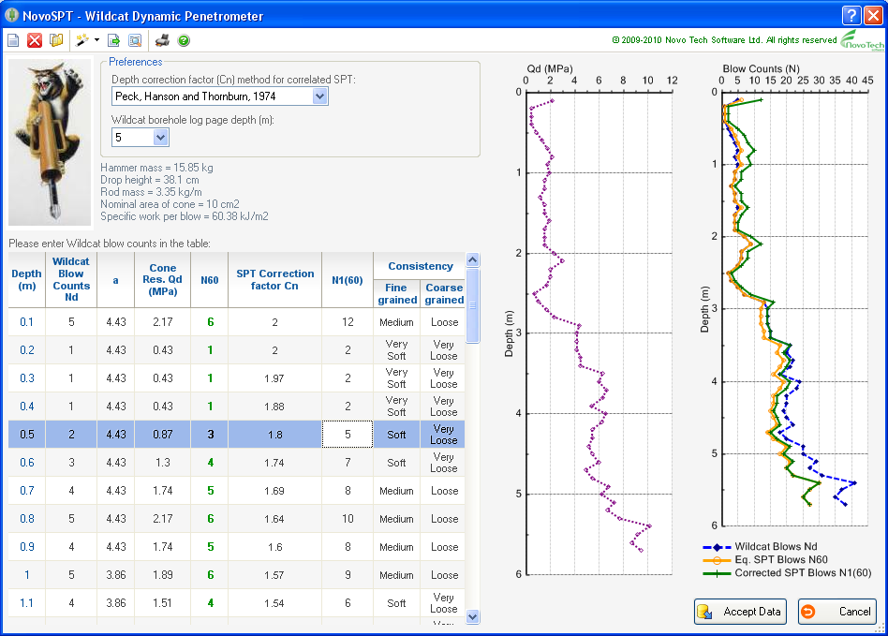
Wildcat Penetrometer Module
www.NovotechSoftware.com
NovoSPT Software

Slide 20
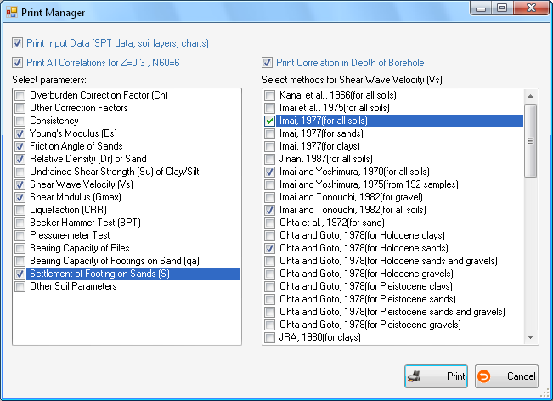
Report Manager
www.NovotechSoftware.com
NovoSPT Software

Slide 21
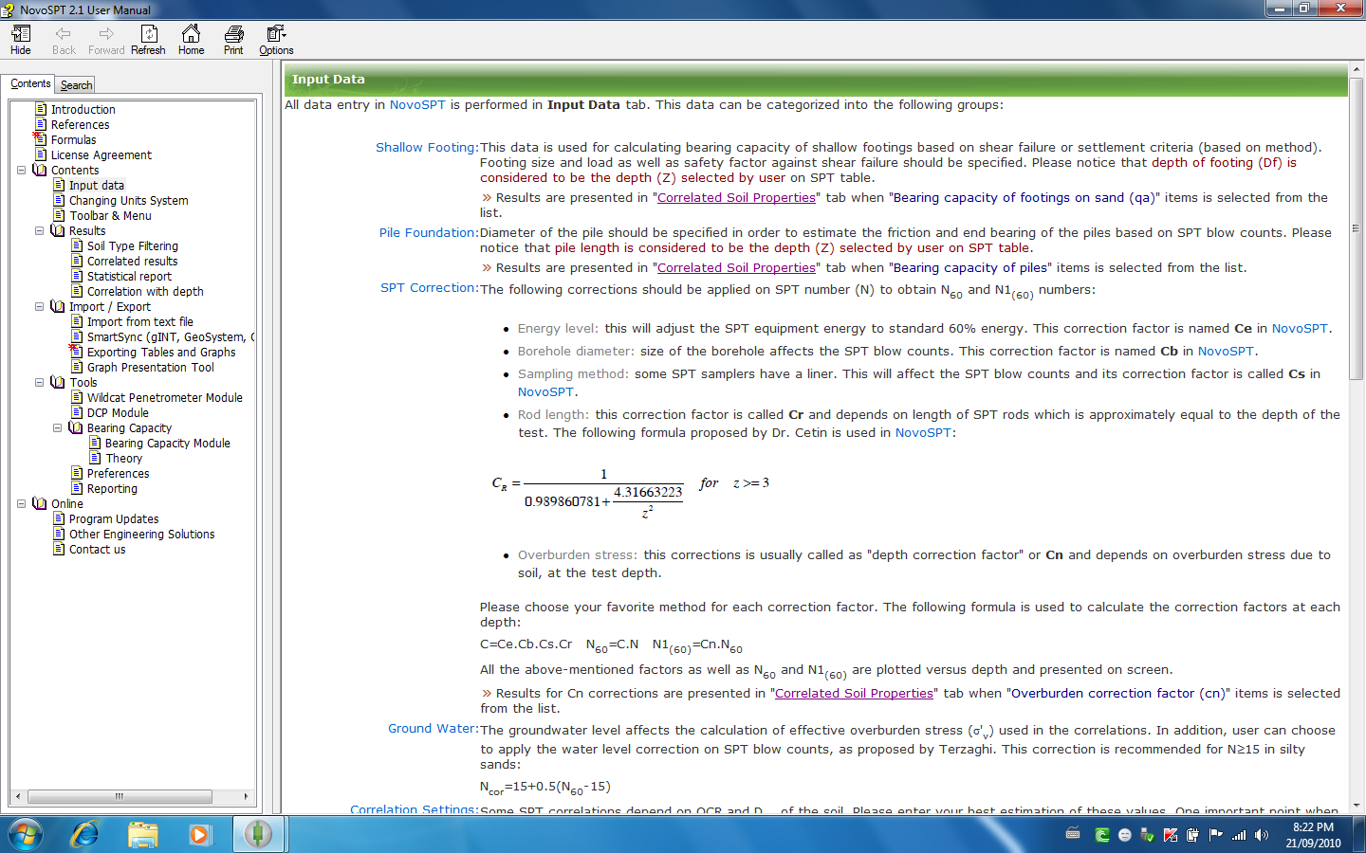
User manual (Help)
www.NovotechSoftware.com
NovoSPT Software

Slide 22
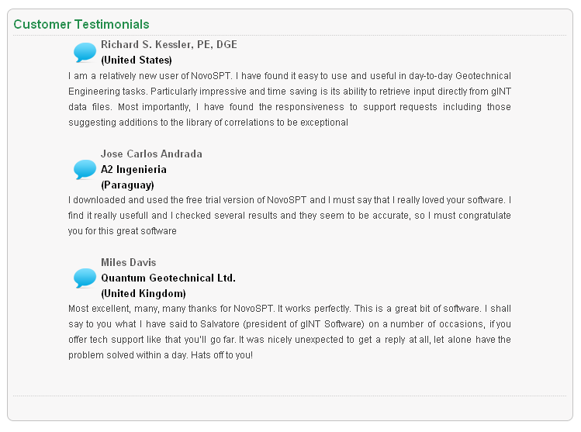
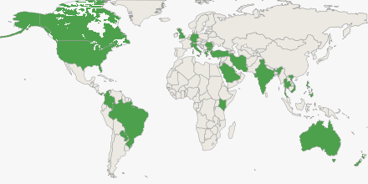
NovoSPT customers in more than 30 countries around the world, including geotechnical consultants, universities and governmental organizations

Slide 23
Our other software solutions:
Cone Penetration Test (CPT) Interpretation Software (NovoCPT): for interpretation of CPTu including liquefaction analysis, foundation settlement analysis and pile bearing capacity analysis (LCPC) tools.
Liquefaction Analysis Program (NovoLiq): based on 10 different methods for calculating Cyclic Resistance Ratio (CRR), with more than 55 options for other formulas, including post-liquefaction lateral displacement and settlement ...
VisLog: This powerful program is designed for visualizing geotechnical/geological borehole logs and automatically drawing soil profiles. 3D environment and easy zoom and rotation features make it so easy to work with VisLog...
Beam Section Properties (BeamProps): This software is used to calculate beam section properties such as area, moment of inertia, radius of gyration, etc. for more than 25 sections and shapes...
SMTP: is a comprehensive solution for processing soil mechanics laboratory tests such as sieve test, Aterberg limits, moisture and density, direct shear, triaxial, compaction, permeability, etc and designing borehole logs.
LateralK: Calculating lateral earth ressure coefficient program in static (Rankine/ Coulomb) and earthquake (Mononobe/ Okabe) conditions ...
Peysanj: A complete set of geotechnical modules for bearing capacity and settlement of shallow footings, pressure-meter test, plate load test, liquefaction analysis, lateral earth pressure coefficients, and more ...

Slide 24

Thank you for watching
Visit us today and download your own NovoSPT
www.NovoTechSoftware.com

