Slide 1

PEYSANJ 3.0
Geotechnical Eng. Software
Designed & Developed by : Novo Tech Software Ltd.
www.novotechSoftware.com

Slide 2
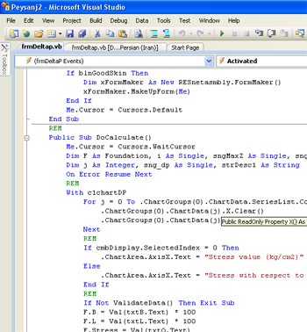
Introduction
www.NovoTechSoftware.com
PEYSANJ Started at 1997 with Bearing Capacity Module
Current version with more than 5 modules
Database (Access / SQL Server)
User friendly design, easy to use
Single / Network installation

Slide 3
Peysanj modules:
www.NovoTechSoftware.com
Shallow Footings
Shear Failure
Settlement
Retaining Walls
Lateral earth pressures coefficients
Stress distribution behind wall
Slope stability
Limit equilibrium analysis based on Fang handbook’ table
Bearing Capacity
Stress variation below footing
Plate Load Test
Computing Ks30
Ks30 Correction
Ks30 Conversion
Pressure Meter Test
Menard Modulus (Em)
Limit Pressure (Pl)
Liquefaction
Based on SPT, BPT, Vs
6 Methods for CRR
Considering MSF
Considering calibration
CRR, CSR, Safety factor calculation along depth
Lateral displacement

Slide 4
References :
www.NovoTechSoftware.com
Stress below footing
Westergard
2:1 slope
Settlement
Goodier & Timoshenko
Rigid (semi-infinite)
Average (semi-infinite)
Saturated/Un-saturated consolidation
Soil Shear Failure
Hansen
Effect of water level
Lateral Earth Press.
Rankin (Static)
Columb (Static)
Mononobe-Okabe
Liquefaction
Japan’ highway code
Kokusho 1983
Chinese code
Seed 1983
Shibata 1981
Tokimatsu/Yushimi 1983
NCEER workshop 1996
CRR methods
Supported tests:
SPT
BPT
Shear Wave Velocity
Vancouver Task Force 2007
Lateral Disp. Method:
Zhang & Robertson, 2004
Slope stability
Limit equilibrium analysis
Fang handbook
Pressure-meter
ASTM D4719

Slide 5
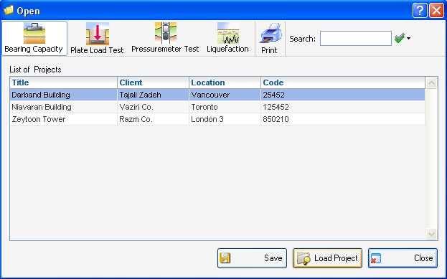
Projects list
www.NovoTechSoftware.com

Slide 6
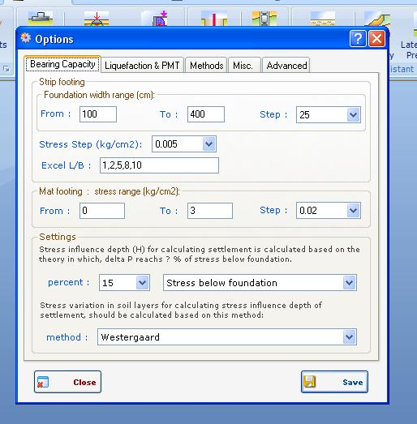
Setting & preferences
www.NovoTechSoftware.com
All settings for level of accuracy in bearing capacity analysis of multi-layer soils can be set by user

Slide 7
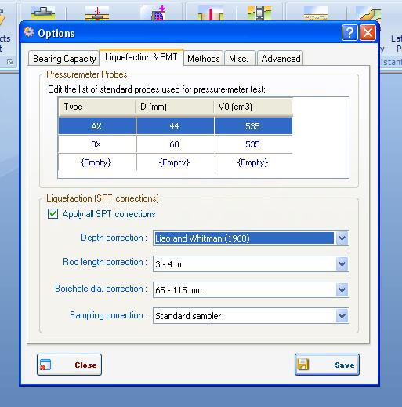
Setting & preferences
www.NovoTechSoftware.com
Correction factor for SPT during liquefaction analysis and list of pressure-meter tubes can be defined

Slide 8
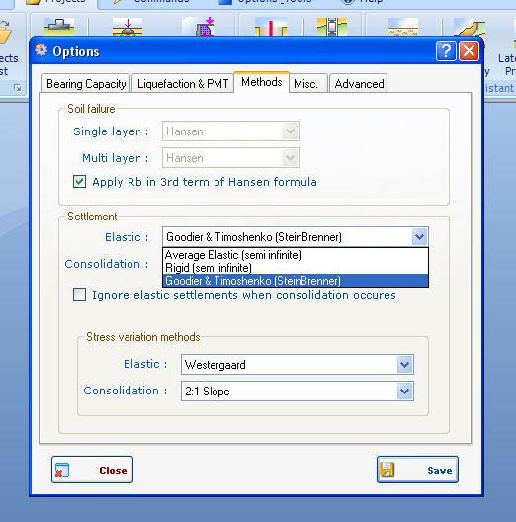
Setting & preferences
www.NovoTechSoftware.com
Settlement and soil failure parameters

Slide 9
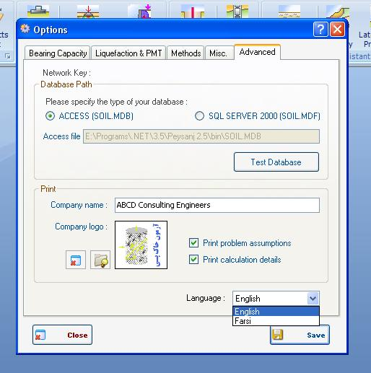
Setting & preferences
www.NovoTechSoftware.com

Slide 10
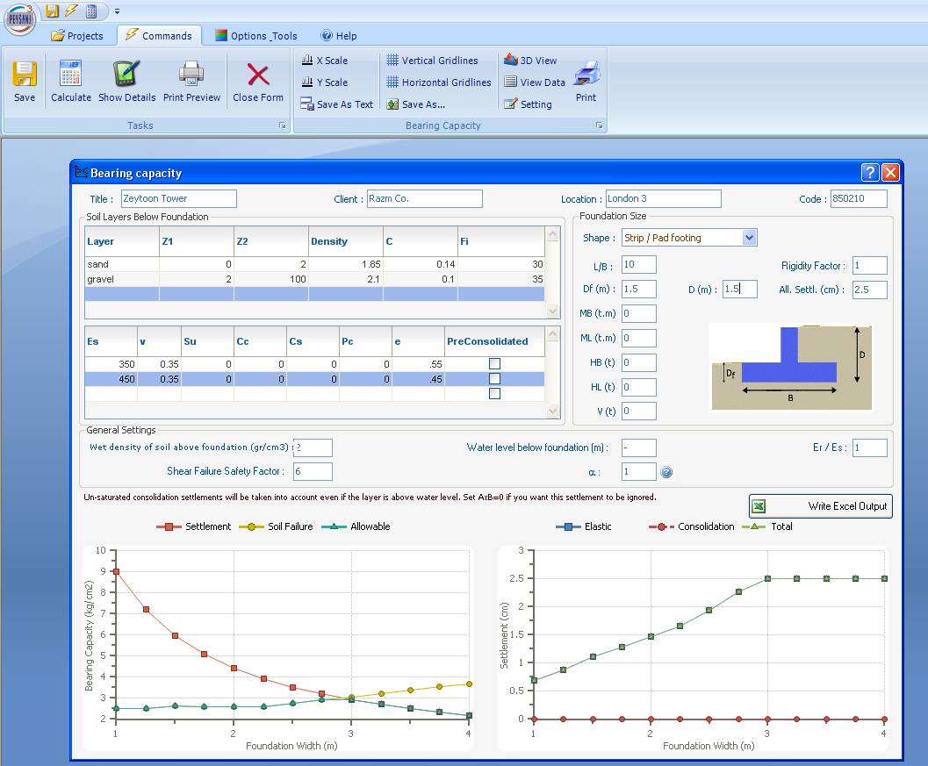
Bearing capacity
Allowable bearing capacity
www.NovoTechSoftware.com

Slide 11
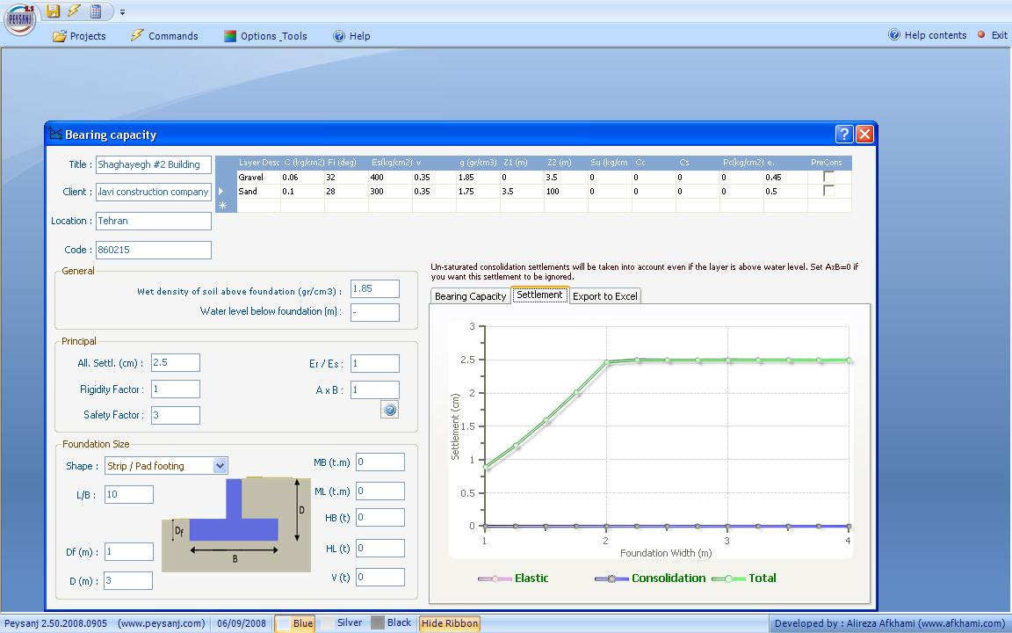
Bearing capacity settlements
www.NovoTechSoftware.com

Slide 12
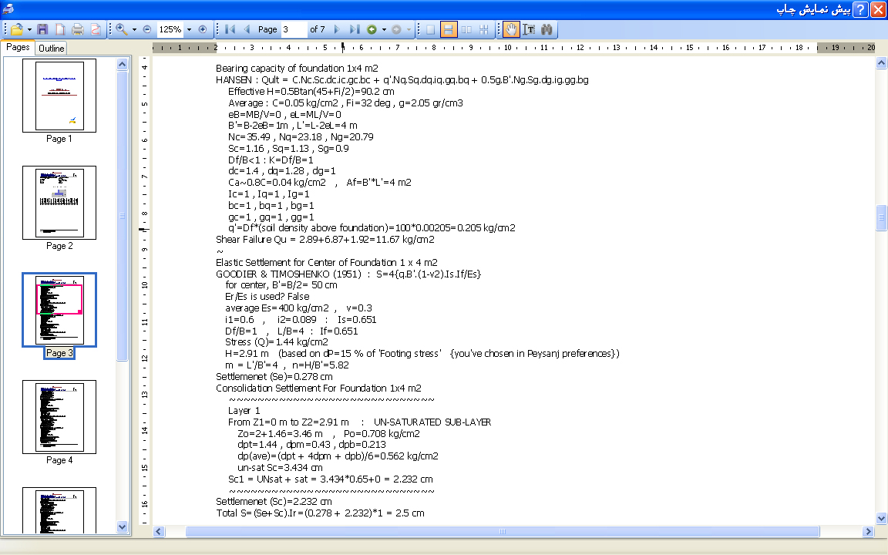
Bearing capacity calculation details
www.NovoTechSoftware.com

Slide 13
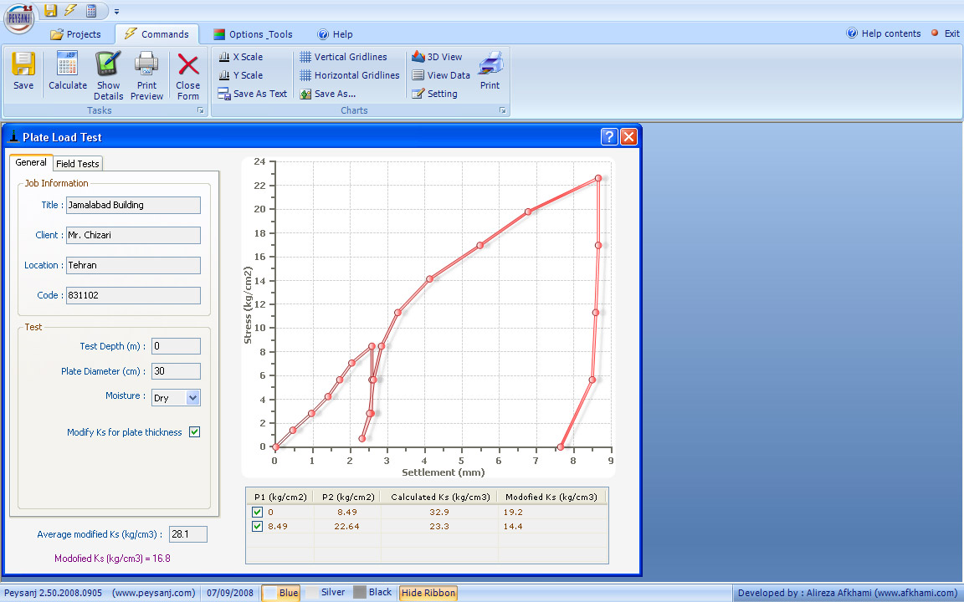
Plate load test
www.NovoTechSoftware.com

Slide 14
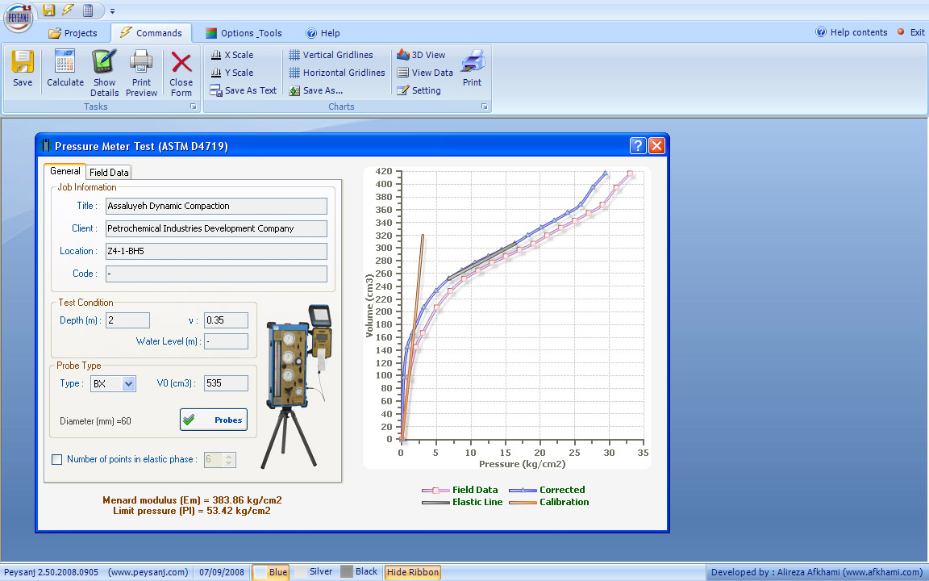
Pressure-meter test (astm d4719)
www.NovoTechSoftware.com

Slide 15
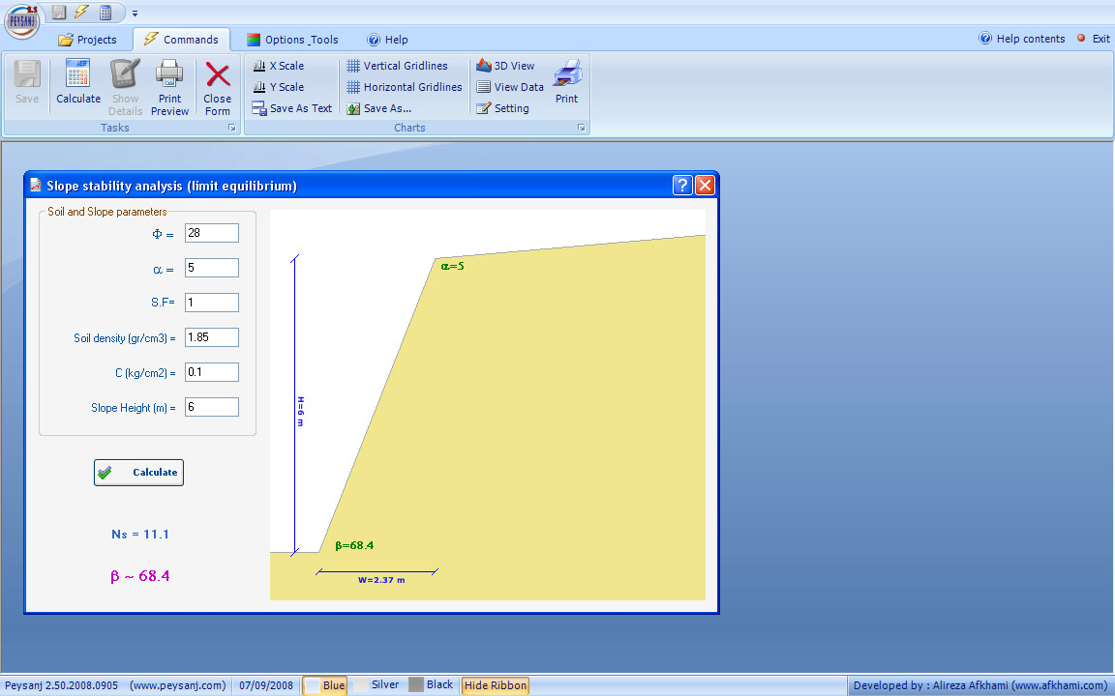
Slope stability
www.NovoTechSoftware.com

Slide 16
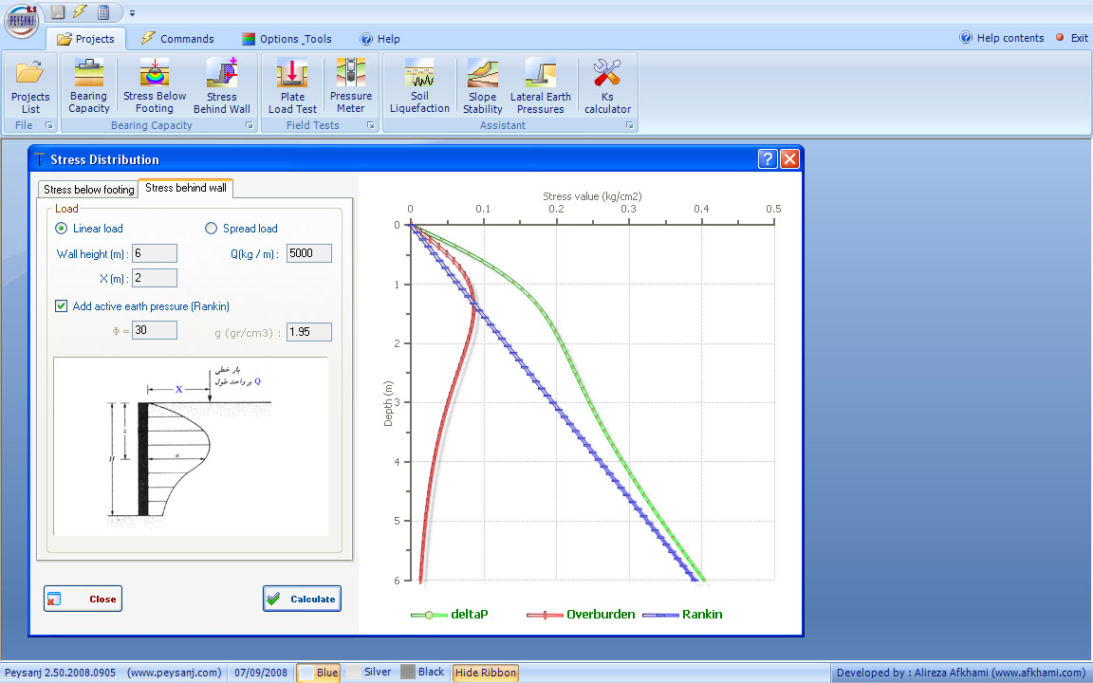
Stress behind Retaining wall linear load
www.NovoTechSoftware.com
Q

Slide 17
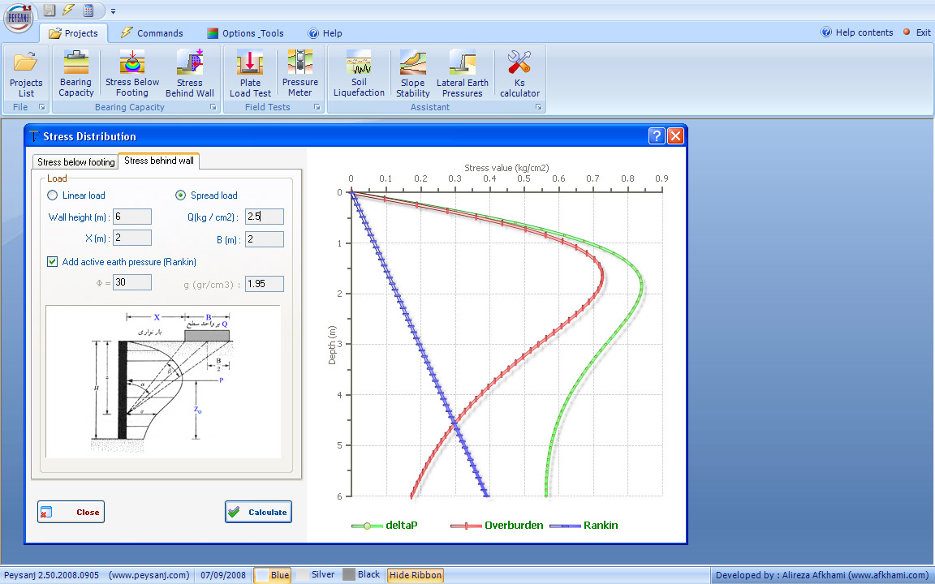
Retaining wall strip load
www.NovoTechSoftware.com
Q

Slide 18
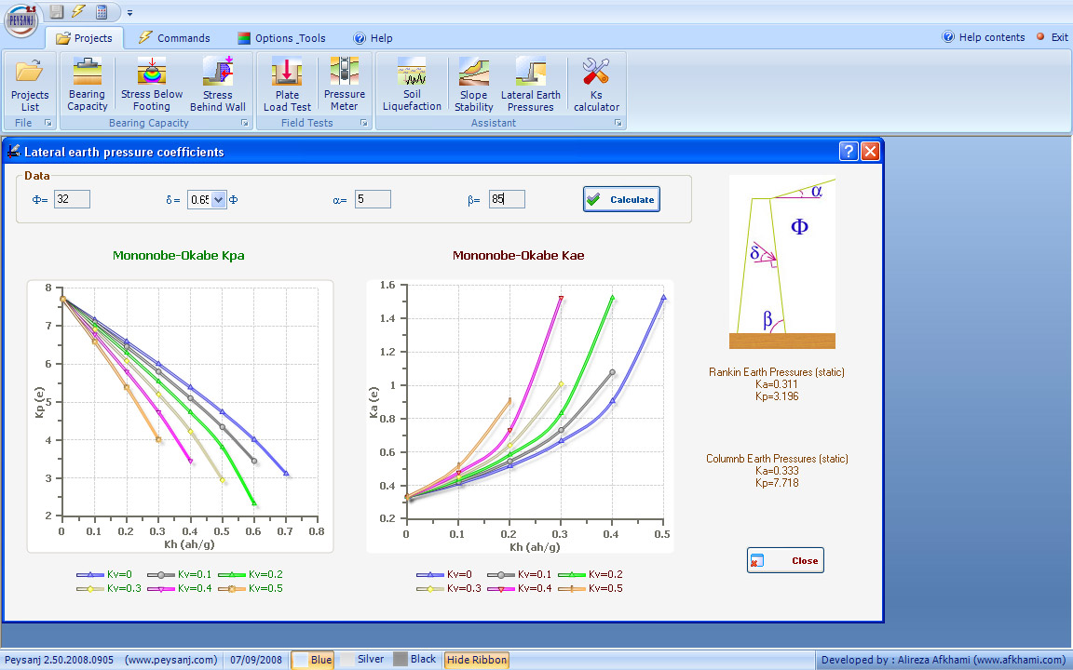
Retaining wall lateral earth pressure K (static & earthquake)
www.NovoTechSoftware.com

Slide 19
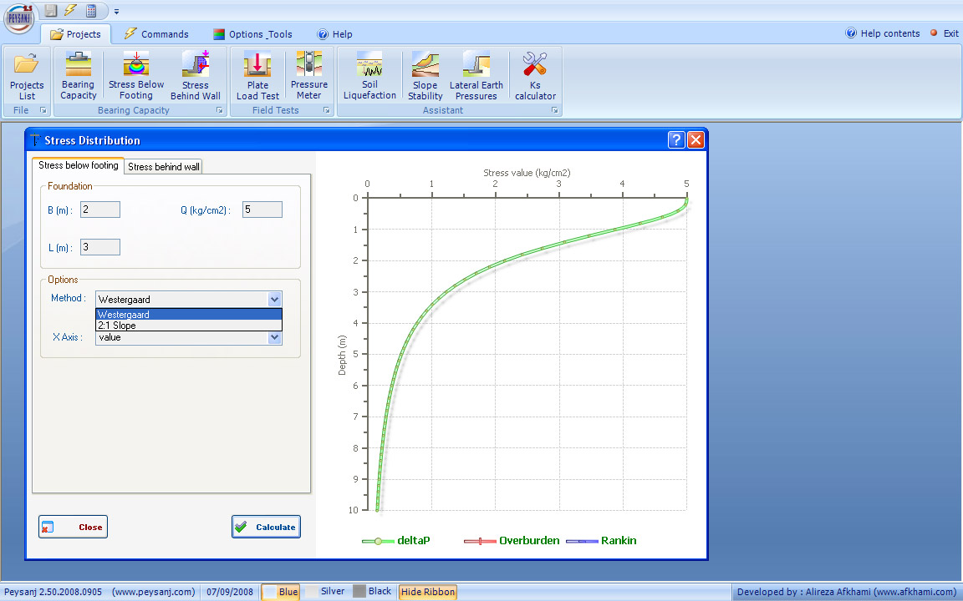
Stress distribution
www.NovoTechSoftware.com

Slide 20
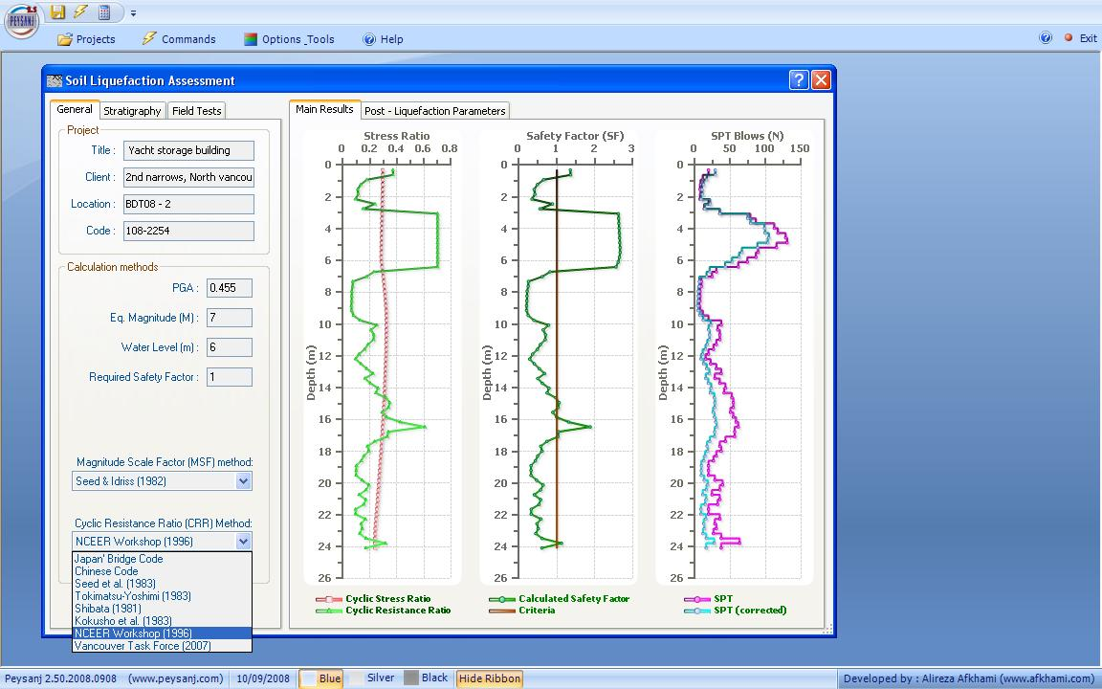
Liquefaction assessment
www.NovoTechSoftware.com

Slide 21
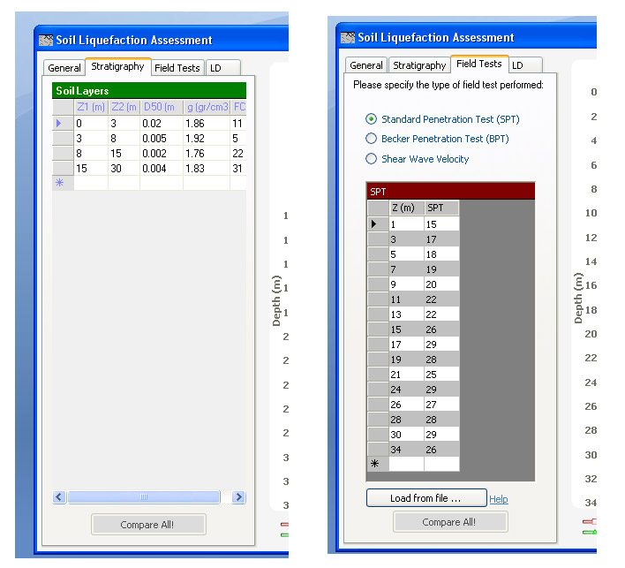
Liquefaction assessment field data
www.NovoTechSoftware.com

Slide 22
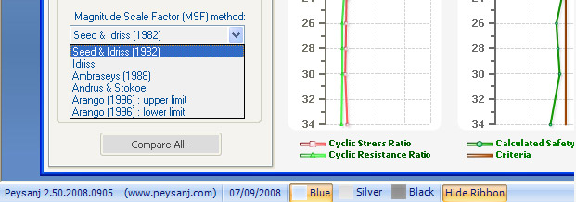
Liquefaction assessment magnitude scale factor (msf)
www.NovoTechSoftware.com

Slide 23
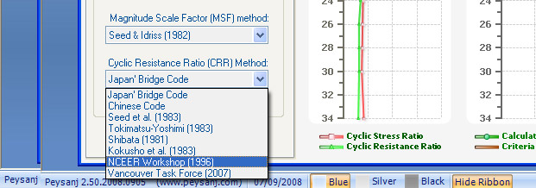
Liquefaction assessment crr calculation methods
www.NovoTechSoftware.com

Slide 24
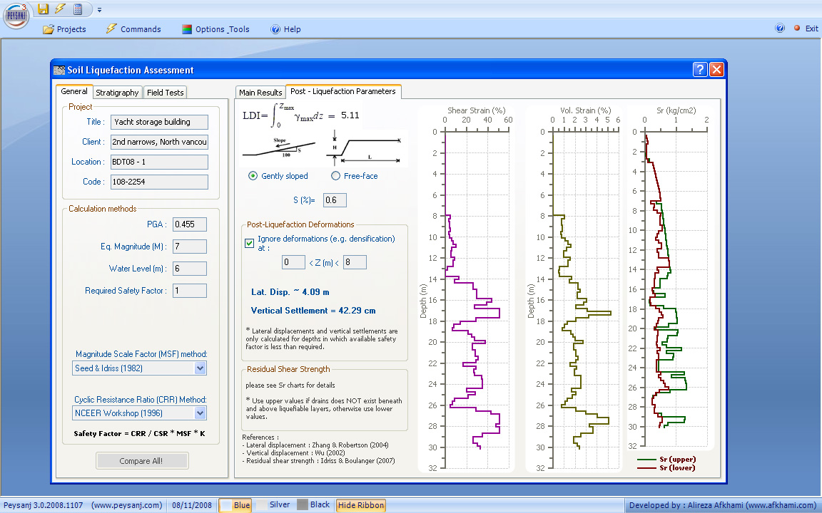
Liquefaction assessment
Lateral Displacement, Vert. Settlement, RESIDUAL SHEAR STRENGTH after liquefaction
www.NovoTechSoftware.com

Slide 25
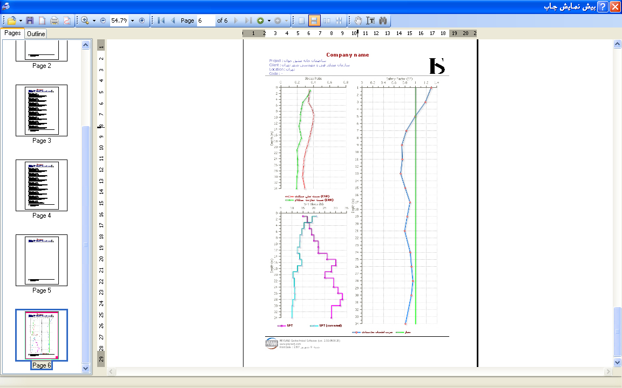
Liquefaction assessment print preview
www.NovoTechSoftware.com

Slide 26
Please Visit Our website for more information www.novotechSoftware.com/peysanj/
Novo Tech Software Ltd.
North Vancouver,
BC, Canada

