Slide 1
Elasto - plastic behavior of beam-to-column connections with fillets of steel bridge frame piers

Slide 2
Abstract
The seismic design method of beam-to-column connections of steel bridge frame piers has not been established and it is necessary to develop it. Moreover the fatigue damage of beam-to-column connections of steel bridge frame piers is one of serious problems. It is proposed to install the fillets in beam-to-column connections of steel bridge frame piers for improving fatigue performance. The influence of fillets on seismic performance of beam-to-column connections must be considered in developing the seismic design method. In this study, cyclic loading experiments were conducted.

Slide 3
INTRODUCTION
On the other hand, seismic design method of beam-to-column connections of steel bridge frame piers has not been established because the elasto-plastic behavior has not been investigated sufficiently and there are a lot of things to make clear for developing the ductility design method. Then beam-to-column connections of steel bridge frame piers are sometimes applied to elastic design method against level 2 Earthquake Ground Motions and it is not rational. It is necessary to clear up the elasto-plastic behavior of them in order to develop the ductility design method as the seismic design.

Slide 4
However buckling at fillets is easy to occur and the buckling at fillets may have a bad influence on the seismic performance
of beam-to-column connections. It is important to make clear the influence of
fillets on the elastic-plastic behavior of beam-to-column connections.

Slide 5
OUTLINE OF EXPERIMENTS
Two types of test specimens were employed. One of them is with fillets and another is without fillets. In this study, survey of major parameters of actual beam-to-column connections of steel frame piers which have been designed by the 1996 or the 2002 design specifications for high bridges were carried out so that the parameters of test specimens could be set in consideration of those of actual beam-to-column connections of steel bridge frame piers.

Slide 6
Fig.1 shows the survey results of the parameters. In Fig.1, RR and RF are the with-thickness ratio parameters of plate panels between longitudinal stiffeners and overall stiffened plate panels respectively.

Slide 7
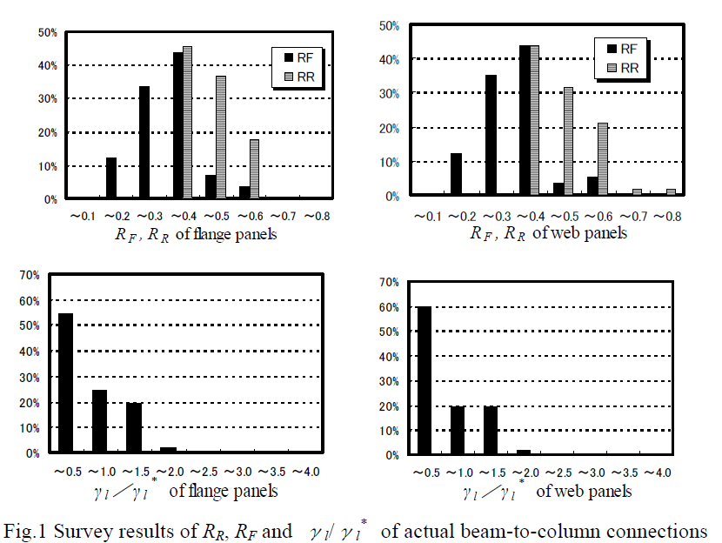

Slide 8
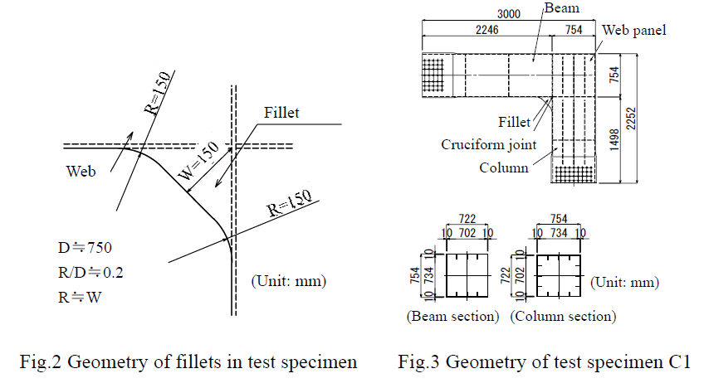

Slide 9
The geometry of a test specimen C1 with fillets is given in Fig.3 and the values of major parameters and material properties of the test specimens are listed in Table 1.
where b = width of flange; t = thickness of plate; E = Young’s modulus; σy= yield stress ;
ν = Poisson’s ratio (=0.3) ; n = number of panels; kR = bucking coefficient; α = aspect
ratio; γl = relative stiffness ratio of an actual longitudinal stiffener.
Based on survey results shown in Fig.1

Slide 10
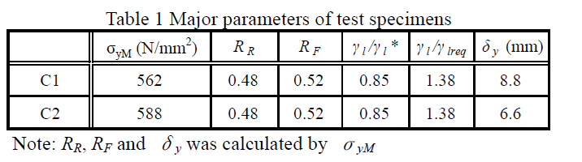

Slide 11
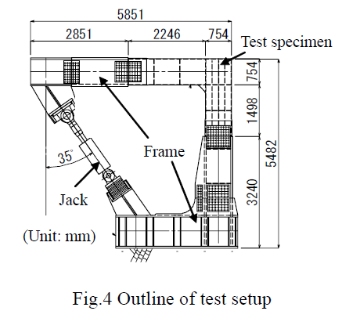

Slide 12
Fig.4 is an outline of test setup. Each specimen was set in fully stiff frames. A hydraulic jack was fixed at the end of each flame. The jack adapted an angle of about 35°to the vertical axis so that distribution of moment acting on beam-to-column connections of specimens and that of actual beam-to-column connections could be as approximate as possible.

Slide 13
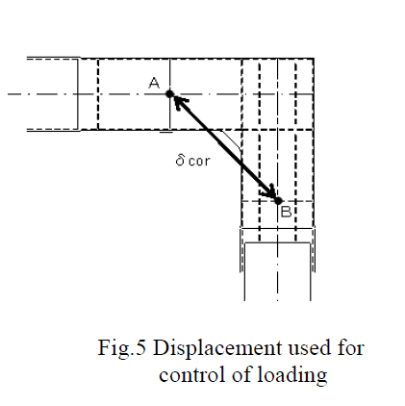
Each experiment was controlled by the displacement δcor. δcor is a displacement as shown in Fig.5.

Slide 14
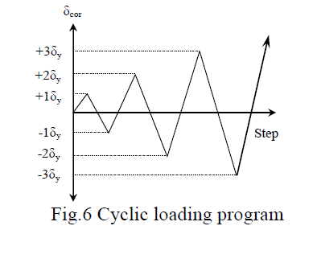
The cyclic loading program is schematically shown in Fig.6. δy in Fig.6 is the
yield horizontal displacement and it was decided by the following procedure. As shown Fig.7, strain gauges were attached on both surfaces of inner flange plates in the beam and the column and the distance between the gauges and the cruciform joint is 50 mm.

Slide 15
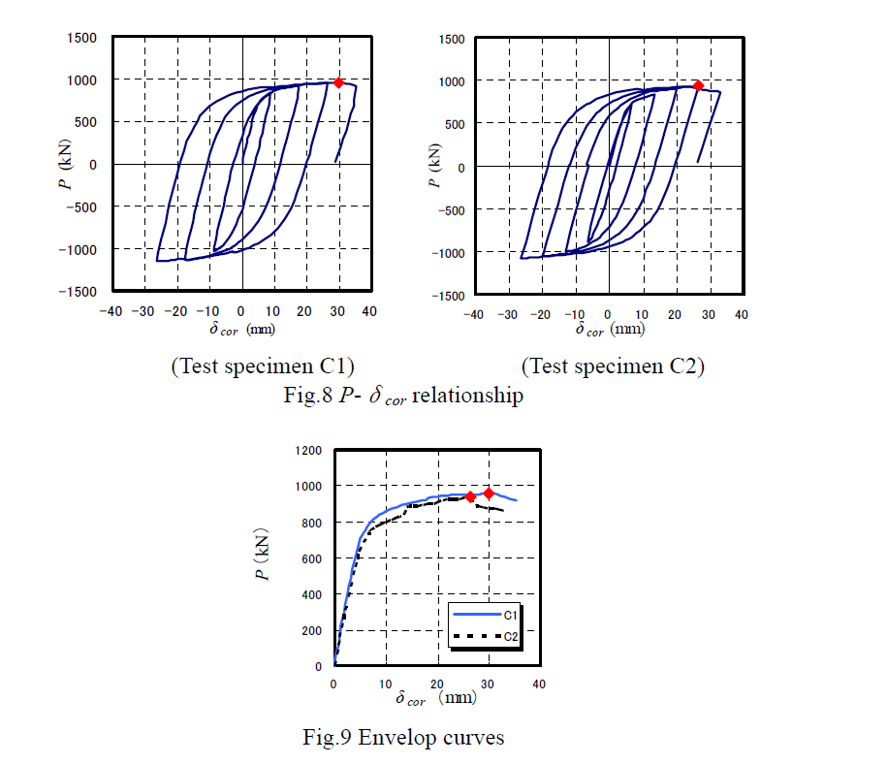

Slide 16
Fig.8 indicates a jack load P-displacement δcor relationship and Fig.9 shows the envelope curves of the test specimens. The square symbols (◆) in Fig.8 and Fig.9 exhibit the points where Pmax appeared.
Fig.9 demonstrates that Pmax and the displacement at Pmax of C1 are a little larger than those of C2. However the envelop curve of C1 before Pmax is almost identical with that of the specimen C2.

Slide 17
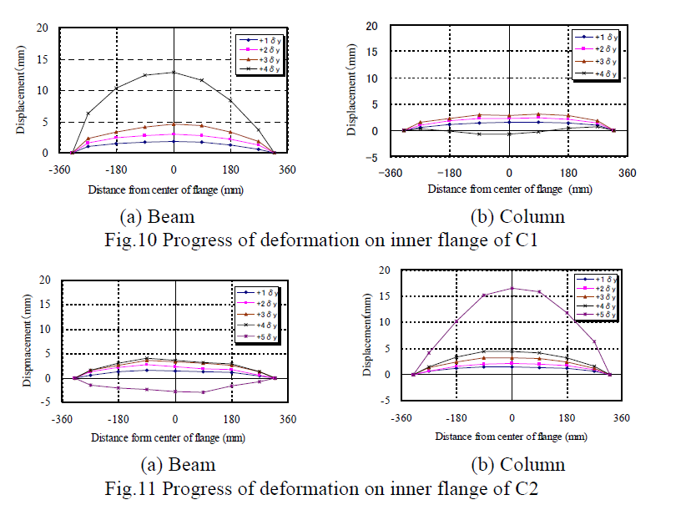

Slide 18
Buckling behavior and low cycle fatigue performance:
Fig.10 and Fig 11 show the progress of out-of-plane deformation of the inner flanges in the beam and the column at the end of each loop respectively. The points where the displacement was measured were 50 mm from the cruciform joint. And positive values of the deformation in Fig.10 and Fig.11 mean the out-of-plane displacement occurred into inside of flange plates.

Slide 19
flange plates in the beam in the loading path of +4δy as shown in Fig.12. This bucking caused decline of strength and Pmax appeared. The deformation of the inner flange plate in the beam in the loop of +4δy was much larger than that in the other loops as shown in Fig.10(a).
Regarding a test specimen C2, the cracks were found on the flange side surface of weld bead of the cruciform joint at the corner in the loop of -3δy as shown Fig.13. These cracks
propagated with the progress of the loading in the loop of -3δy, but the load P didn’t decline.

Slide 20
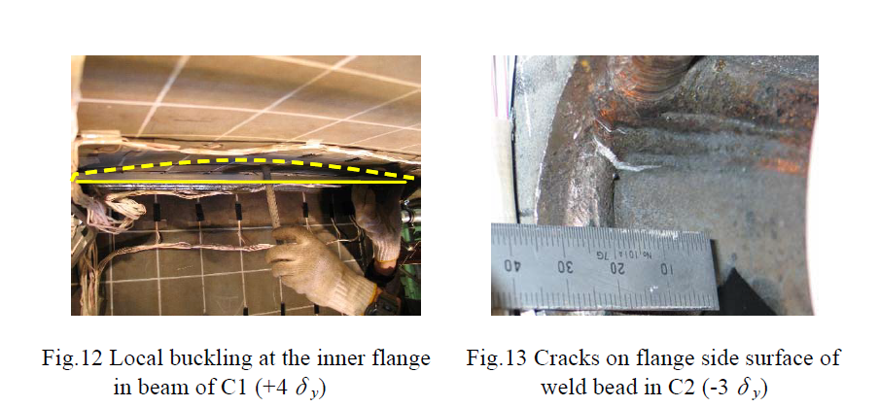

Slide 21
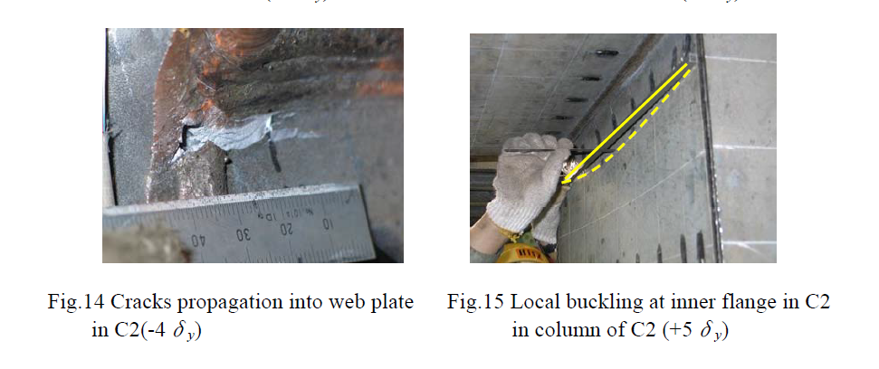

Slide 22
The cracks initially found in -3δy propagated to web plates in the loop of -4δy as shown in
Fig.14. In the loading path of +5δy , the local buckling occurred with large deformation at
the inner flange plates in the column as shown in Fig.15 and this bucking caused decline of
strength and appearance of Pmax as well as C1.

Slide 23
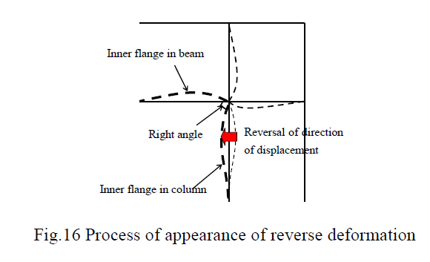
Therefore, if the buckling occurs with large deformation at the inner flange plates in the column or the beam, the large deformation of one member may cause deformation of another member in the reverse direction for keeping the right angle of the cruciform joint as shown in Fig.16.

Slide 24
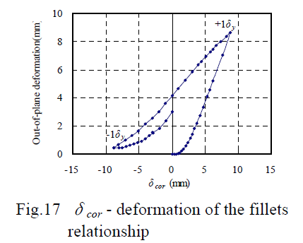
Fig.17 shows the relationship between δcor and out-of-plane deformation of the fillets in the loops of +1δy and -1δy at the point shown in Fig.18. In Fig.17, the positive values of the deformation mean the out-of-plane deformation occurred inside. Fig.17 indicates that the maximum value of the deformation in the loop of +1δy is about 9mm.

Slide 25
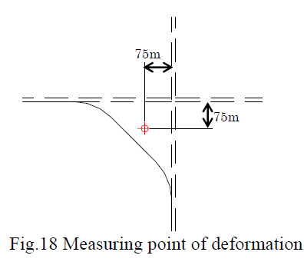
Fig.17 shows the relationship between δcor and out-of-plane deformation of the fillets in the loops of +1δy and -1δy at the point shown in Fig.18

Slide 26
Feature of stress distribution on inner flanges in elastic range:
Fig.19 and Fig.20 show the stress distribution on the outside surface of inner flange in the beam at 50 mm and at 280 mm from the cruciform joint respectively. The point at 280 mm from the cruciform joint corresponds to the edge of the fillets. The stress in Fig.17 and 18 was in the elastic range and the load corresponding to the stress in these figures was about 300kN in both C1 and C2.
Fig.19 demonstrates that stress of C1 is smaller than that of C2 and especially the high stress concentration at the corners of C1 is much smaller than that of C2 at 50mm from the cruciform joint.

Slide 27
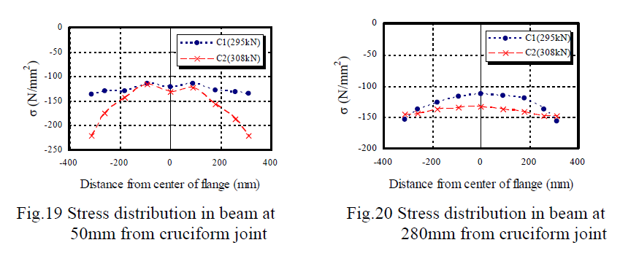

Slide 28
CONCLUSION
Cyclic loading experiments of beam-to-column connections of steel bridge frame piers were carried out in order to grasp of the elasto-plastic behavior of beam-to-column connections with fillets and the influence of fillets on it. Based on the experimental results, the following conclusion can be drawn.
1) Fillets dealt with in this paper have little effect on the overall load – displacement
relationship of beam-to-column connections before Pmax and on buckling behavior of the
inner flange plates of beam-to-column connections. However it is important to consider
the residual deformation of fillets.
2) Fillets can improve the low cycle fatigue performance of the cruciform joint.
3) Fillets can reduce the stress near the cruciform joint overall. Especially, they can decrease
stress concentration at the corners greatly. However fillets may increase the stress
concentration at the edge of fillets.

