Slide 1
Concrete Repair presented by:
Amirhossein Jodeiri
Mapua Institute Of Tecnology

Slide 2
Repair refers to modification of structure, damaged in its appearance or serviceability, to restore, partly or wholly, the pre-existing characteristics of serviceability, load-bearing capacity and if necessary, to improve its durability.
Concrete structures deteriorate due to a number of processes leading to cracking and spalling of the concrete.

Slide 3
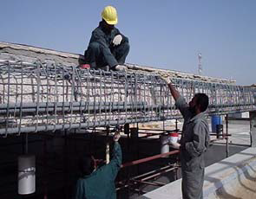
Repair of Beam damaged by corrosion of Reinforcement

Slide 4
Replacement may represent a programmed operation if referred to structural elements having a lower intrinsic longevity than the service life of the whole structure.
Repair techniques are used to restore the structural integrity and shape of a concrete element and generally include removal of damaged concrete and replacement of new concrete.

Slide 5
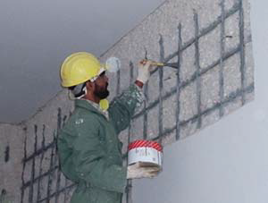
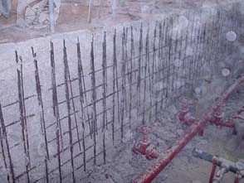
Patch Repair of Concrete wall damaged by corrosion
Water tank wall damaged by Corrosion

Slide 6
The planning, design, implementation and monitoring of a repair and/or strengthening project should basically be directed toward the following objectives:
1. Ascertaining the present state of the structure,
2. Establishing the repair and/or strengthening requirements,
3. Preparation of a repair program,
4. Determining the required target condition of the structure after repair and strengthening,
5. Re-checks and inspection controls.

Slide 7
Types of repairs:
• Structural Lifting and Supporting
• Shotcreting
• Repair of Structural Members Damaged by Corrosion
• Concrete Patch Repair
• Epoxy Injections for Structural Cracks
• Repair of Expansion Joints
• Repair of concrete water tanks and waterproofing

Slide 8
Structural Lifting and Supporting
Mechanical lifting of settled grade slabs or in some cases, even a part or whole of the main structure itself and supporting them in the lifted position by means of piles or pressure grouting.

Slide 9
Equipments for lifting:
1. A set of hydraulic jacks with pumps and
accessories.
2. Lifting frames and accessories.
3. Dywidag bars with anchoring systems.

Slide 10
Procedure:
1. Drill holes and construct the piles to suite the design load.
2. Support the lifting frames on the constructed piles using temporary stools.
3. Anchor the Dywidag bars to the slab to be lifted and connected the Dywidag bars to the lifting frame.
4. Lift the frame against the constructed piles by means of hydraulic jacks in between them.
5. The lifting of the frame will enable the slab also to be lifted, adjust the slab to the required level.
6. Remove the jacks and lifting frame one by one, by connecting the lifted slab to the pile permanently.

Slide 11
Advantages:
1. No excavation is required.
2. Grade slab's capacities are upgraded with
minimum disruption.
3. Disruption to floor finishes is minimal.
4. Fast operation when compared with all other
available methods.
5. Cost effective in saving the structure.

Slide 12
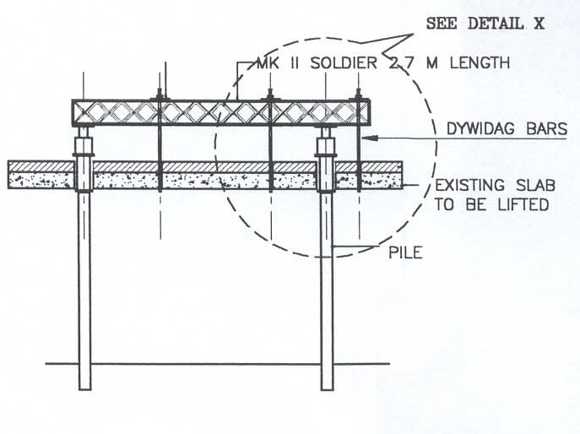
section of lifting frame & poles

Slide 13
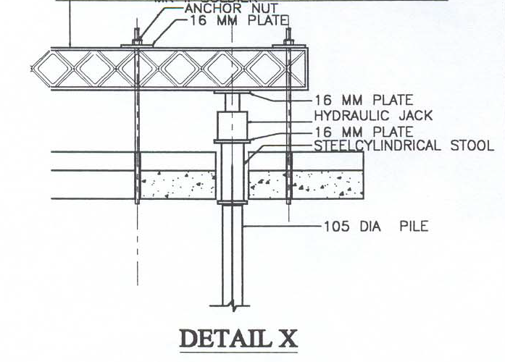

Slide 14
Shotcreting
The process of repairing the concrete affected by reinforcement corrosion or other deterioration and to strengthen any structural elements by a mixture of cement, aggregate and water, with or without admixtures, which are projected at high velocity from a nozzle in to place as a continuous stream without interruption. Compaction to produce a dense homogenous mass is achieved by the mixture's own velocity.

Slide 15
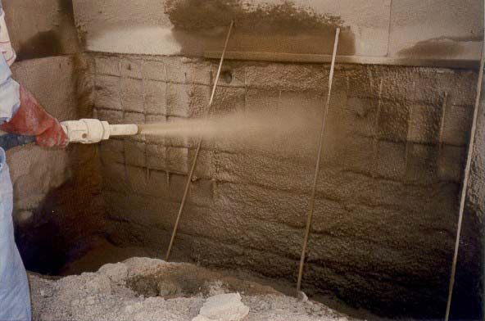
Reinstatement of corroded wall

Slide 16
Dry Process:
In this method, the cement and aggregate are batched and mixed without added water, and fed into the delivery gun. The machine feeds a continuous and even amount of mixed material under high air pressure into a high velocity stream of dry air in the flexible delivery hose. Water is introduced as a spray at a special nozzle at the discharge end.

Slide 17
Wet Process:
In this method, conventional concrete or grout pumping equipment is generally used. A suitable mix is pumped to the discharge nozzle along a flexible delivery hose. An additional air supply is introduced at the discharge nozzle, to speed up the flow and impart sufficient velocity so that the material is compacted on impact.

Slide 18
Fields of Application:
1. Repair of large areas of concrete deteriorated due to reinforcement corrosion or other reasons.
2. Strengthening of existing concrete columns, beams and slabs by increasing the concrete sectional area by the application of shotcreting and by increasing the steel.
3. Construction of structures with complex shapes, where the preparation of shuttering is difficult and complex.

Slide 19
Repair Methodology:
1. Remove all distressed concrete from the affected structural area and a minimum of 20 mm behind the steel reinforcement.
2. Sand blast substrate to remove loose concrete and to remove the corrosion in the steel.
3. Reinforcement which has lost more than 15% of its cross sectional area shall be supplemented with new reinforcement.
4. Protect the application area to avoid over spray
5. Apply the shotcrete, perpendicular to the substrate, ensuring full encapsulation of reinforcement and good bond with the substrate.
6. The shotcreted surface shall be left as-shot or can be formed to a sem-smooth surface, as per the requirement.

Slide 20
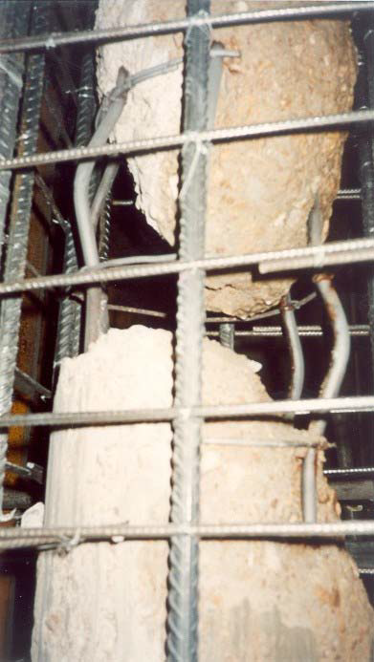
Defective column

Slide 21
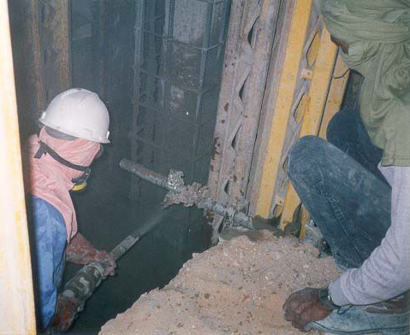
Reinstatement of Column

Slide 22
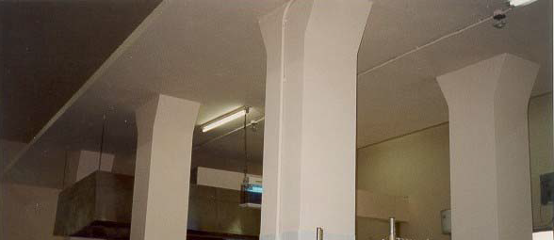
Reinstated columns

Slide 23
Shotcrete Mix
Most repair works use aggregate of less than 5mm maximum size and type I cement. The aggregate cement ratio for a dry process is generally 3.5 : 4.0 : 1 by weight. The water : cement ratio in dry process is low(typically 0.38 to 0.41) as not water is needed to achieve workability. The placed characteristics are good density, low permeability, high strength (typically 30 to 40 N/mm2) and good bond to suitable substrate.

