Slide 1
Foundation Failure

Slide 2
Foundation movement may result from a wide range of factors, which can include:
• Shrinking or swelling of clays caused by changes in moisture content Compression of a soft layer in the ground as a result of the applied foundation loads
• Soil softening
• Frost heave
• Improper back filling
• Variation in groundwater levels
• Erosion
• Vibration from nearby construction
• Hydrostatic Pressure

Slide 3
Lateral pressures on basement walls have four likely sources:
• Pressure from soil weight
• Pressure from soil swell
• Hydrostatic pressure
• Pressure from frost

Slide 4
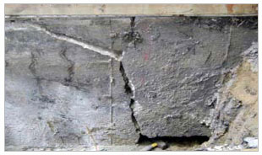
Cracking can also occur when lateral pressure exceeds the strength of the concrete or block wall. The most common crack pattern begins in the corners and move up or down at 45 degree angles in concrete walls. For block walls, the cracks move along the mortar joints in a stair step pattern. Often these cracks end at a long horizontal fracture that parallels the basement floor.

Slide 5
Understanding these foundation cracks is the first step to fixing your foundation. As the illustrations below show cracks come in many forms and have varying meanings.

Slide 6
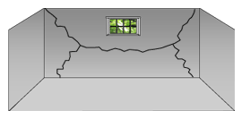
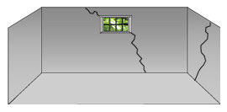
Angled and Horizontal
Vertical

Slide 7
Regardless of their construction, walls crack because they are overloaded or because the structure has settled or heaved. Vertical and angled cracks are usually caused by settlement or heaving. Horizontal cracks are more likely to be caused by lateral pressure.

Slide 8
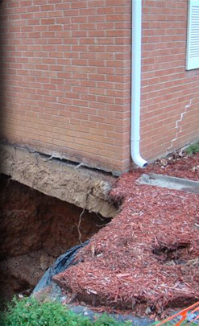

Slide 9
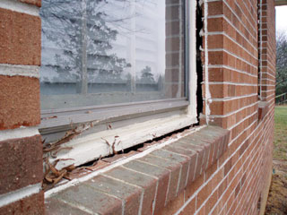
Foundation problems in a home such as a cracked slab or settling footings and walls can be a big problem and can leave a homeowner feeling unsure about how to get the problem fixed. If you’re experiencing bowing or leaning foundation walls, cracks in brick or masonry, or cracks in drywall, your home may need a foundation repair system that will restore property value and give you peace of mind.

Slide 10
solution
The Foundation Support works Push Pier System permanently stabilizes your home's foundation and offers the best opportunity to lift your home back to level without the expense and disruption of a full foundation replacement

Slide 11
Push Pier Advantages:
.Can be installed year-round
.Piers reach greater depth than other options
.Long life span – galvanized steel is resistant to corrosion
.Does not require the use of invasive equipment
In most cases can lift foundation back to level position
.Restores Property Value

Slide 12
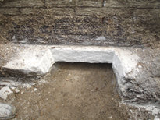
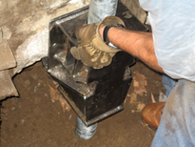
Push Pier Installation Steps:
Step 1: Footing is exposed and prepared for the bracket.
Step 2: Foundation Bracket is secured to the footing.

Slide 13
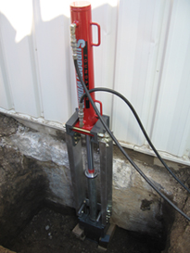
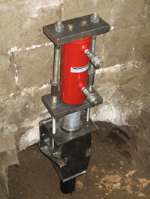
Step 3: Steel pier sections are hydraulically driven through the bracket to competent soil or bedrock.
Step 4: The weight of the home is transferred through the piers to load bearing strata. Home is lifted back to
level if possible.

Slide 14
Foundation Wall and Basement Wall
Cracked, bowed or leaning foundation walls, are signs that you may be in need a basement wall repair that will stabilize your basement wall and keep it from getting any worse.
The Foundation Suppor tworks Wall Anchor System permanently stabilizes basement and retaining walls and offers the best opportunity to straighten walls over time without the cost and disruption of foundation replacement.

Slide 15
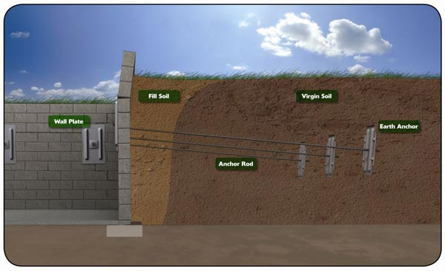

Slide 16
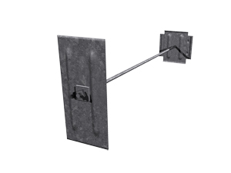

Slide 17
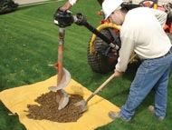
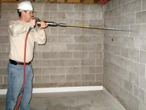
Wall Anchor Installation Steps:
Step 1: Sod is carefully removed and an earth anchor hole is augured.
Step 2: A small hole is drilled through the wall and a rod is driven out.

Slide 18
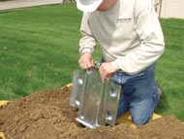
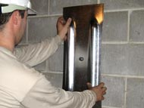
Step 3: An earth anchor is installed and attached to the rod.
Step 4: A wall plate is attached and tightened, seating the earth anchor.

Slide 19
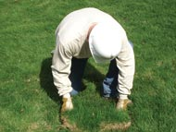
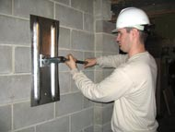
Step 6: Anchors can be tightened at intervals and straighten the wall over time.
Step 5: The hole is backfilled and the sod is replaced.

Slide 20
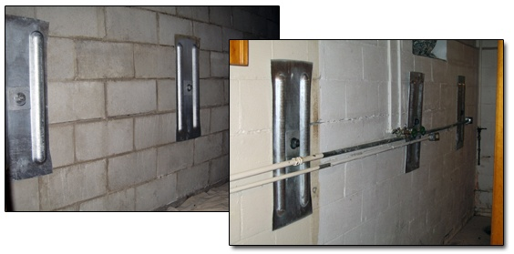

Slide 21
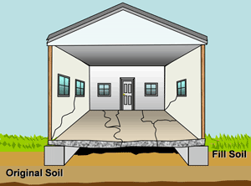
Causes Concrete Slab Settlement
Concrete floor slab settlement is often the result of changes in moisture content or density of the supporting soils. For example, soils beneath a concrete slab foundation can dry and shrink over time due to extended drought-like conditions, leaking HVAC systems, and other reasons. When this happens a void is created under the slab, causing the slab to sink and crack. Along with a settling slab, interior partition walls may settle and cracking in drywall can occur.

Slide 22
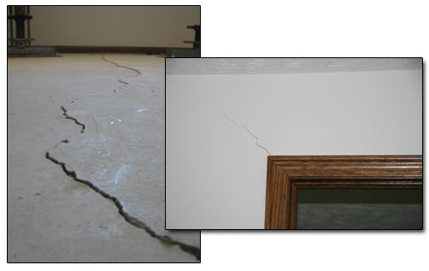
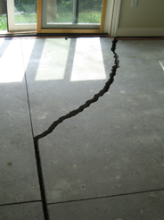
A settling concrete slab can cause major structural problems in a home. An individual may notice signs such as trip hazards, cracks in drywall, and doors that do not open and close properly, all of which indicate a slab settlement problem.

Slide 23
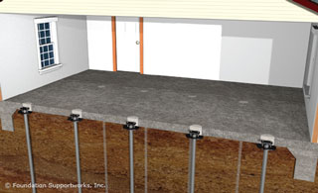

Slide 24
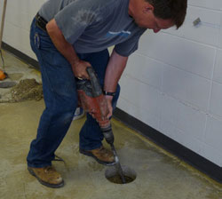
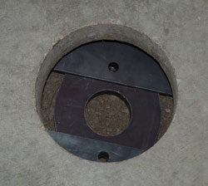
Slab Pier Installation Steps:
Step 1: A small hole is cored through the concrete floor.
Step 2: The slab bracket is positioned beneath the concrete slab.

Slide 25
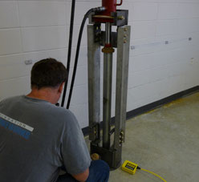
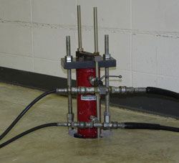
Step 3: Steel tubes are hydraulically driven down through the bracket to competent soil.
Step 4: The weight of the slab is transferred through the piers to load bearing strata. The slab is lifted back to level if possible.

Slide 26
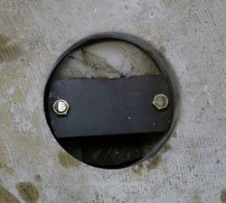
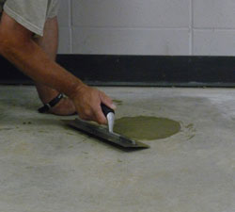
Step 5: Grout is carefully pumped under the slab to fill the void created by the settlement and slab lifting process.
Step 6: Concrete is placed within the cored hole.

