Slide 1

Mexican Society for Geotechnical Engineering
Sociedad Mexicana de Ingeniería Geotécnica, A. C.

Slide 2
Mexico:
“Paradise of Soil Mechanics”
Karl Terzaghi

Slide 3
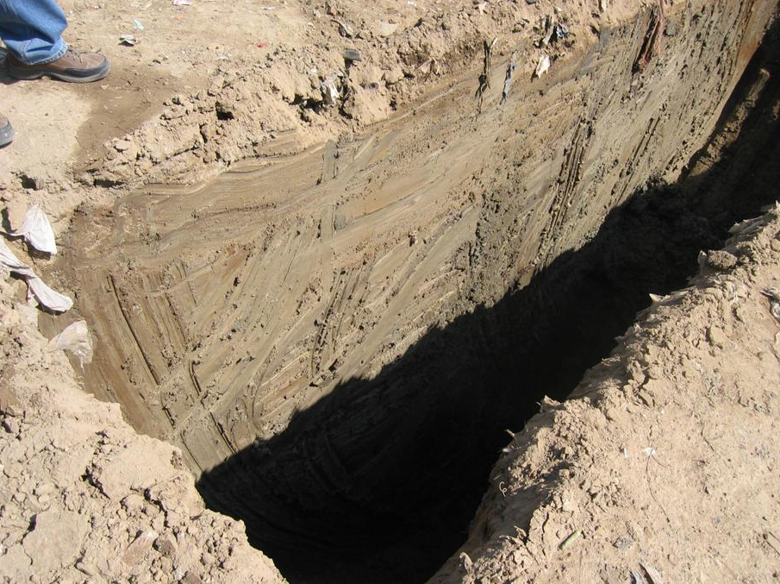
Mexico City clay
Notes:
Open pit 4.6 m deep. Pozo a cielo abierto de 4.6m de profundidad

Slide 4
Typical properties of Mexico City clay
Property | Value
Void ratio (e) | 5−10
Porosity (n) | 0.83−0.90
Water content (w) | 220−420%
Liquid limit (w_{L}) | 110−458%
Plastic limit (w_{P}) | 37−116%
Plastic index (I_{P}) | 73−342%
Permeability (k) | 1×10⁻⁷cm/s
Compressibility index C_{c} | 3−8
Undrained modulus E | 4000−7000 kPa
Undrained shear strength c_{u} | 15−35 kPa
Sensitivity | 8
Internal friction angle | 34−41 degrees
Shear wave velocity | < 100 m/s
Mexico City lacustrine clays unusual properties have been a matter of curiosity
and a subject of research for many outstanding geotechnical engineers

Slide 5
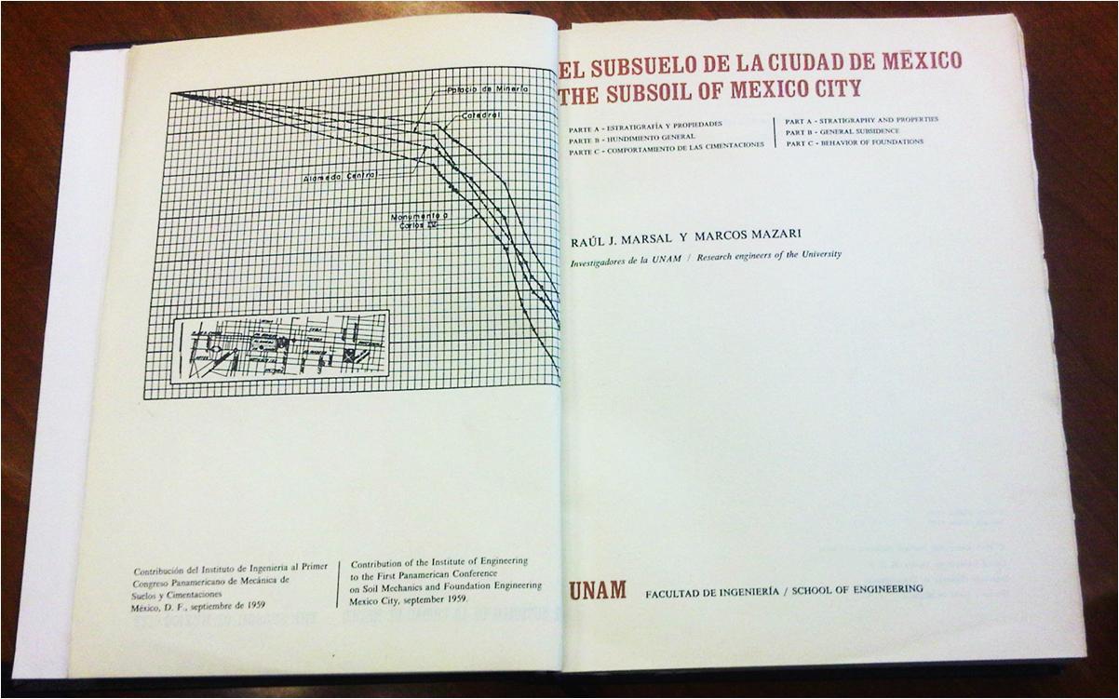
A. Casagrande referred to the famous book by R.J. Marsal and M. Mazari as “the bible”

Slide 6
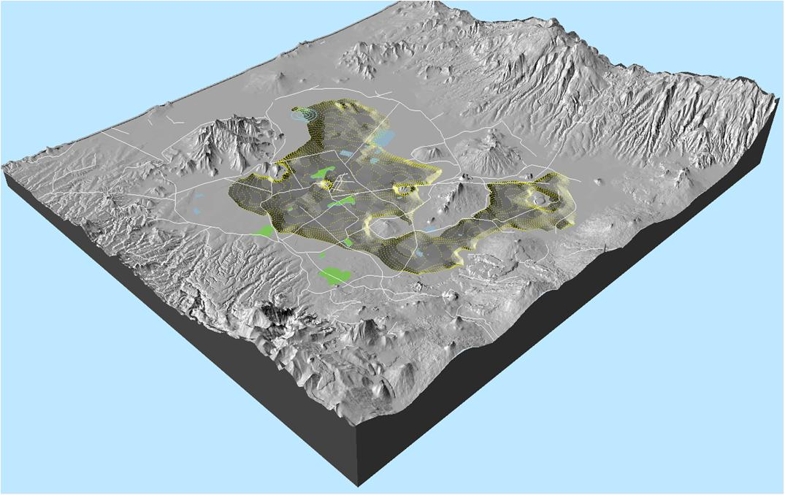
Subsidence of Mexico City
Mexico City lacustrine zone presents a regional subsidence
that has reached 13.5m in some areas (1862-2013)

Slide 7
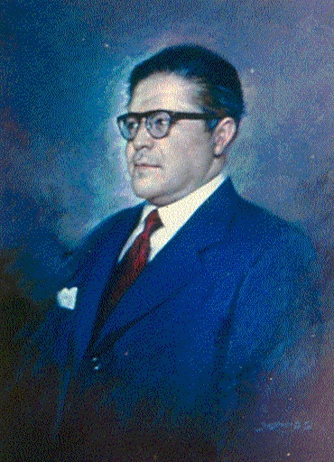
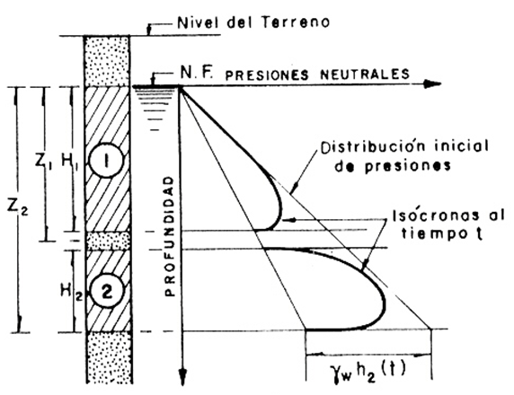
Regional subsidence
Dr. Nabor Carrillo
Dr. Nabor Carrillo provided a scientific explanation of Mexico
City subsidence in 1948
Carrillo, N. 1948. “Influence of Artesian Wells on the Sinking of Mexico City”, Proc. Second International
Conference on Soil Mechanics and Foundation Engineering, Rotterdam, Nederland.

Slide 8
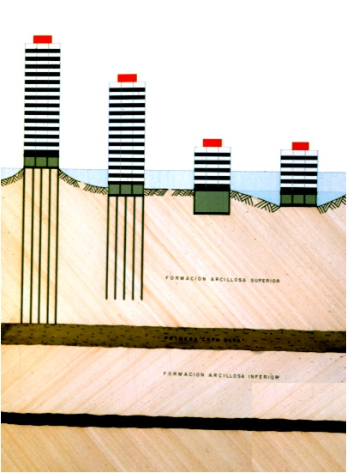
Behavior of foundations in Lake zone
Upper clay formation
Lower clay formation
Special foundations systems are used in Mexico City to avoid excessive settlement of surface foundations or apparent protruding of point bearing foundations

Slide 9
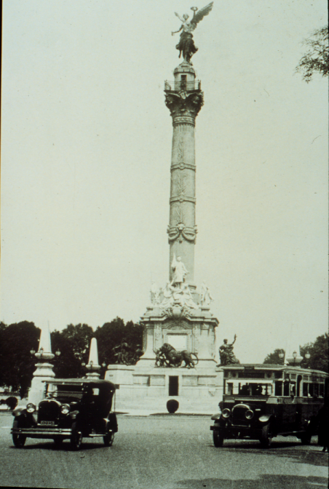
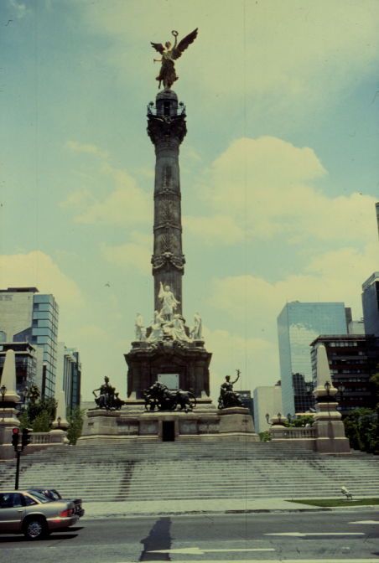
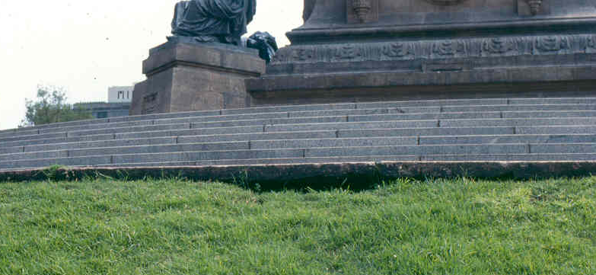
1911
2010
Δh
Apparent protruding of
point-bearing piled foundations

Slide 10
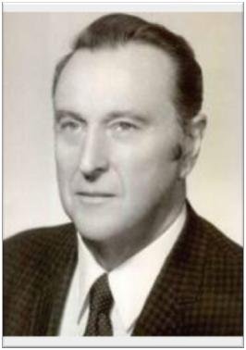
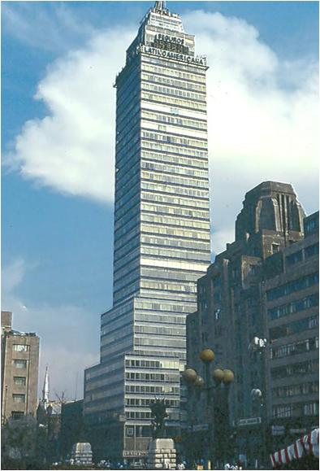
Leonardo Zeevaert introduced innovative design methods for compensated foundation, piled raft foundations and compensated-friction pile foundations
Dr. Leonardo Zeevaert Wiechers
“Compensated Friction-Pile Foundation to Reduce the Settlement of the Highly Compressible Volcanic Clay of Mexico City”, Proceedings Fourth International Conference on Soil Mechanics and Foundation Engineering, Vol. II, pp. 81-86, London, England, August.

Slide 11
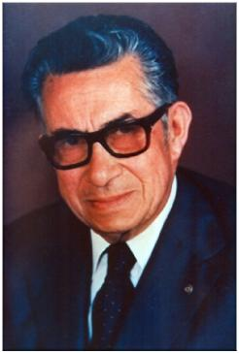
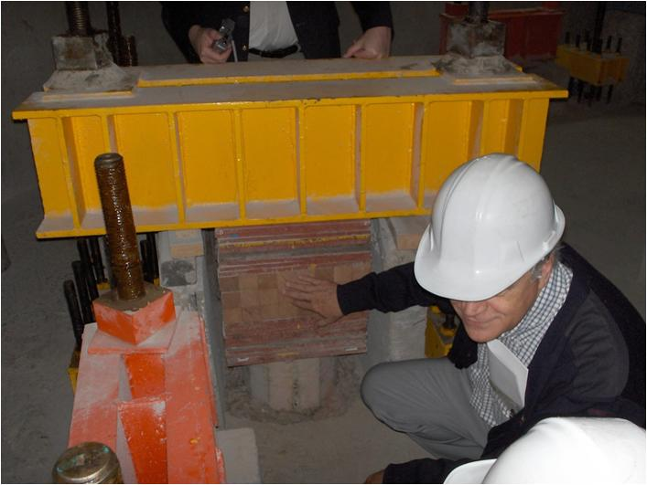
Control piles
Manuel González Flores
Manuel González Flores introduced “Control piles” equipped with a mechanical system for controlling loading on individual piles and foundation differential settlements
González Flores, M., 1948, “Level control in buildings by means of adjustable piling”,
Proceedings, Second International Conference on Soil Mechanics and Foundation Engineering,
Rotterdam, Vol. IV, p. 152

Slide 12
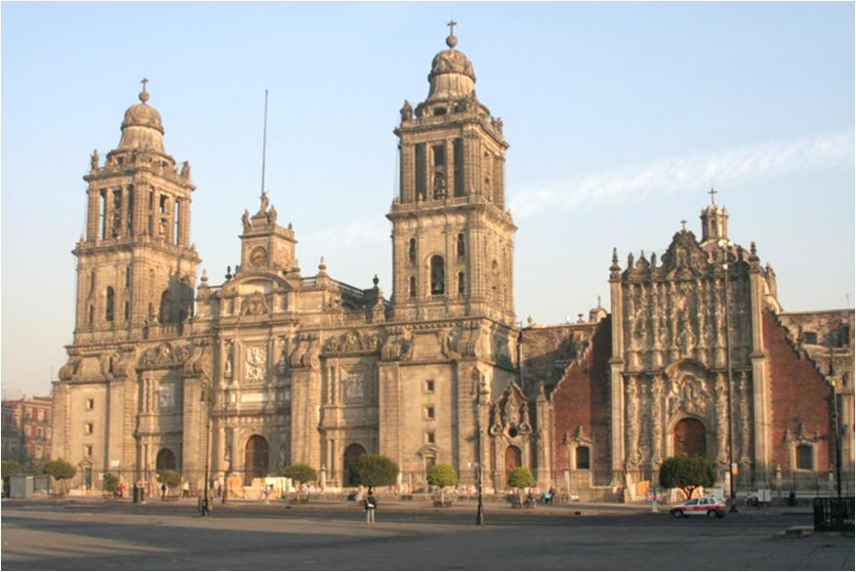
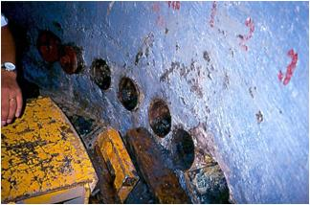
Metropolitan Cathedral
Geotechnical team:
Enrique Tamez
Enrique Santoyo
Efraín Ovando
During the 1990-2000 period, the large differential settlements of the Metropolitan Cathedral of Mexico City were corrected by a team of Mexican Engineers by the sub-excavation technique, a procedure that was subsequently adopted also for the Pisa Tower…

Slide 13
ACC [cm/s²]
200
100
CU EW COMP.
0
-100
.
-200

Slide 14
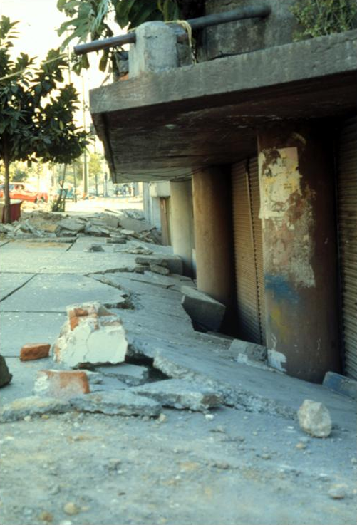
Some foundations suffered severe damage
during the 1985 earthquake
Romo, M.P. and Auvinet, G., 1992, “Seismic behavior of foundations on cohesive soft soils”, in “Recent Advances in Earthquake Engineering and Structural Dynamics”, edited by V. Davidovici, Ouest Editions, pp. 311-328, Paris, France.
Auvinet, G., Pecker, A. & Salencon, J., 1996, “Seismic bearing capacity of shallow foundations in Mexico City during the 1985 Michoacan Earthquake”, Proceedings, Eleventh World Conference on Earthquake Engineering, (CDROM), Acapulco, Mexico, July.

Slide 15
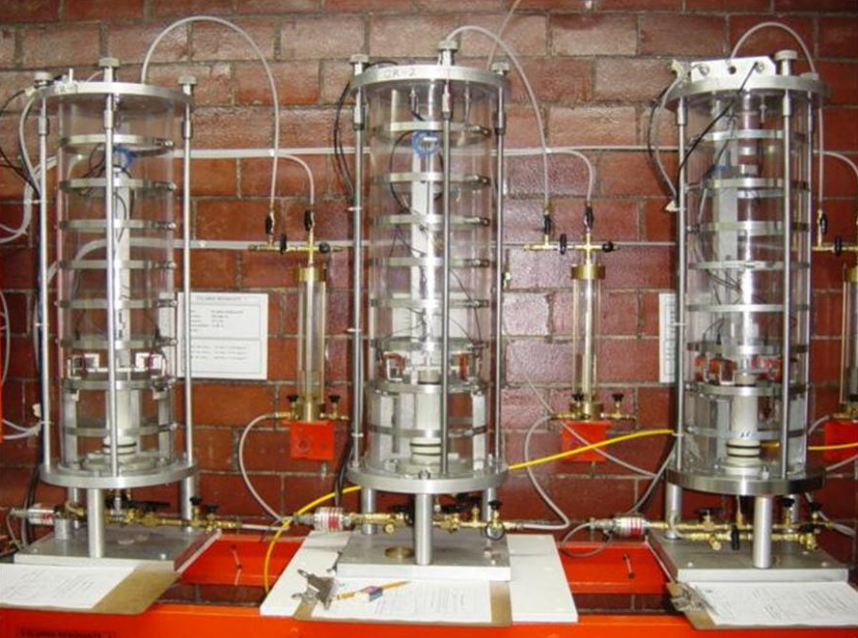
Resonant column
A thorough experimental and theoretical research program
was developed following 1985 earthquake

Slide 16
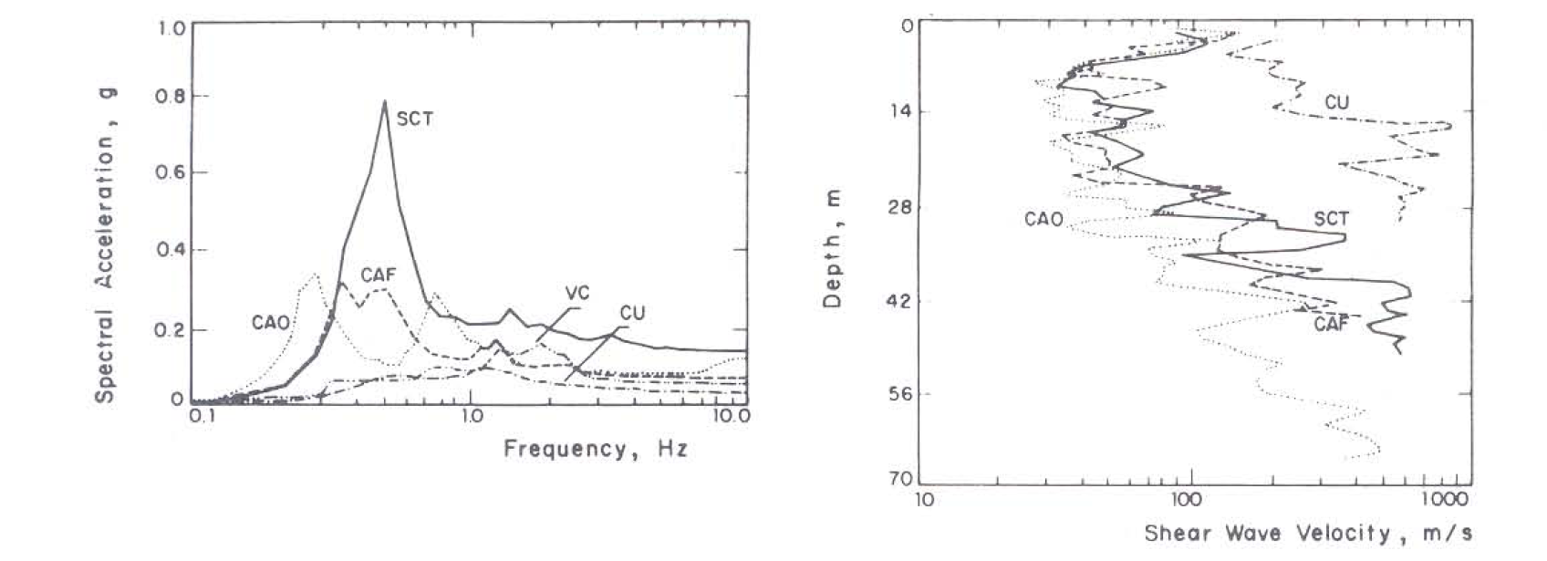
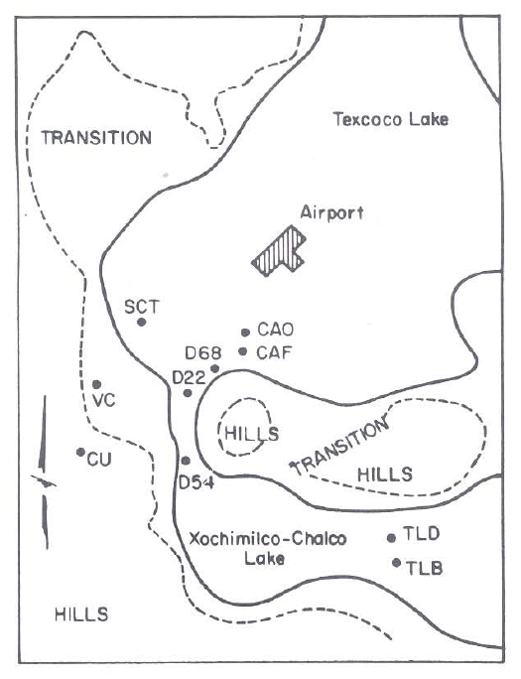
Computed response spectra, Mexico City
Romo, M.P. and Seed, H. B. (1986). “Analytical modelling of dynamic soil response in the Mexico earthquake of September 19, 1985”, Proc. ASCE Specialty Conf. on the Mexico Earthquakes-1985, Factors Involved and Lessons Learned. Mexico, September.

Slide 17
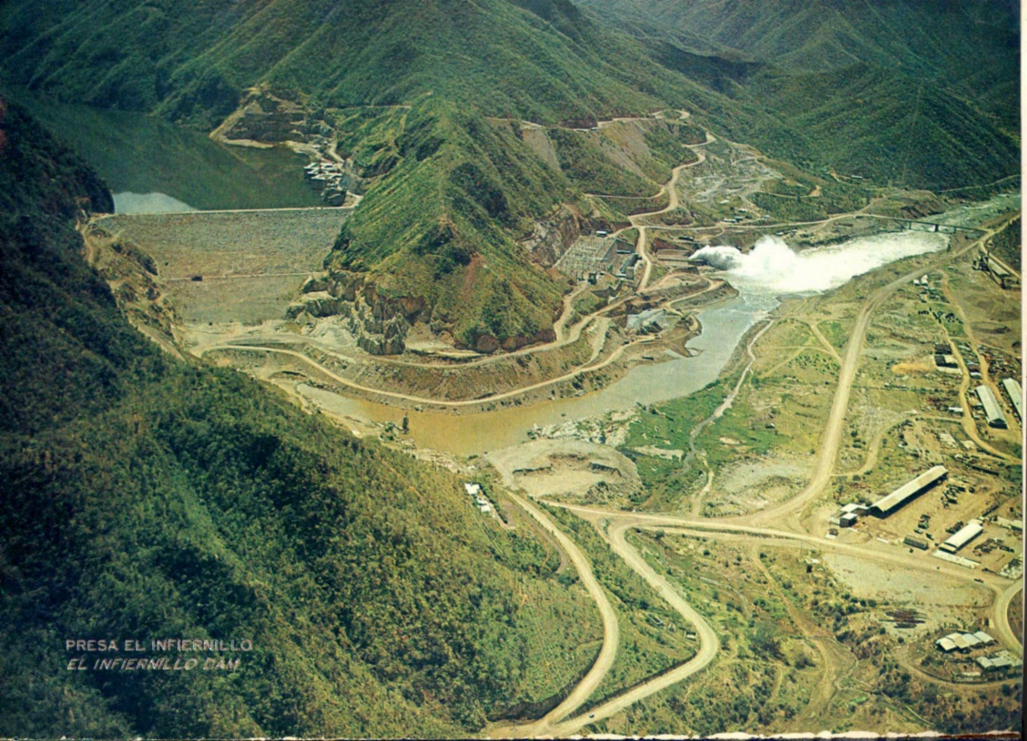
Earth and Rockfill dams in Mexico
“El Infiernillo” Dam

Slide 18
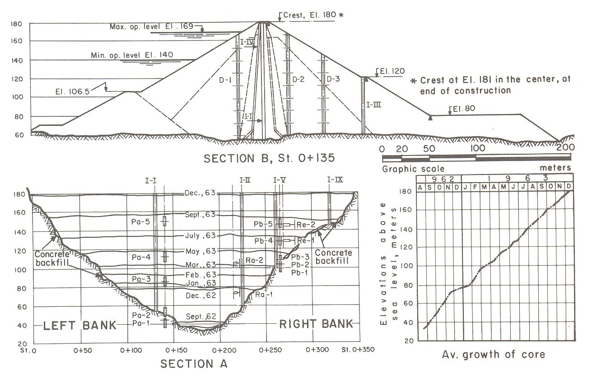
“El Infiernillo” Dam was the first structure of this type to be thoroughly instrumented

Slide 19
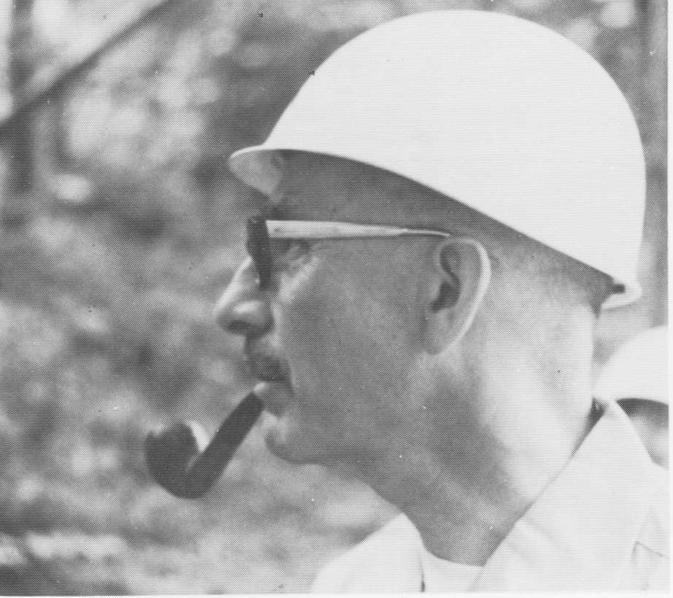
Prof. Raúl J. Marsal
Raúl J. Marsal is considered as one of the most important scientists and engineers
behind modern design of earth and rockfill dams
Marsal, R.J. and Ramírez de Arellano, L., 1967, “Performance of El Infiernillo Dam,
1963-1966”, Journal of the Soil Mechanics and Foundations Division, ASCE, July.

Slide 20
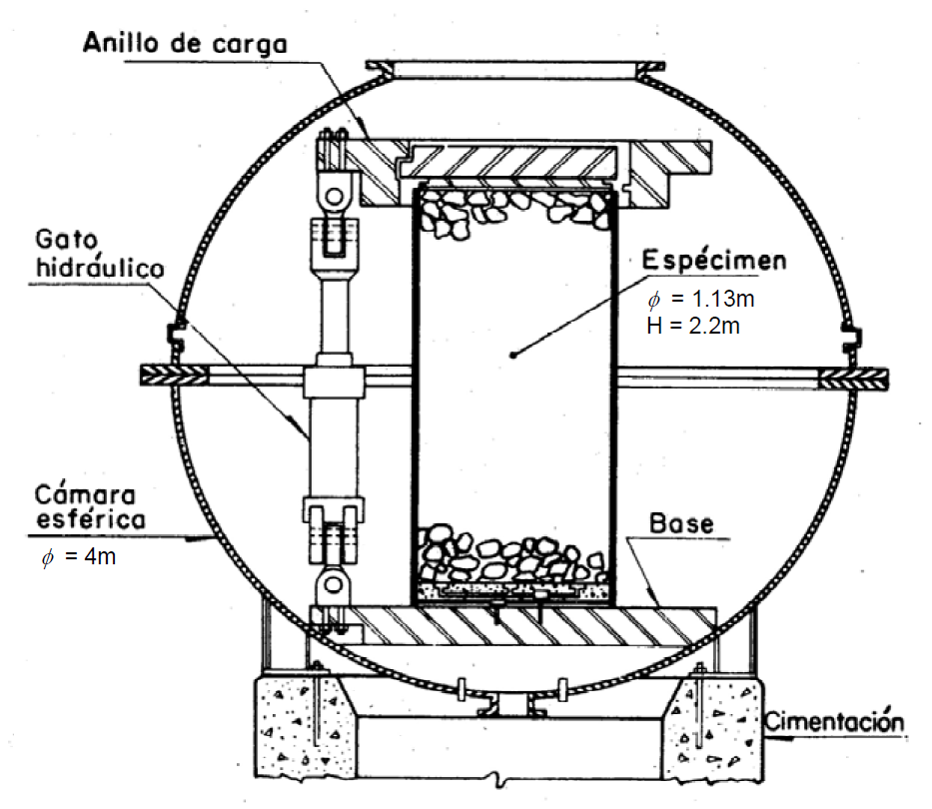
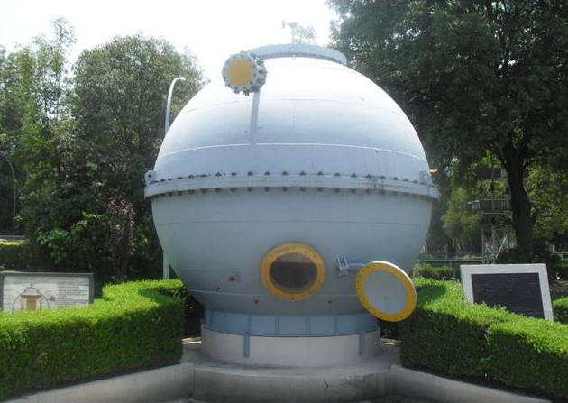
The largest triaxial cell in the world (T113-25) was built by Marsal in Mexico for Rockfill testing
Marsal, R.J., 1963, “Triaxial apparatus for testing rockfill samples”, Proceedings,
IInd Pan-American Conference on Soil Mechanics and Foundation Engineering, Brazil.

Slide 21
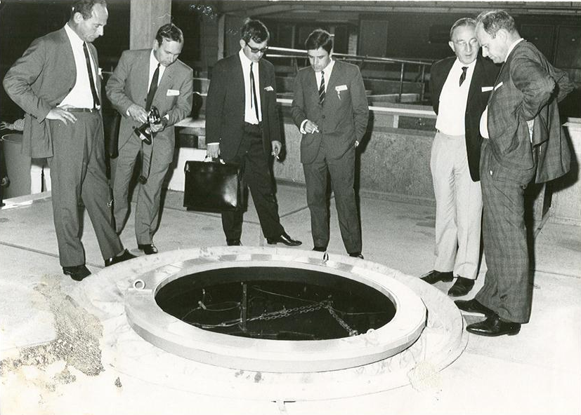
Triaxial cell T113-25 was the star of the 1969 ICSMFE
(fourth from left: G. Auvinet, Institute of Engineering UNAM)

Slide 22
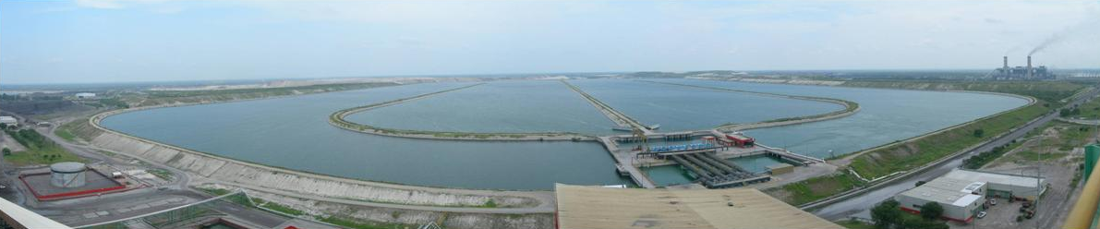
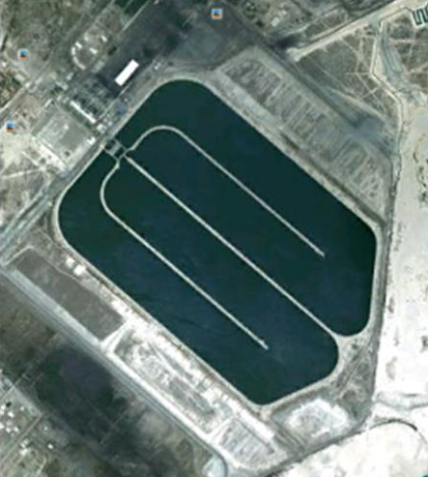
Artificial Impoundment
The 300-hectare, 6m deep, cooling pond
of the Río Escondido Power Plant in Northern Mexico has behaved satisfactorily without any detectable leakage for more than thirty years thanks to a specially designed clay liner
Auvinet, G. & Espinosa, 1979, "Impermeabilization of a 300-hectare cooling pond", ASTM Special Technical Publication N⁰ 746, “Permeability and Groundwater Contaminant Transport” pp. 151-167, USA.

Slide 23
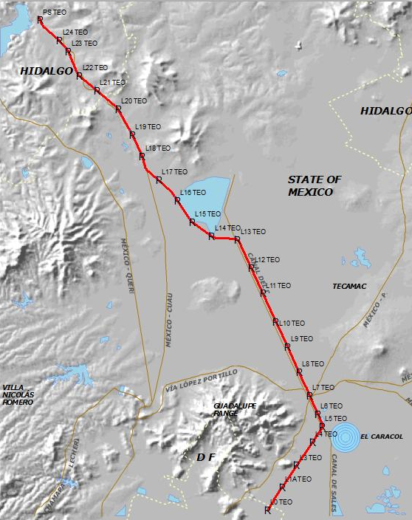
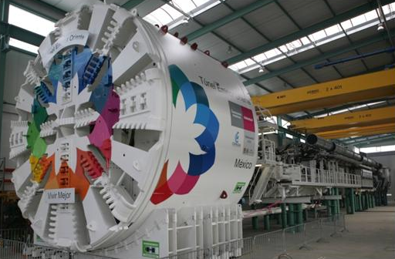
“Emisor Oriente” tunnel
Total length = 62 km
Diameter = 7 m
24 tunnel shafts (from 20 to 155 m deep)
Geotechnical team:
M. Aguilar
G. Auvinet
D. Reséndiz
J.L. Rangel
J.F. Rodríguez
“Emisor Oriente” tunnel, one of the largest tunnel in the world, is now under construction in Mexico valley in challenging geotechnical conditions

Slide 24
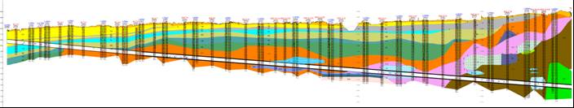
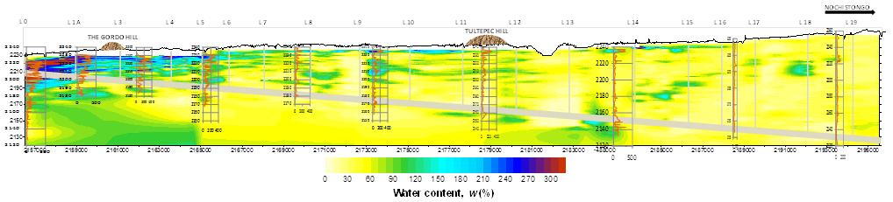
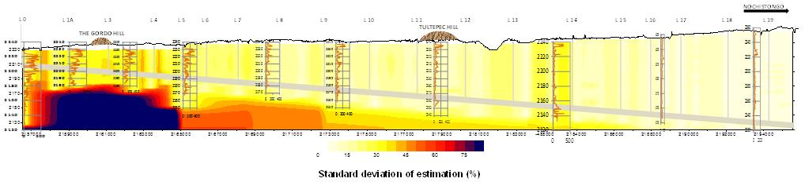
Geostatistical model
a) Traditional cross section (CFE, 2009)
b) Estimated cross section of water content (virtual)
c) Standard deviation of estimation
Auvinet, G. & Juárez, M., 2012, “Geotechnical Characterization of subsoil along Emisor Oriente Tunnel in Mexico City”, Proceedings, International Conference on Soil Characterization, ICS’4, Porto de Galinhas, Pernambuco, Brazil, Vol. 1 pp. 1273-1281, ISBN 978-0-415-66069-3.

Slide 25
“ISSMGE has not yet had a President from Mexico, from which a great deal of the classical work in our subject developed”
Harry Poulos
(26/11/2012)

Slide 26
The Mexican Society for Geotechnical Engineering together with ISSMGE Member Societies from:
Argentina
Canada
Chile
China
Colombia
Dominican Republic
El Salvador
Venezuela
support the candidacy of Professor Gabriel Auvinet to the position of ISSMGE President for the 2013-2017 period.
Encouragement messages have been received from many members societies and distinguished personalities from Africa, Asia, Australasia, Europe, North America and South America.

Slide 27
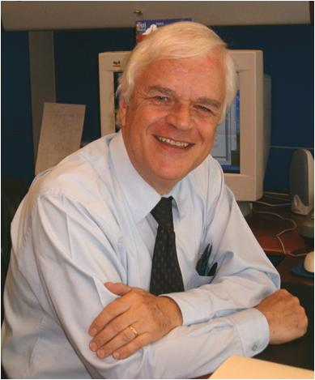
Professor Gabriel AUVINET
President of ISSMGE Candidate
Geocomputing Laboratory, Institute of Engineering
Torre de Ingeniería, 2nd floor, Circuito Escolar,
Ciudad Universitaria, Mexico, D.F.
e-mail: gauvinetg@iingen.unam.mx
Office phone: +52(55)56233600, ext 8324, Mobile: +52(55)54122915

