Slide 1
Soil Classification – Part 1
Sieve Analysis
Pre-laboratory
Interaction Learning Module
Notes:
In this practical, we will examine sieve analysis and the consequent grading distribution of soils.

Slide 2
Learning Objectives
At the completion of the laboratory class, you will be able to:
  State the objective of undertaking sieve analysis;
  Describe the laboratory procedures;
  Identify the key differences between fine-grained and coarse-grained soils;
  Select suitable testing for fine- and coarse-grained soil; and
  Calculate and interpret the grading curve - percentage passing (and percentage retained) versus particle diameter.
Notes:
At the completion of the laboratory class, you will be able to: explain the objective of undertaking sieve analysis; describe the laboratory procedures; identify the key differences between fine-grained and coarse-grained soils; select suitable testing for fine- and coarse-grained soil; and finally, calculate and interpret the grading curve that is the percentage passing (and percentage retained) versus the diameters of the soil particles.

Slide 3
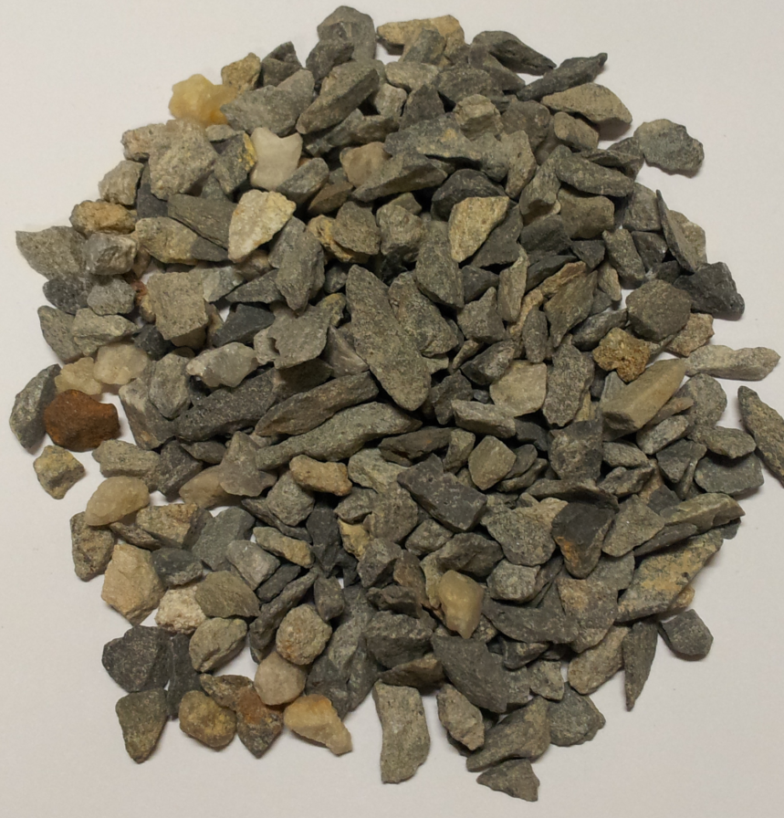
Soil as a 3 Phase System
A soil mass is generally a 3 phase system that consists of solid particles, liquid (e.g. water) and gas (e.g. air).
The solid phase is composed
of a collection of mineral and
rock particles.
Notes:
A naturally-occurring soil is generally a three phase system that consists of solid particles, liquid (usually water) and gas (usually air). Sometimes in contaminated soils the liquid and gas phases include pollutants, such as petrol and methane.
The solid phase of the soil mass is composed of a collection of mineral and rock particles.

Slide 4
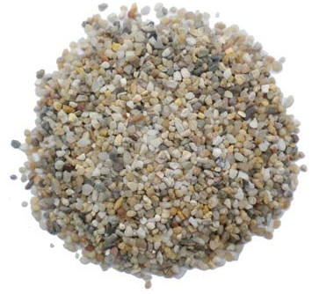
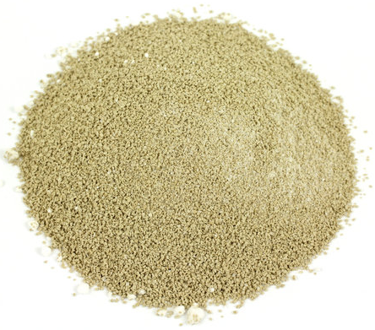
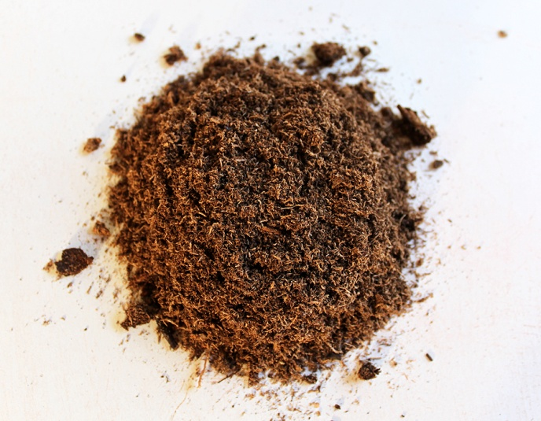
Introduction
The size, shape and relative density of these solid particles, as well as the range and the distribution of those sizes can affect the behaviour and texture of soil.
Soils are subdivided into
three major categories:
  Coarse-grained soils;
  Fine-grained soils; and
  Peat.
Notes:
The size, shape and relative density of these solid particles, as well as the range and the distribution of those sizes, can affect the geotechnical characteristics of soils.
Geotechnical engineers classify soils according to their properties. One of the major factors that affects the behaviour of soils is the size of the solid particles or grains.
The soils are subdivided into three major categories: coarse-grained soils, which are composed of sands and gravel, fine-grained soils which include clays and silts, and finally, highly organic soil known as peat.

Slide 5
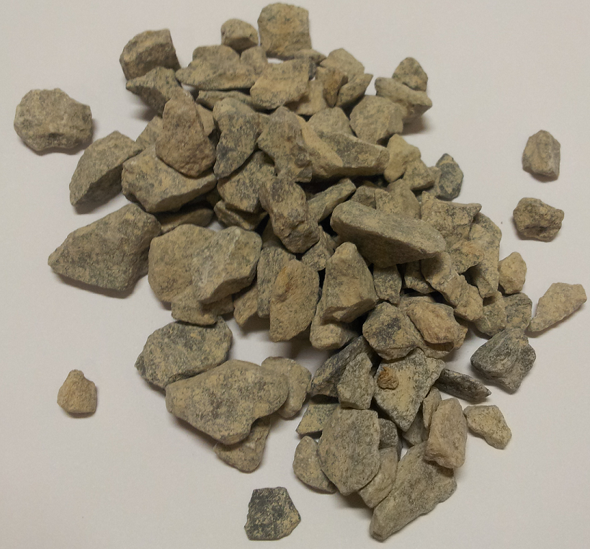
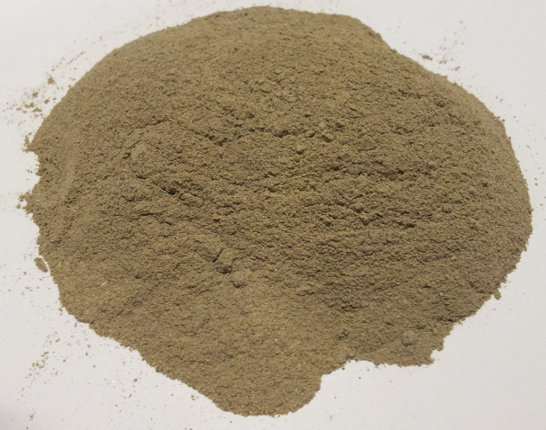
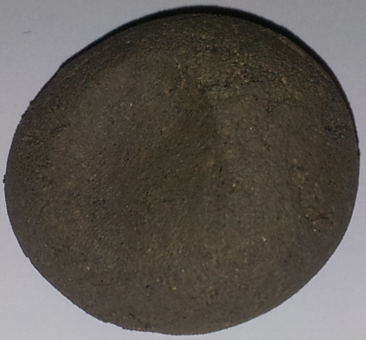
Fine- and Coarse-Grained Soils
The geotechnical characteristics of coarse-grained soils are governed the size, shape, distribution and relative density of the solid particles.
For fine-grained soils, the presence of water and the soil structure have a greater effect on their behaviour.
Notes:
The behaviour of coarse-grained and fine-grained soils is different. The geotechnical characteristics of coarse-grained soils are generally governed the size, shape, distribution and relative density of the solid particles.
On the other hand, for fine-grained soils, the presence of water and the soil structure have a greater effect on their behaviour. The structure or fabric of the soil is the arrangement and bonding between the particles.

Slide 6
Characterisation
In order to characterise:
  Coarse-grained soils, such as gravel and sand, sieve analysis is used by geotechnical engineers; and
  Fine-grained soils, such as silt and clay, Atterberg limits are employed.
Notes:
Different tests are employed to characterise coarse- and fine-grained soils.
For coarse-grained soils, sieve analysis is used by engineers to classify soil. In this interactive learning module, we will explain and demonstrate how coarse-grained soils are classified using sieve analyses.
Whereas, for fine-grained soils, tests that determine the Atterberg limits are undertaken. The details of these tests will be presented in Part two of this series.

Slide 7
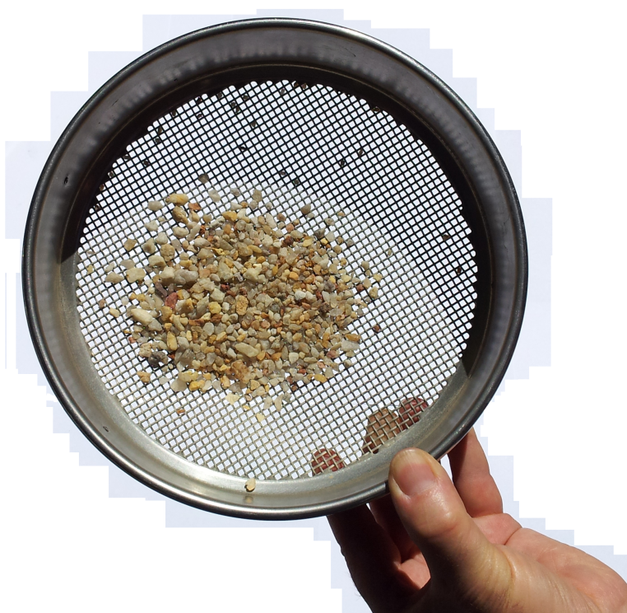
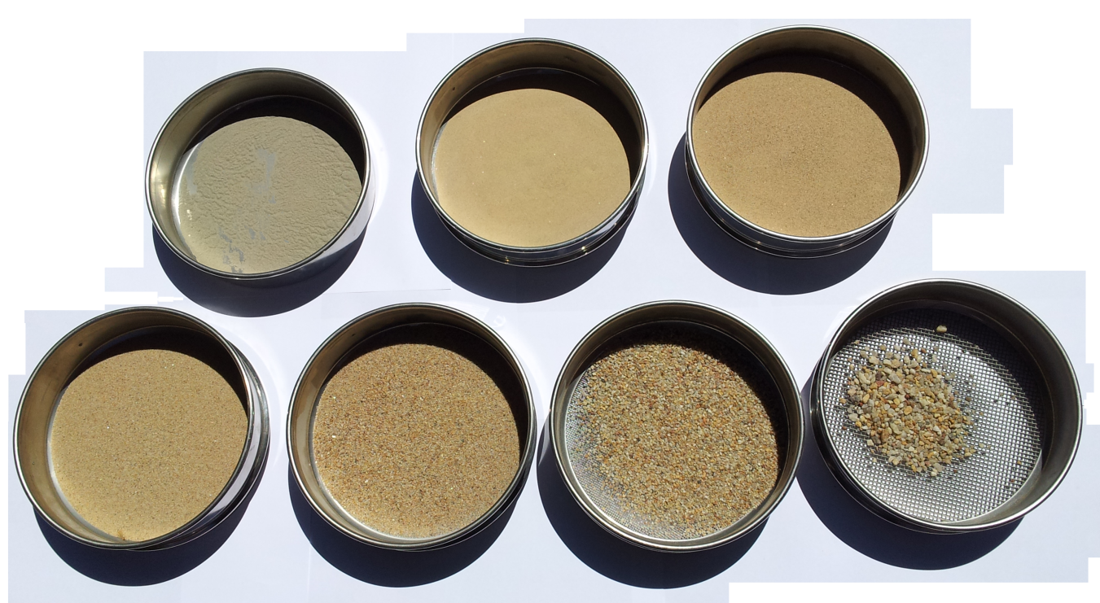
Objective
To determine the grading or grain size distribution:
  For coarse-grained soils – Sieve analysis
  For fine-grained soil – Hydrometer
Notes:
By now you will have been introduced to the concept of sieve analysis in lectures and you probably will have seen various sieve sizes.
The sieves are arranged in a stack, with the coarsest sieve, that is the one with the largest opening, at the top. The sieves become progressively finer from the top to the bottom of the stack. At the very base of the sieve stack is a pan, which captures all of the soil particles which pass through the finest and, hence, bottom sieve.
To facilitate the sorting process of the particles passing through the various sieves, a sieve shaker is often used, as will be seen later.

Slide 8
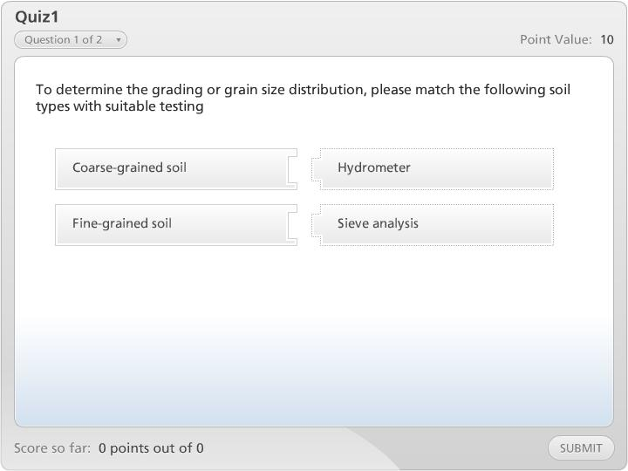


Quiz1

Slide 9
Grain Size
Name | Sub-Division | Size mm |  |  | AS Sieve
Clay Size
Silt Size | Fine
 | Medium
 | Coarse
Sand | Fine
 | Medium
 | Coarse
Gravel | Fine
 | Medium
 | Coarse
Cobbles | -
Boulders | -
2 μm
Fine-Grained Soils
6 μm
20 μm
60 μm
75 μm
200 μm
150 μm
600 μm
600 μm
Coarse-Grained Soils
2.0 mm
2.36 mm
6.0 mm
6.7 mm
20 mm
19 mm
60 mm
63 mm
200 mm
200 mm
Notes:
The size of the solid particles that constitute soils may vary from boulder or cobble size, that is measured in hundreds of millimetres, down to clay particles which are measured in thousandths of millimetres.
This table shows the classification names given to various soil particles dependent on their size. Soil particles that are larger than 75 microns (or millionths of metres), that can usually be seen by the naked eye, are classified as coarse-grained soils. Any particles that are smaller than 75 microns are classified as fine-grained soils.

Slide 10
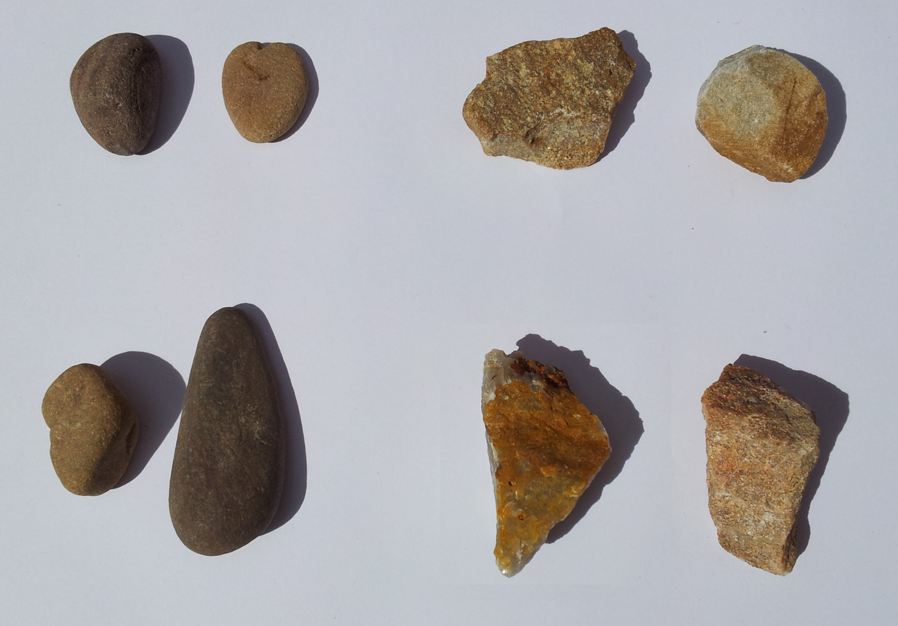
Grain Shape
Rounded
Subangular
Subrounded
Angular
Notes:
As previously mentioned, the particle shape influences the behaviour of coarse-grained soils.
This figure shows the four grain shape classifications commonly used in geotechnical engineering based on their roundness or angularity.

Slide 11
Grain Size Distribution
Sedimentation Analysis
Sieve Analysis
Well Graded Soil
Gap Graded Soil
Uniform Soil
Notes:
The grain size distribution is represented on a semi-logarithmic plot of percentage passing versus particle size. For example, 60% passing a 3 mm aperture size suggests that, by weight, 60% of the soil is smaller than 3 mm in particle size or diameter.
A uniform soil has a steep gradation and is one where only a small range of grain sizes are present within the soil.
A well-graded soil has a relative flat gradation curve and is one where a wide range of particle sizes are present.
Whereas, a gap-graded soil has a grading curve with one or more steps, which indicates that one or more grain sizes are absent from the soil mass. Both the uniform and gap-graded distributions are examples of poorly graded soils.
Two coefficients, namely the coefficient of uniformity and the coefficient of curvature, are used to quantify the particle size distribution.

Slide 12
Testing
Notes:
Initially, the stack is assembled, first with the pan and then the finest sieve at the bottom, with progressively coarser sieves as we work upwards through the stack.
Then, the scales are zeroed. Each empty sieve is weighed in turn and its weight recorded.
The total weight of the soil is then measured and then the soil is carefully tipped into the uppermost sieve. It is important to take care with this, as any lost soil will compromise the accuracy of the test.
The lid is then placed on top of the sieve stack.
The empty tray is weighed and recorded.
The sieve stack is then placed into the sieve shaker and the device is activated.
After a few minutes the sieve shaker is turned off and the sieve stack is removed from the device.
The sieve stack is progressively disassembled. Each sieve with retained soil is then progressively weighed.
The sum of the retained weights on each sieve, including the pan, should equal the total soil weight measured earlier.

Slide 13
Example of Test Results
Soil + Tray (g): 5625.2
Empty Tray (g): 460.28
Soil (g): 5164.9
Aperture Size (mm) | Mass of Sieve m_{sieve} (g) | Mass of Sieve + Soil m_{i} (g) | Mass of Retained (g) | Percentage Retained (%) | Percentage Passing (%)
13 | 403.9 | 476.7 | 72.8 | 1.4 | 98.6
9.5 | 419.1 | 548.6 | 129.5 | 2.5 | 96.1
6.7 | 448.6 | 609.2 | 160.6 | 3.1 | 93.0
4.8 | 404.0 | 602.8 | 198.8 | 3.8 | 89.1
2.4 | 390.7 | 1172.5 | 781.8 | 15.1 | 74.0
1.2 | 409.2 | 2623.8 | 2214.6 | 42.9 | 31.1
0.6 | 424.4 | 1013.5 | 589.1 | 11.4 | 19.7
0.4 | 408.2 | 638.0 | 229.7 | 4.4 | 15.3
etc …
Notes:
The test results are usually presented in tabular form and an example is given here. The total mass of the dry sample is first recorded and calculated. In the first and second columns, the aperture sizes and the mass of the sieves are recorded at the beginning of the test and the mass of sieve and soil are recorded in the third columns at the end of the test. The mass of retained soil, percentage retained and percentage passing each sieved are then calculated and presented in 4th, 5th and 6th columns, respectively.

Slide 14
Calculations
The percentage retained on each sieve, i, is calculated by using the following relationship:
Calculate the cumulative percentage passing each sieve:
Notes:
The percentage retained on each sieve, i, is equal to the difference between the mass of the sieve and the soil, m_{i}, and mass of the sieve itself, m_{sieve}, divided by the total weight of the sample and expressed as a percentage.
The percentage passing each sieve is the difference between the cumulative percentage retained and 100%.

Slide 15
Grading Curve
Notes:
Once, the mass of each portion of soil retained on each sieve is measured, it is then possible to determine the percent passing through each sieve. The process for doing so is very straightforward and is given in the lecture, as well as in the practical notes. A grain size distribution is then obtained, as shown here.

Slide 16
Coefficient of Uniformity
    where D₆₀ is the grain diameter (in mm) corresponding to 60% passing by weight, and D₁₀ to 10% passing.
  C_{u} is a measure of the uniformity of a soil.
  If C_{u} = 1 then the soil has only one grain size.
  If C_{u} ≥ 15 the soil is very well-graded.
Notes:
As mentioned earlier, various coefficients have been established as an aid in the quantification of the grain size distribution.
The coefficient of uniformity, C_{u}, measures the uniformity of the soil.
If C_{u} = 1 then the soil has only one grain size. If C_{u} >= 15 the soil is very well-graded.

Slide 17
Coefficient of Curvature
    where D₃₀ is the grain diameter (in mm) corresponding to 30% passing by weight, D₆₀ to 60% passing and D₁₀ to 10% passing.
  If C_{c} is between 1 and 3 then the soil is considered to be well-graded provided that C_{u} > 4 for gravels and
  C_{u} > 6 for sands.
  Note that these coefficients are to be used only as guides as they do not yield correct results for all soil types.
Notes:
The coefficient of curvature, C_{c}, is another coefficient which assists with the distinction between poorly and well graded soils.
If C_{c} is between 1 and 3 then the soil is considered to be well-graded, provided that the coefficient of uniformity, C_{u} > 4 for gravels and C_{u} > 6 for sands.
It is important to note that these coefficients, while being useful, are only guides and may not always be reliable.

Slide 18
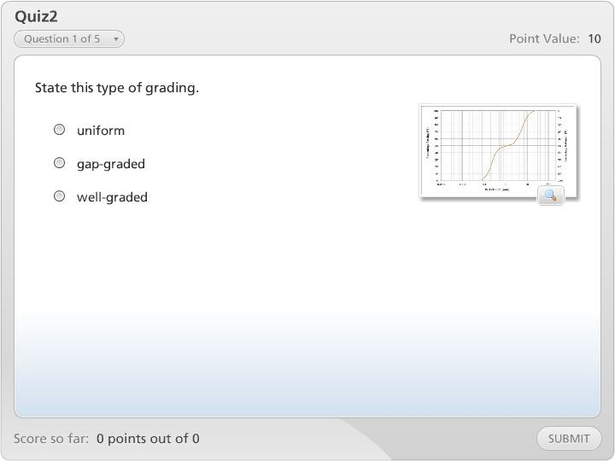
Quiz2

Slide 19
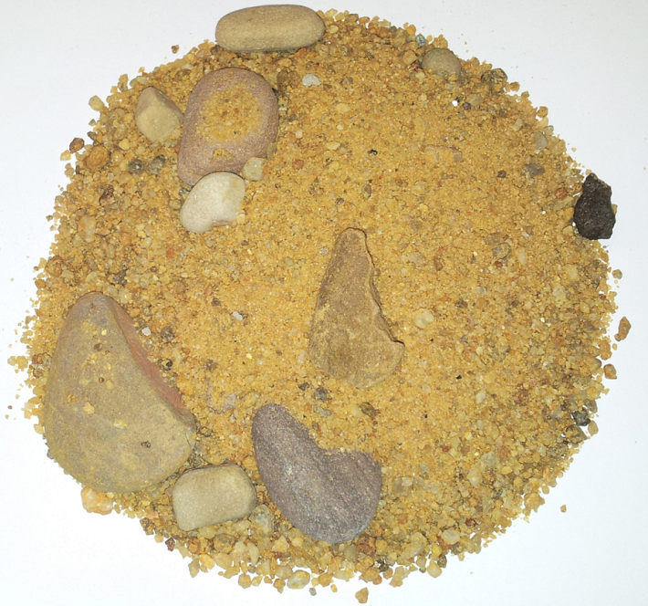
Soil Description and USCS Classification
Full description and USCS classification:
  Example:
SW. Well-graded Gravelly SAND with a trace of fines, coarse to fine sand, subrounded to angular; pale brown; about 35% hard angular gravel particles, 14 mm maximum size.
Notes:
In your report, a full soil description and the USCS symbol should be given based on your test results, an example of which Is given here. The full soil description should be given in the following format:
First, the USCS symbol, followed by the name of the soil, the amount of fines, angularity, colour and indicate the approximate amount of gravel and sand and their maximum size.
Note that this is a disturbed and oven dried sample, so other information such as moisture conditions and relative density cannot be determined.

Slide 20
Report
Your practical report should include the following:
  For the coarse-grained soil:
    A grain size distribution chart and associated calculations;
    Calculation of the coefficients of uniformity and curvature; and
    A soil description and USCS classification.
    Discuss the performance of the soils for engineering purposes on the basis of your results.
Notes:
In your practical report the following should included: a grain size distribution chart and its associated calculations; calculation of the coefficients of uniformity and curvature; the soil description and USCS classification, and finally a discussion on the performance of the soils for engineering purposes on the basis of your results.

